Slide 1
Count What You Want: Exemplar Identification and Few-shot Counting of Human Actions in the Wild
Yifeng Huang^{1*}, Duc Duy Nguyen^{2*}, Lam Nguyen² , Cuong Pham^{2,3} Minh Hoai^{1,2}
¹Stony Brook University ²VinAI
³Posts & Telecommunications Institute of Technology
*Equal contribution
Notes:
Hello Everyone, we are glad to present our paper What You Want: Exemplar Identification and Few-shot Counting of Human Actions in the Wild.

Slide 2
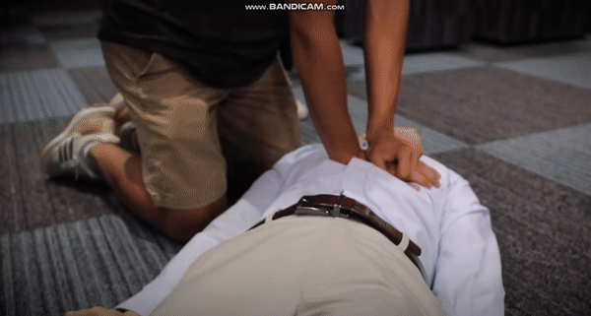
Applications of Action Counting
Fitness and Sports Training
Performance Evaluation
The sample Images are from TransRAC and YouTube.
2
Notes:
Action counting is vital in areas like fitness and sports training, where it helps count exercise repetitions, enabling athletes and enthusiasts to track their performance and consistency. Similarly, in physical therapy and rehabilitation, it's used to evaluate the skill performance.

Slide 3
Existing Works for Action Counting
Previous methods tend to focus solely on the most repetitive temporal patterns, thus overlooks less frequent but potentially crucial actions.
PoseRAC(ARXIV2023)
TransRAC(CVPR2022)
RepNet(CVPR2020)
……
The sample gif are from RepNet.
3
Notes:
Previous methodologies, relying heavily on temporal self-similarity, encounter a significant limitation: they tend to focus solely on the most repetitive temporal patterns. This approach overlooks less frequent but potentially crucial actions, as these methods are primarily calibrated to identify and count only the dominant patterns. Such a constraint becomes particularly problematic in scenarios where the less frequent actions, such as specific mistakes in sports training, are of greater significance.

Slide 4
Goal of Our Work
The main goal of our work is to develop a few-shot action counting method using data from wearable devices like smartwatches, with a focus on counting less dominant, novel actions.
Notes:
To Address the limitations identified in prior research. The main goal of our work is to develop a few-shot action counting method using data from wearable devices like smartwatches, with a focus on counting less dominant, novel actions.

Slide 5
Our Contribution
We introduce a novel strategy for using audio prompts to specify exemplars of what needs to be counted.
We propose a novel counting method that utilizes exemplars, incorporating a distance-preserving loss and an exemplar-based data synthesis pipeline.
We introduce an unique dataset with multiple data modalities to develop a practical counting method for real-world scenarios.
5
Notes:
Our contributions are threefold. First, we introduce a novel strategy for using audio prompts to specify exemplars of what needs to be counted. Second, we propose a novel counting method that utilizes exemplars, incorporating a distance-preserving loss and an exemplar-based data synthesis pipeline. Third, we introduce an unique dataset with multiple data modalities to develop a practical counting method for real-world scenarios.

Slide 6
Problem Formulation
Given the sensor data and the audio signal that includes three specific audio prompts - "one", "two", and "three", we count the number of repetitive actions indicated by the audio prompts.
Notes:
The input to our method consists of sensor data from a watch, accompanied by audio data containing three specific audio prompts that denote the action of interest. Initially, our approach extracts exemplars based on these audio cues. Following this, each sliding window of sensor data is projected into a feature embedding. Subsequently, we assess the similarity between the query data and the exemplar. Then we infuse the exemplar-based similarity with the sensor sliding window embedding. The final stage entails estimating a temporal density map using the infused feature, which effectively captures the occurrence and frequency of the interested actions. Then we will detail each module in our method.

Slide 7
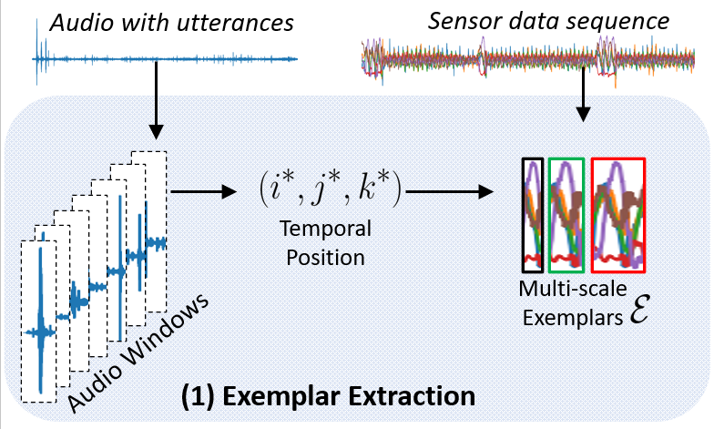
Exemplar Extraction
Temporal ordering: The temporal order of the audio cues.
Proximity constrain: These three audio cues are close temporally.
Assessing audio window classification score.
(2) Searching for the optimized temporal position.
(3) Multi-scale exemplar extraction.
Notes:
In exemplar extraction, we first utilize a pretrained audio cue classifier to ascertain a classification score for each audio segment. Then, we methodically search for the most optimized temporal positions, taking into account the temporal ordering and proximity. Lastly, we extract multi-scale exemplars from the sensor data.

Slide 8
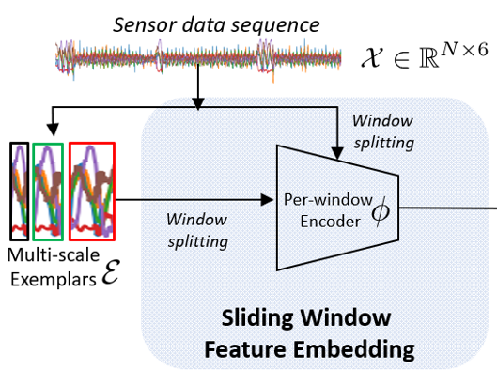
Per-window embedding
Distance Preserving constraints for a better embedding:
The closer in raw data space the closer in the embedding space.
(1) Build a KNN Graph with
(2) Loss on embedding and graph Laplacian
Notes:
After extracting the exemplars, we obtain both exemplar and sensor embeddings using a pre-window encoder. Unlike video action counting, sensor watch data lacks a fundamental feature encoder like swin transformer. To compensate, we introduce a distance-preserving loss to improve feature embedding, ensuring that windows close in the pre-encoding space remain close in the embedding space. This is achieved by constructing a K-nearest neighbor graph using Gaussian kernel distance, with the graph Laplacian applied as a penalty to maintain proximity.

Slide 9
To-Exemplar Similarity Estimation
Similarity map based on correlation and Soft-DTW.
Notes:
After obtaining the per-window embeddings, we assess the similarity between the exemplar and sensor data. This evaluation is conducted using correlation and soft dynamic time warping as measures of similarity, and we then will introduce the motivation of using them.

Slide 10
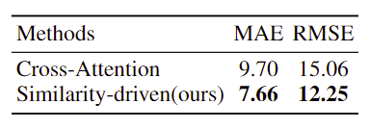
To-Exemplar Similarity Estimation
Comparison with cross-attention
Notes:
We begin with vanilla correlation, a common approach in similarity estimation. However, we observed suboptimal performance with certain static signals using this method. To address this, we incorporated soft dynamic time warping, yielding significantly improved results. Additionally, we compared our method with cross-attention and found that our approach for similarity estimation outperforms the vanilla cross-attention technique.

Slide 11
Temporal Density Estimation
Feature fusion with similarity map
Temporal density estimation
Notes:
Upon obtaining the similarity map between the exemplar and sensor embeddings, we then integrate this similarity map with the sensor's per-window embedding. Subsequently, we estimate the temporal density map, utilizing both the fused feature and the raw sensor per-window embedding. The final action count is the summation over the temporal density map.

Slide 12
Training Objective and Pretraining Data Synthesis
Counting Loss:
Distance Preserving Loss:
Pretraining Data Synthesis:
Fragment extraction with audio prompts
Augmentation with duration scaling, time shifting, amplitude scaling and random noise addition.
Notes:
Our method incorporates two distinct training objectives. The first objective involves applying a criterion to the predicted count, ensuring accuracy in the final tally. The second objective focuses on maintaining the distance relationships after embedding, and we have introduced it in the previous slides.
Also, given the constraints of data availability, our approach includes a pretraining phase enhanced by data synthesis to boost performance. Initially, we identify action fragments using the audio classification score, specifically selecting audio windows that exhibit both high confidence and moderate length. Following this, we augment these chosen fragments through various techniques: duration scaling, time shifting, amplitude scaling, and the addition of random noise. Additionally, to simulate real-world variability, we introduce irrelevant actions into the dataset as a form of repetitive noise, further enriching the pretraining process.

Slide 13
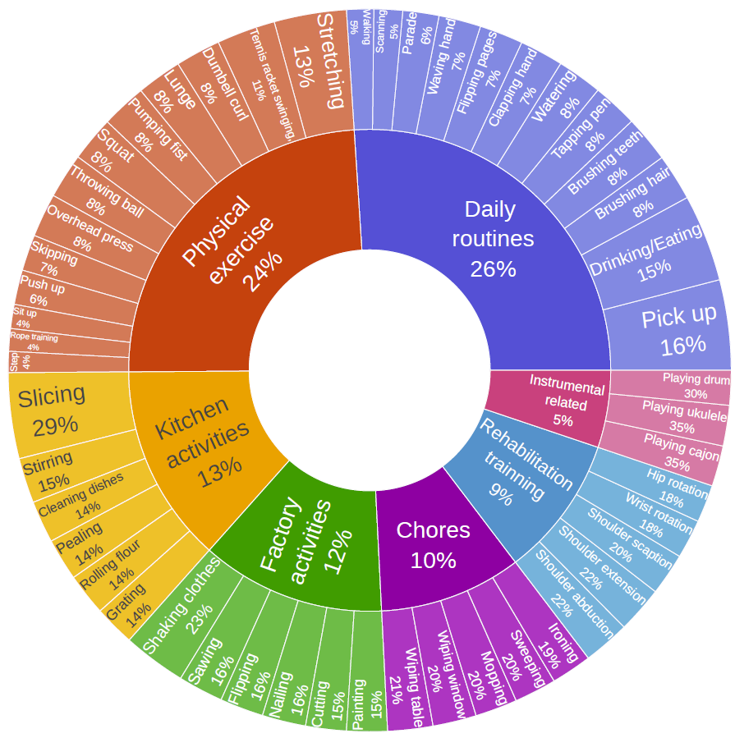
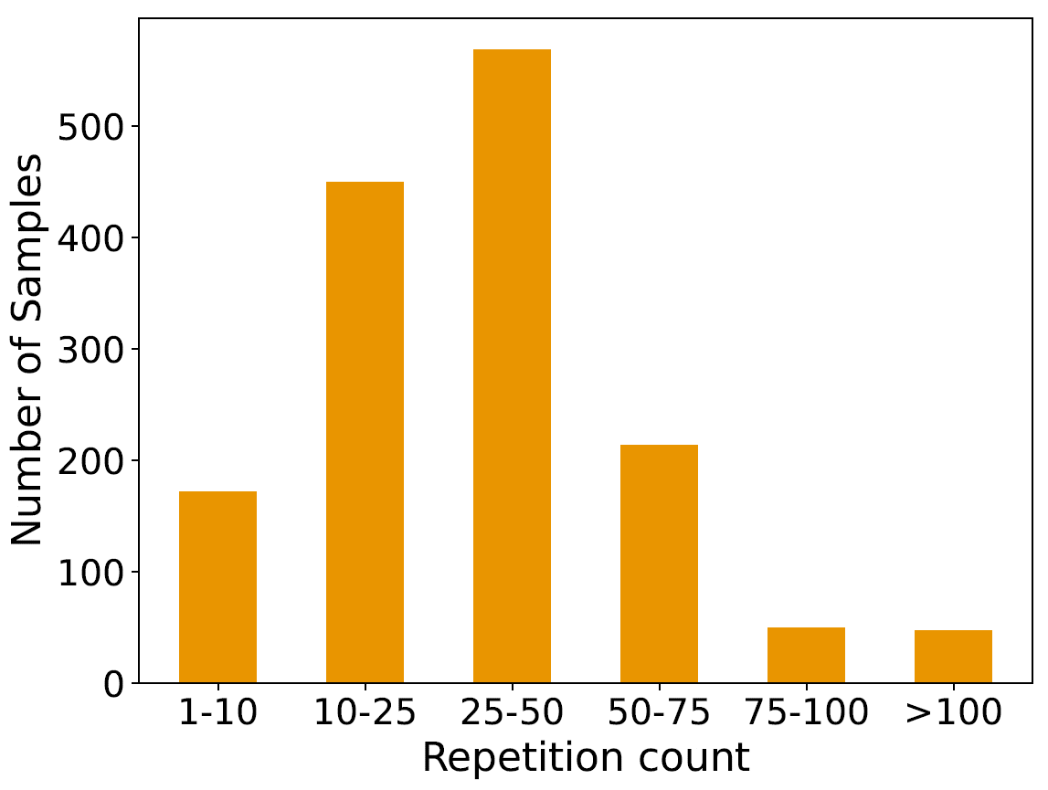
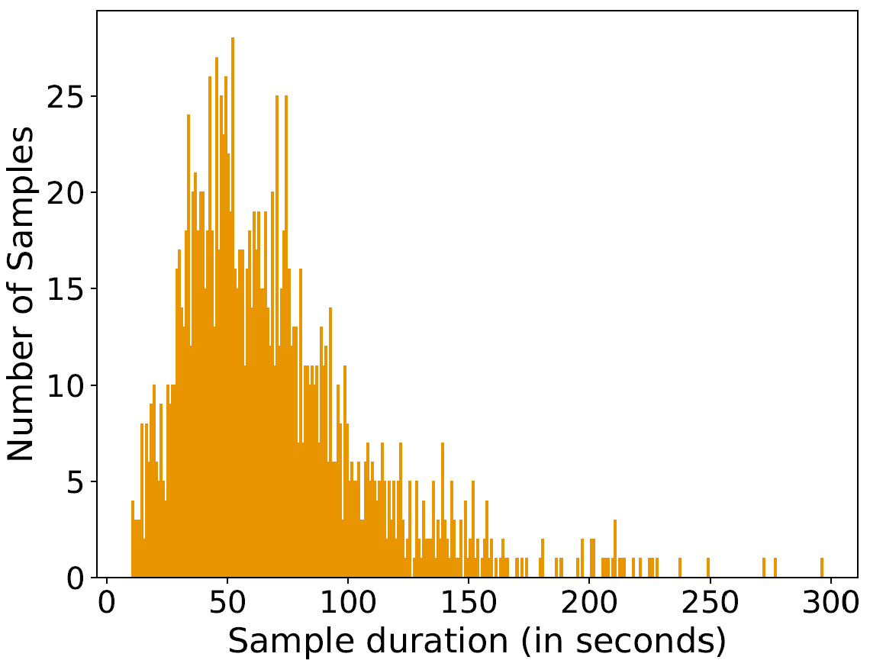
DWC Dataset
Notes:
Existing wearable device datasets for action counting often lack diversity in action categories and count values. Additionally, the data samples usually feature predominantly a single class of actions. To address these gaps, we introduce a new dataset named DWC (Diverse Wearable Counting). This dataset, comprising 1502 entries from 37 subjects, spans seven categories — kitchen activities, household chores, physical exercises, factory tasks, daily routines, instrument-involved activities, and rehabilitation training. Encompassing 50 distinct action classes, DWC offers significantly greater diversity than existing datasets in this area.

Slide 14
Quantitative Result
DWC Val Set | MAE | RMSE
RepNet | 11.95 | 17.33
TransRAC | 14.51 | 20.40
Ours | 7.66 | 12.25
DWC Test Set | MAE | RMSE
RepNet | 10.82 | 14.75
TransRAC | 12.97 | 16.82
Ours | 7.47 | 13.09
Notes:
Results on DWC validation set and test set demonstrate the effectiveness of our method. For more details, please refer to our paper.

Slide 15
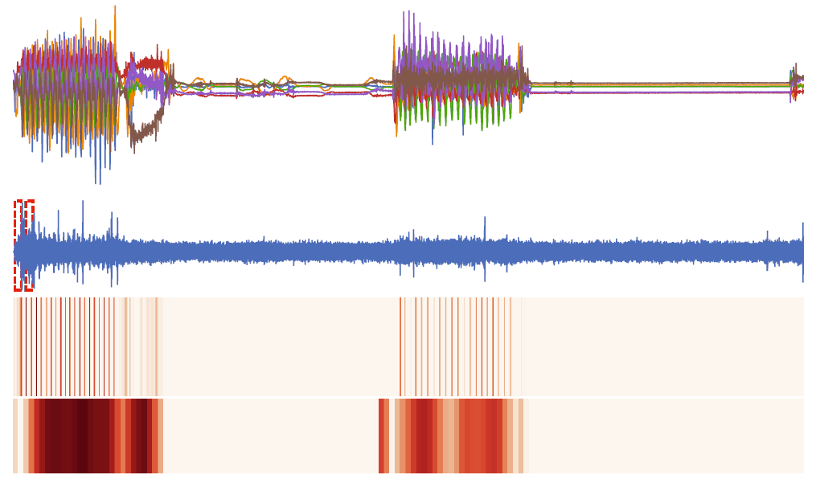
Qualitative Result
Predict: 40.4 GT: 40
Notes:
The qualitative analysis of our results shows that our method successfully counts the actions of interest as indicated by the audio prompts. The shown result is arranged vertically with the sensor data at the top, followed by the audio data, the similarity map, and finally, the temporal density map at the bottom. Within the audio data, the retained exemplars are highlighted in red.

Slide 16
Project, Code and Data:
https://github.com/cvlab-stonybrook/ExRAC
Thank you!
16
Notes:
Our code and data is available on this link. thank you!

