Slide 1





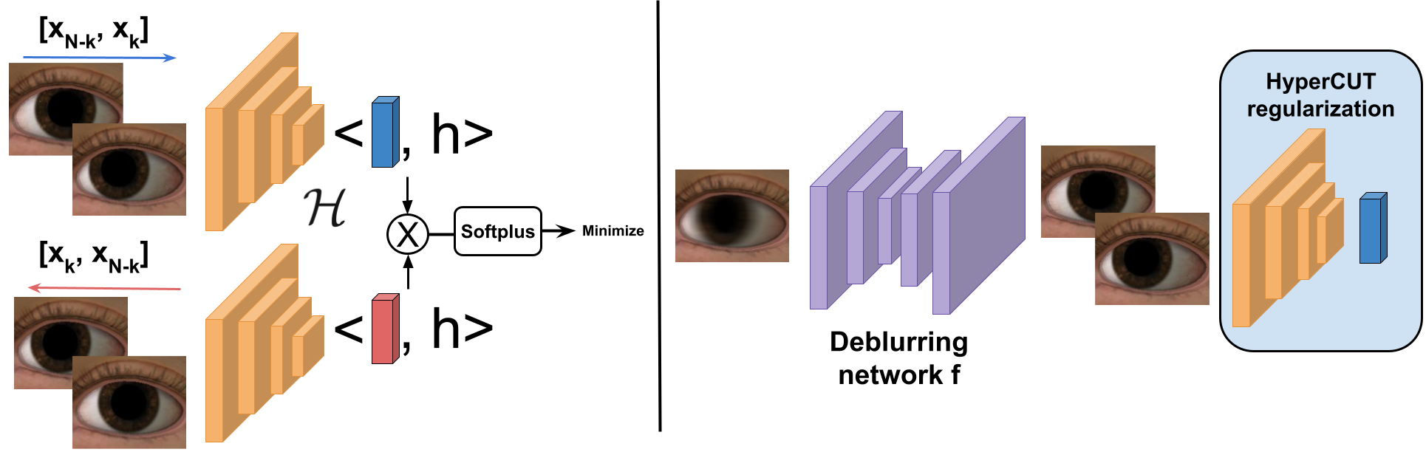
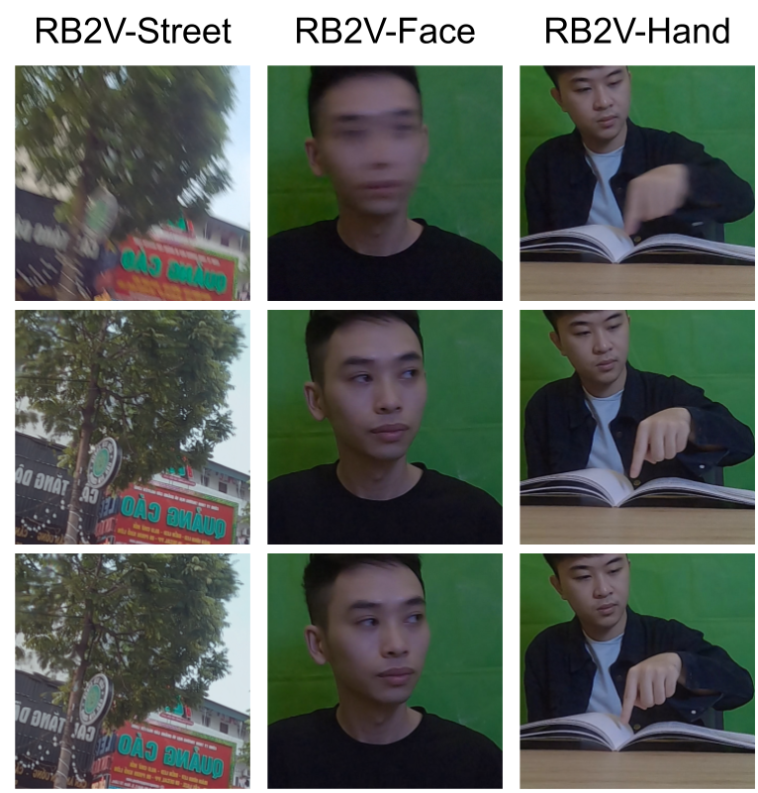
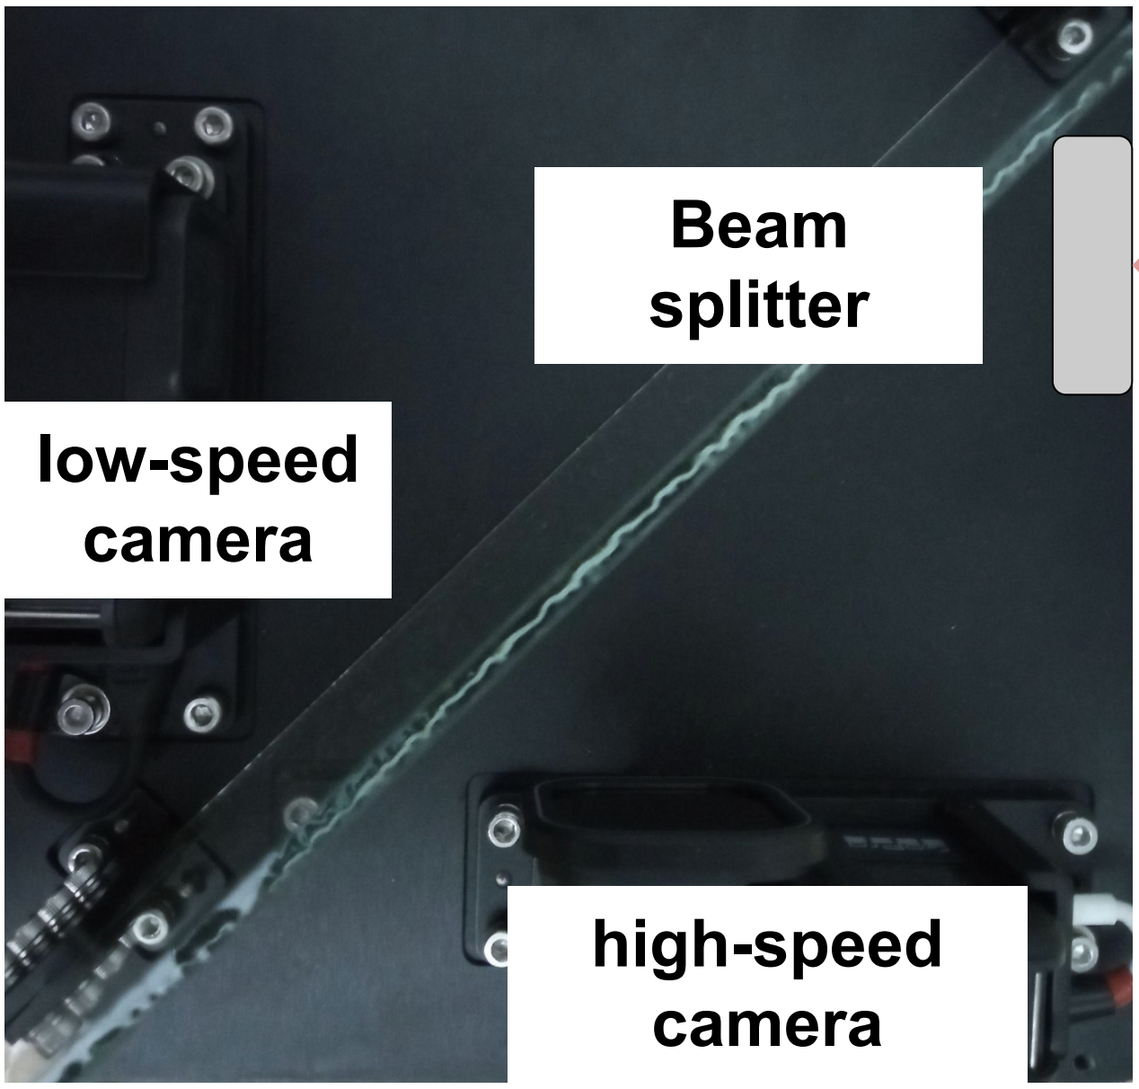
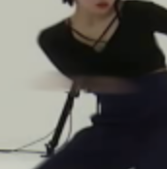
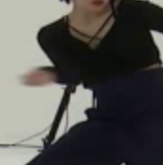
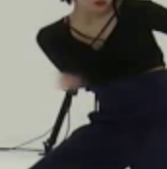

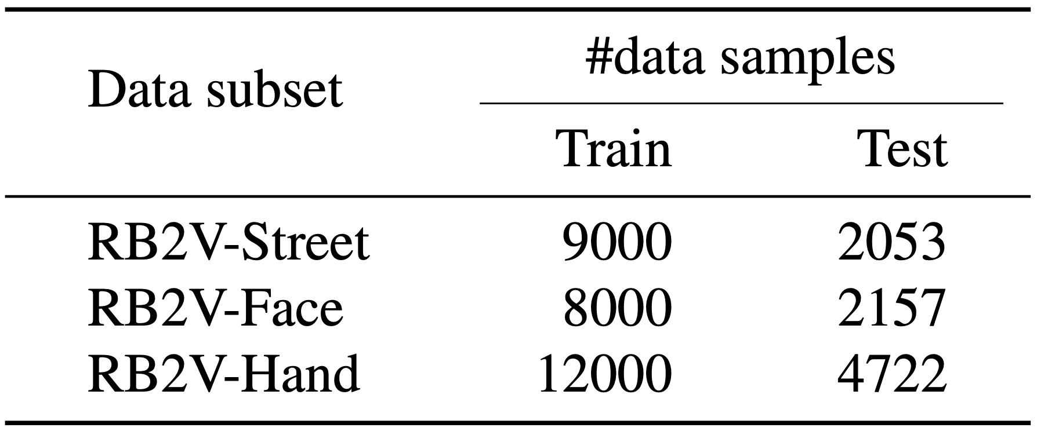
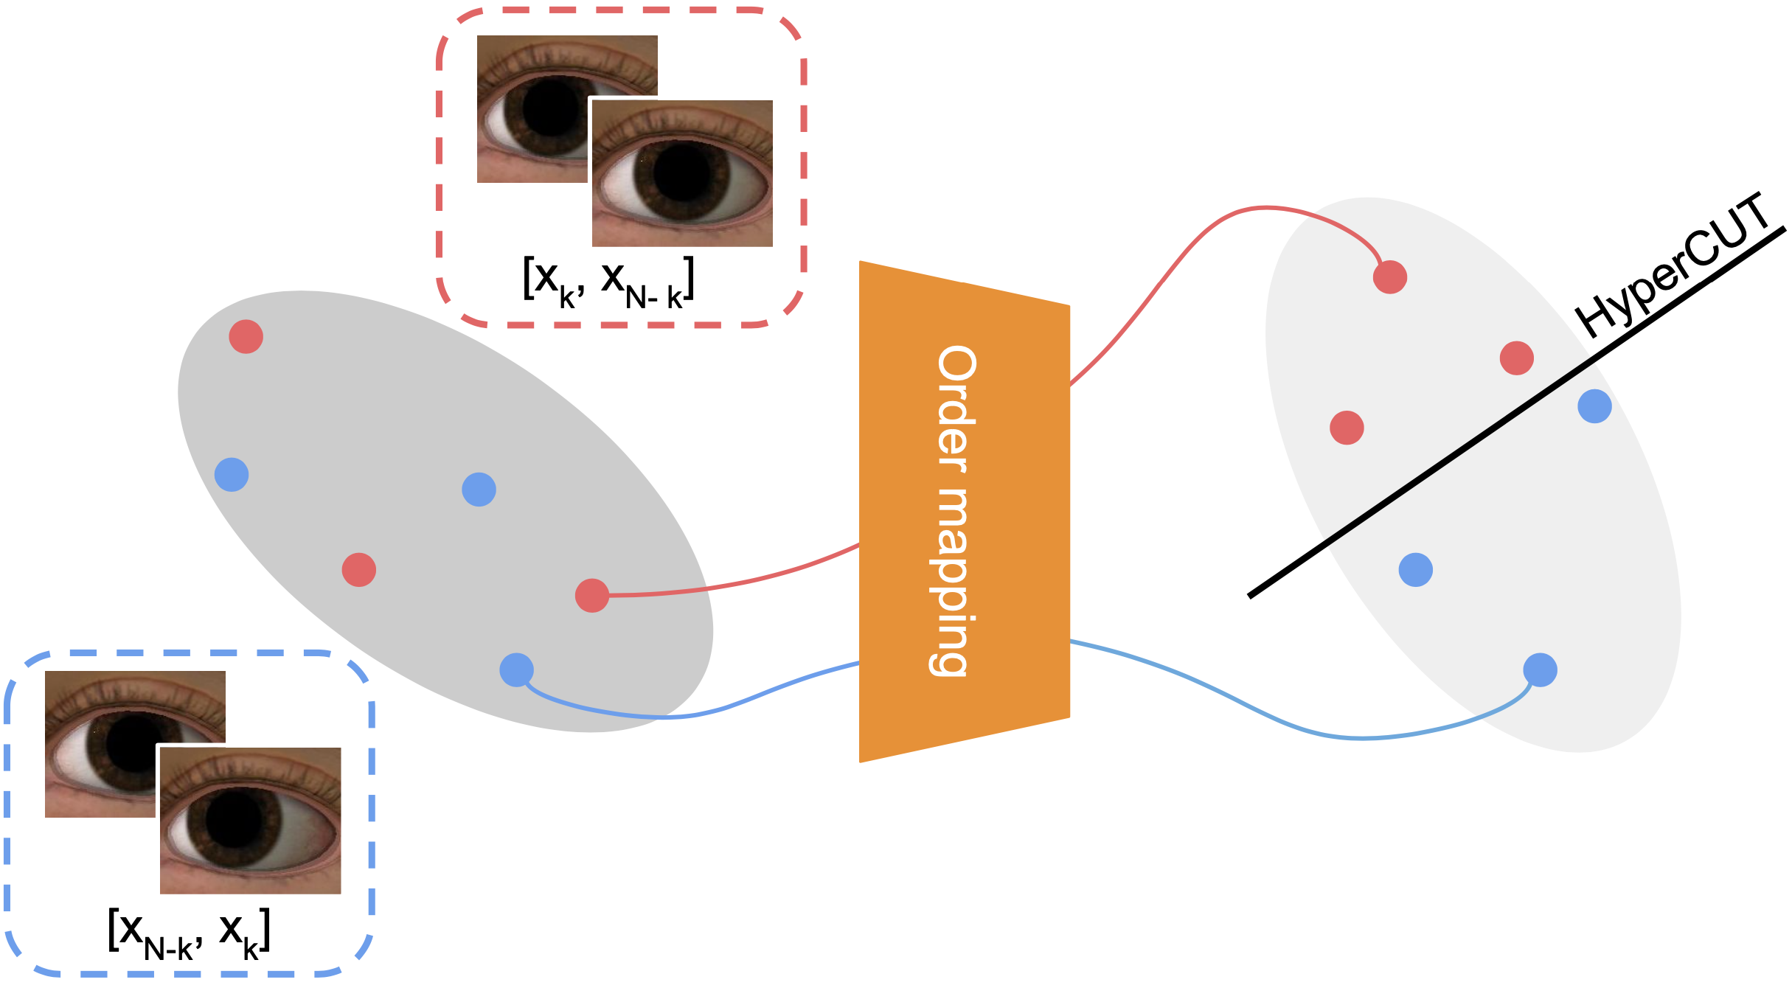
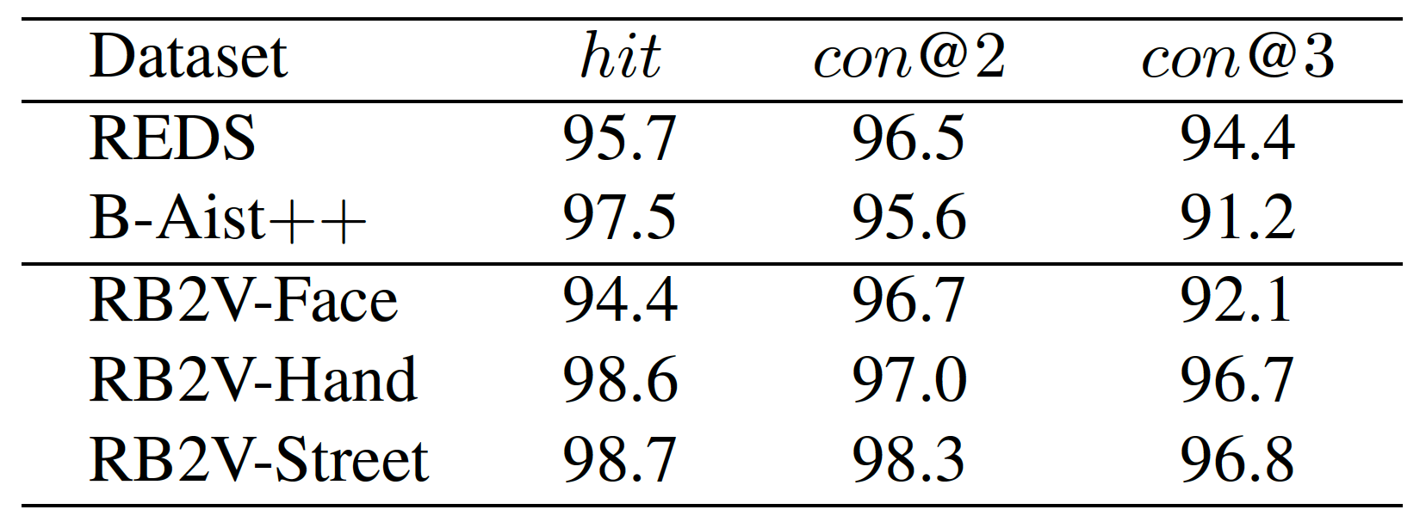
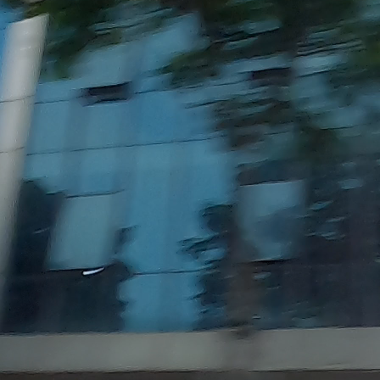
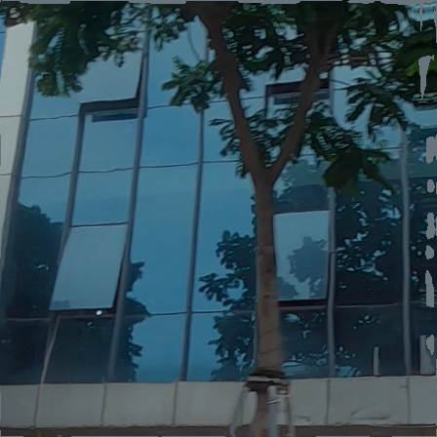
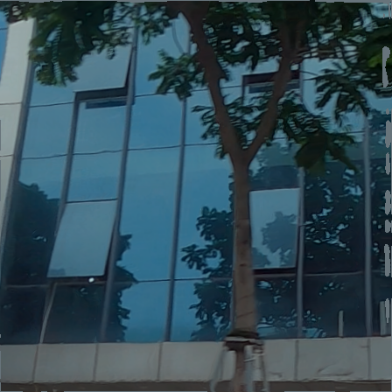
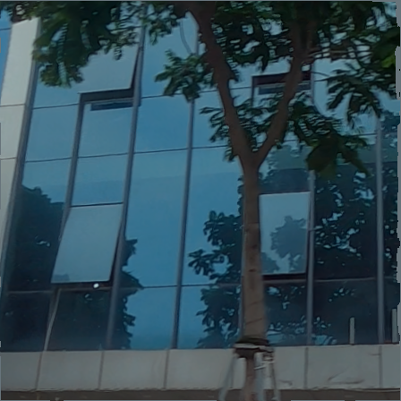
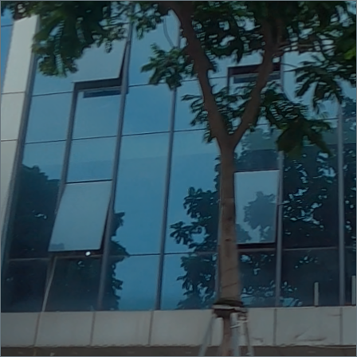
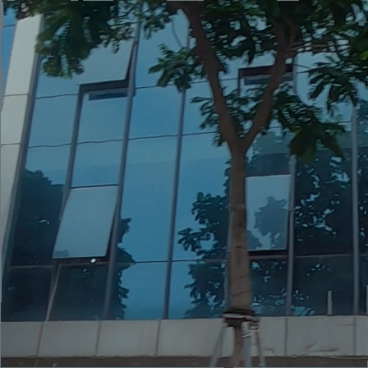
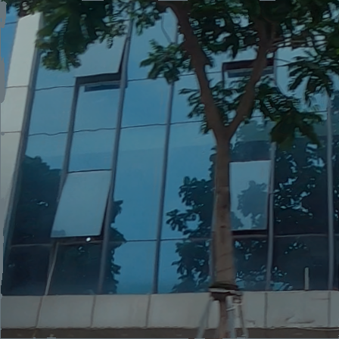
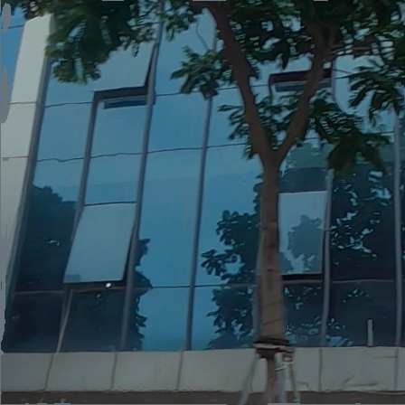
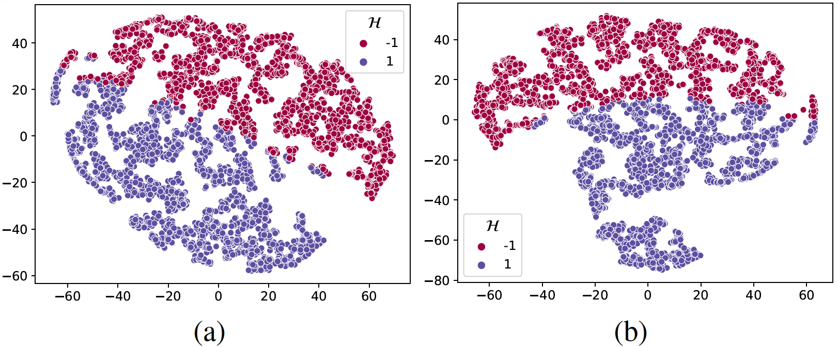
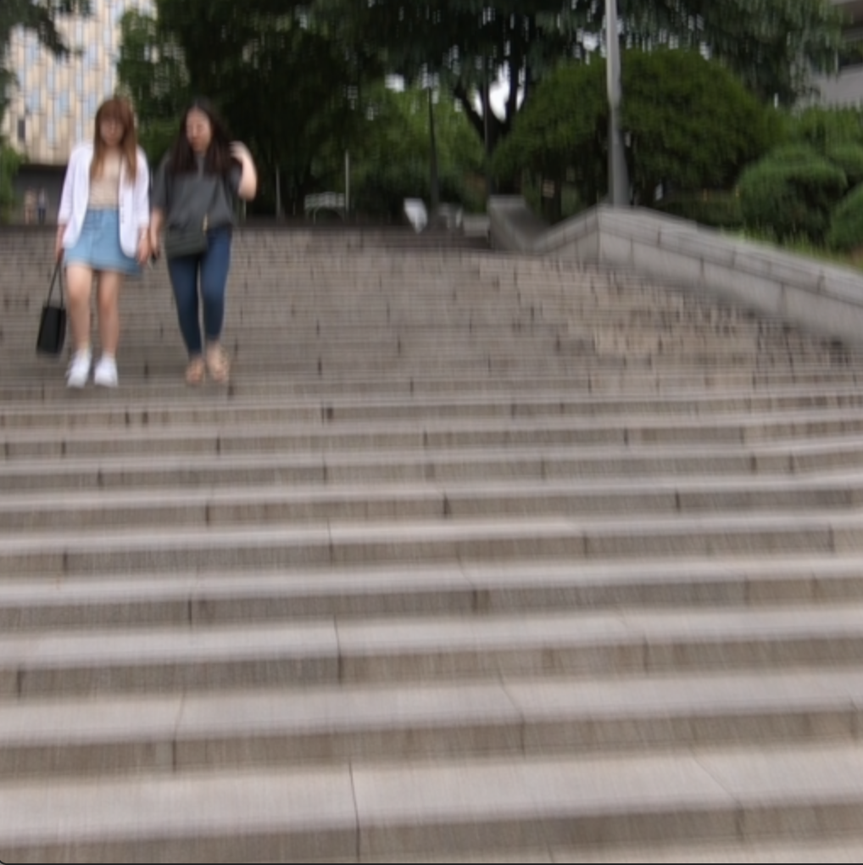
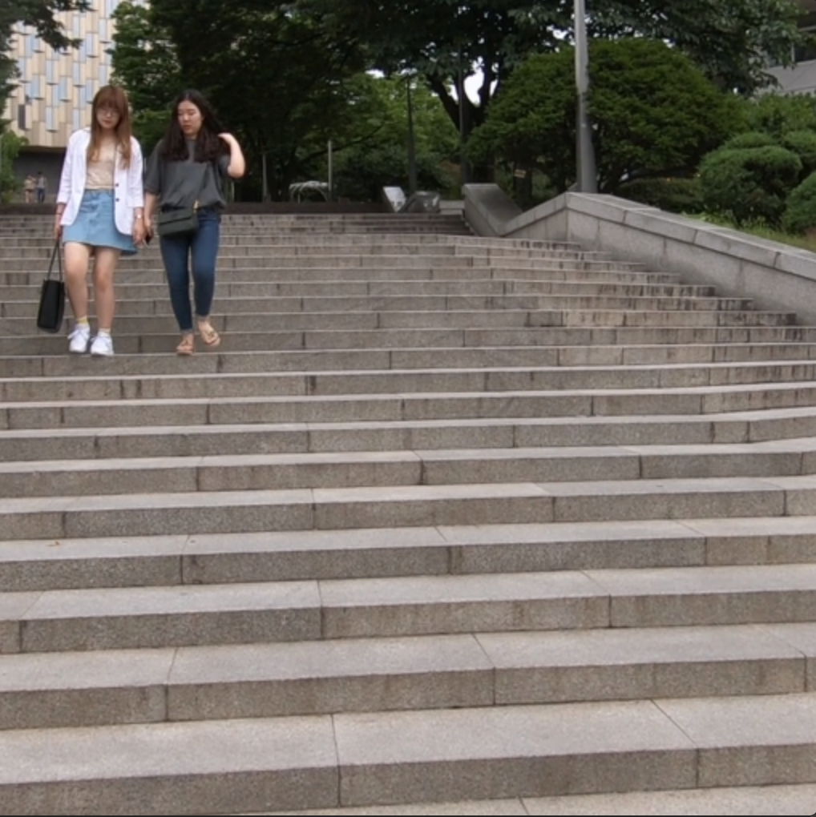
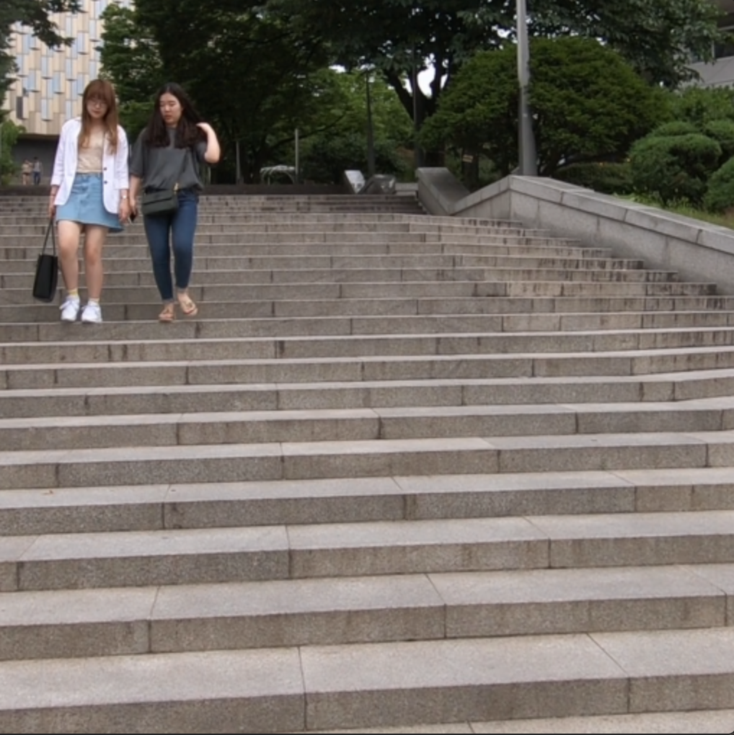
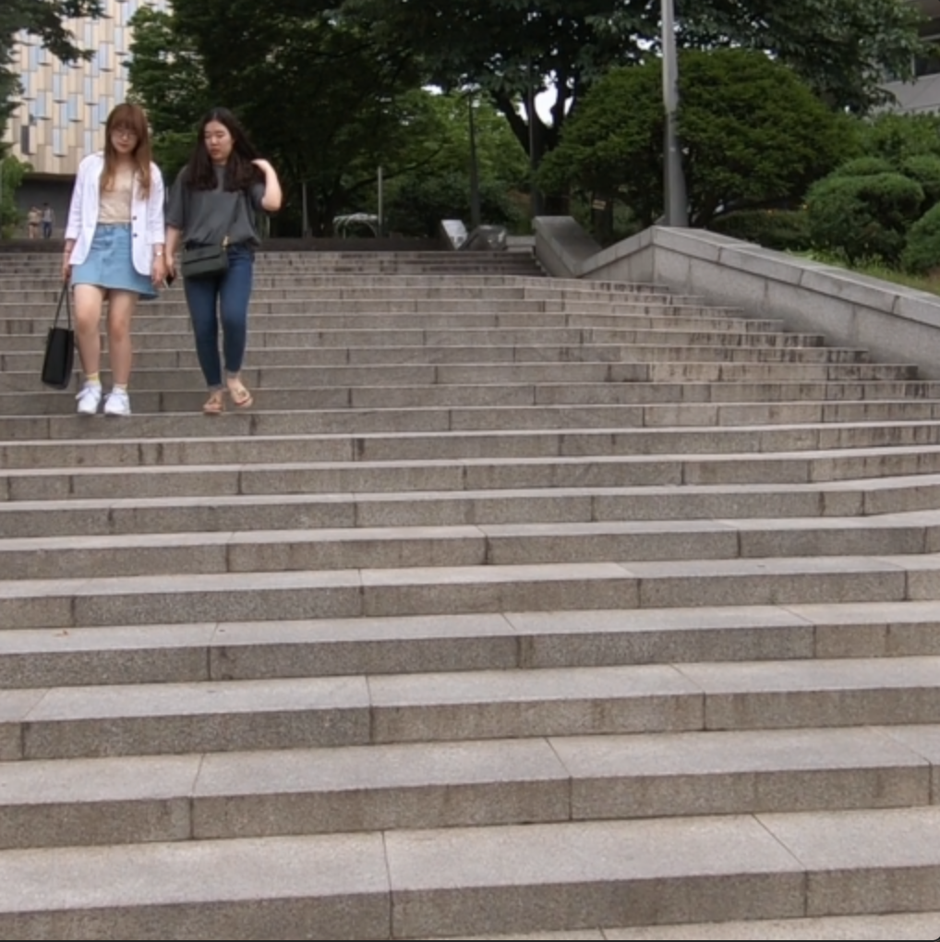
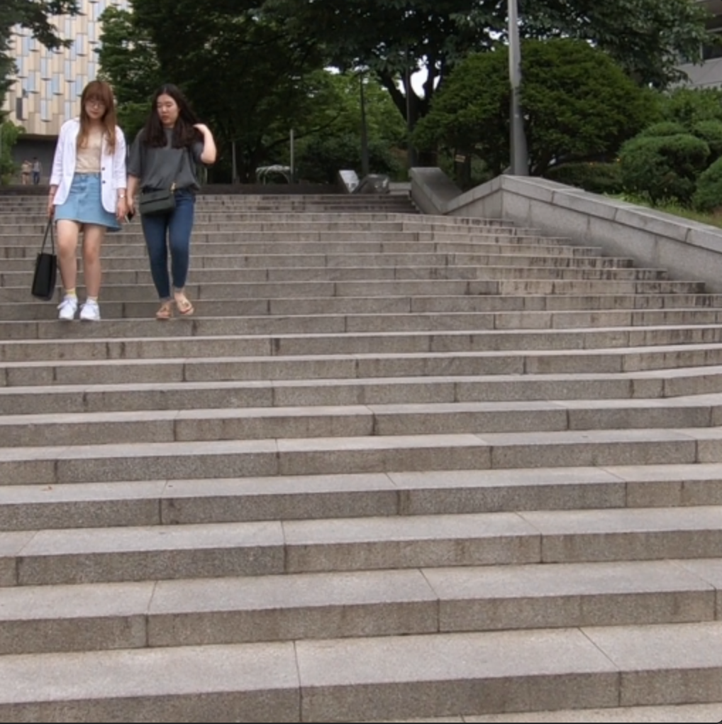
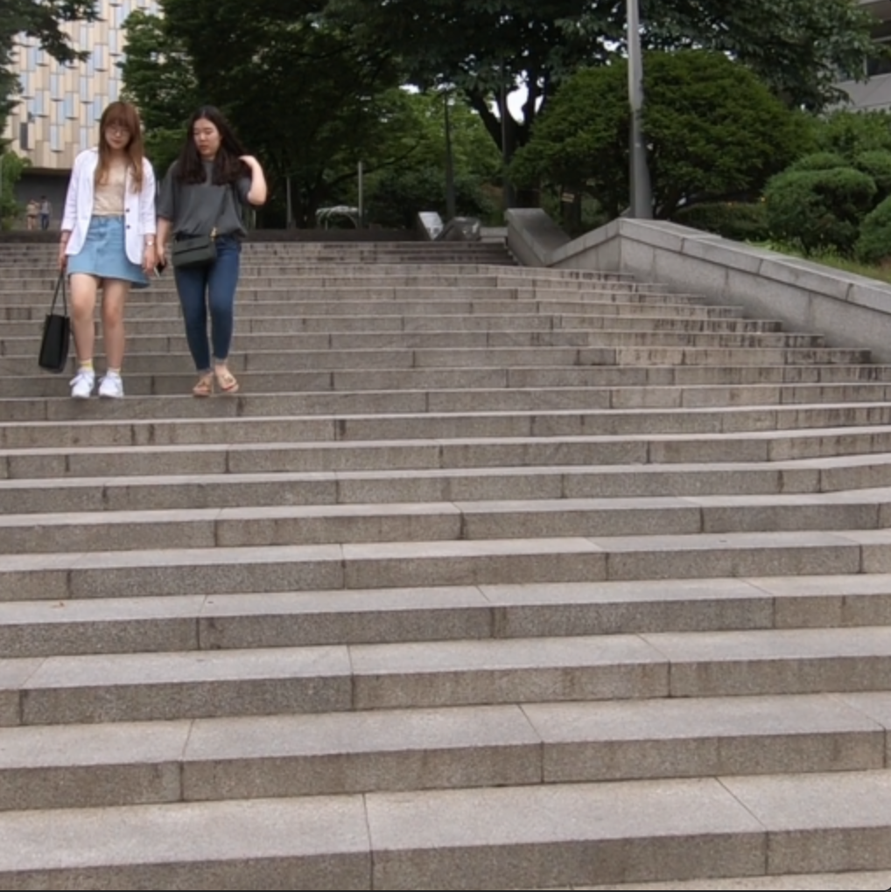
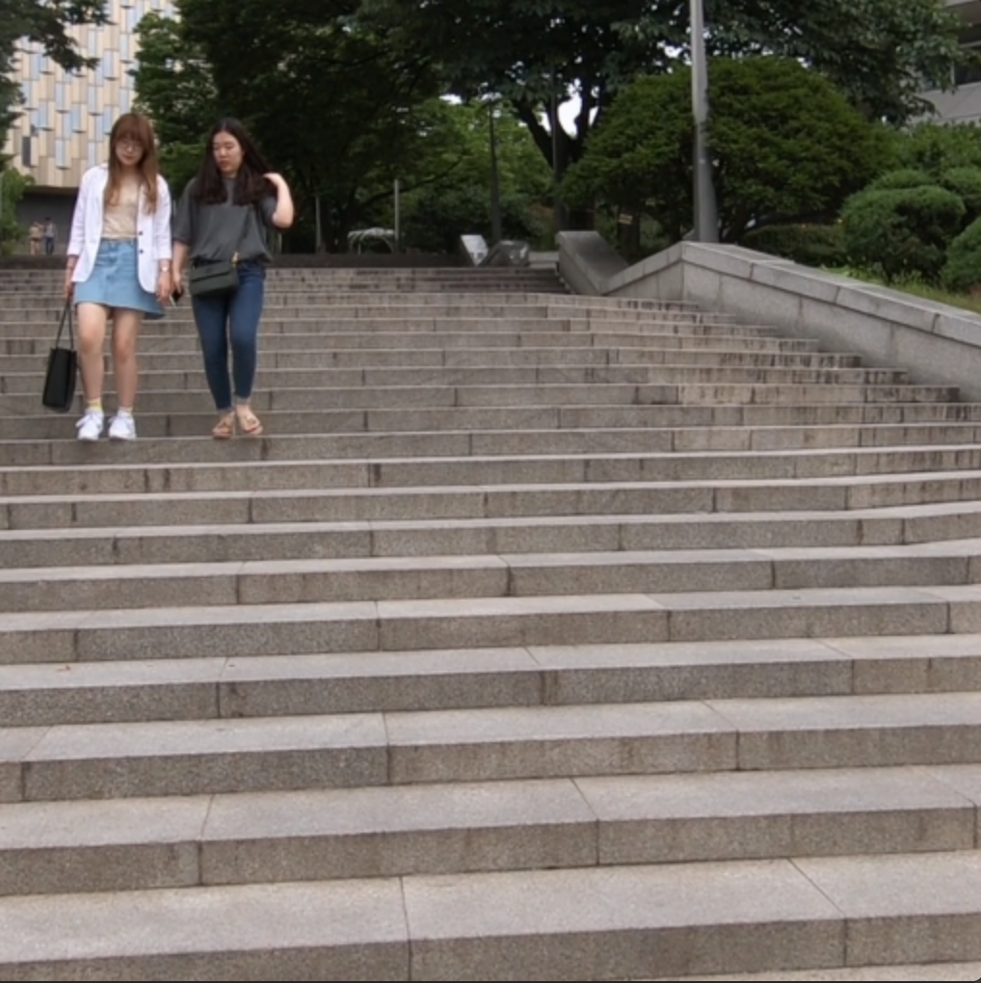


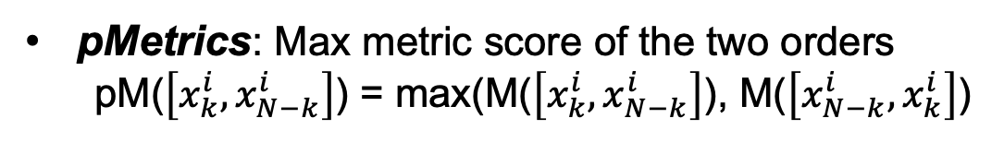
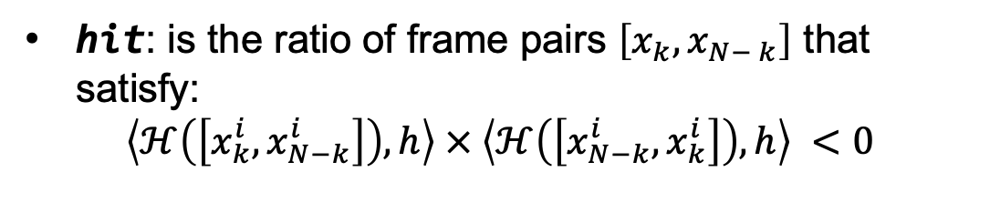
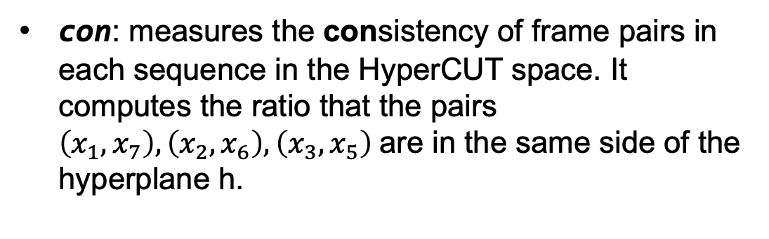

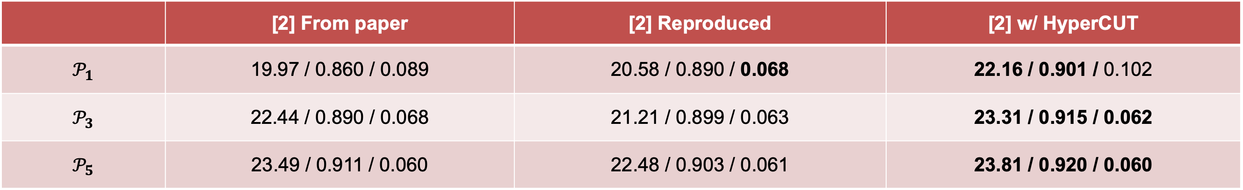
HyperCUT: Video Sequence From a Single Blurry Image
Using Unsupervised Ordering
Bang-Dang Pham, Phong Tran, Anh Tran, Cuong Pham, Rang Nguyen, Minh Hoai
Overview
Methodology
RB2V Dataset
Low shutter speed (blur process)
Blurry
image
Sequence of sharp images
Given a fixed hyperplane h, we want to find a mapping $𝓗$ that map a video sequence and its reverse to different sides of h
The output of deblurring networks are force to be only one fixed side of HyperCUT by applying
HyperCUT regularization:
$ℋ$ is represented by a neural network and can be found by optimizing:
Our dataset capture device
Video sequence from blurry image
(blur2vid)
$$ℋ^{∗}=argmin_{ℋ}softmax(\left\langle ℋ\left(\left[x_{k}^{i}, x_{N−k}^{i}\right]\right), h\right\rangle × \left\langle ℋ\left(\left[x_{N−k}^{i}, x_{k}^{i}\right]\right), h\right\rangle )$$
$$ℛ_{hyp}\left(f\right)= Ε_{y}(\left\langle \left({ℋ([f}_{k}\left(y\right), f_{N−k}\left(y\right)\right], h\right\rangle )$$
Blur2vid: We aim to solve the task of extracting a video sequence from a single blurry images
Challenge: One blurry image has two groundtruth (forward and backward order) -> Naïve supervised blur2vid network will predict the average of two (undesired)
Results
Conclusion
 | 1 | 2 | 3 | 4 | 5 | 6 | 7
[1] | 22.78/26.99 | 24.47/27.99 | 26.14/29.45 | 31.50/32.08 | 26.12/29.55 | 24.49/28.06 | 22.83/27.04
[1] + Ours | 26.75/28.29 | 28.30/29.20 | 29.42/30.43 | 29.97/32.08 | 29.41/30.53 | 28.30/29.22 | 26.76/28.25
Order Accuracy of HyperCUT
We introduce HyperCUT which is used to solve the Order-Ambiguity Issue for the task of extracting a sharp video sequence from a blurry image.
We build a new dataset for the task - RB2V, covering three categories: street, face, and hand. This is the first real and large-scale dataset for image-to-video deblurring.
Limitation: Only handle standard motion blur in normal capturing conditions with short exposure time
hit: is the ratio of frame pairs $\left[x_{k},x_{N− k}\right]$ that satisfy:
$$\left\langle ℋ\left(\left[x_{k}^{i}, x_{N−k}^{i}\right]\right), h\right\rangle × \left\langle ℋ\left(\left[x_{N−k}^{i}, x_{k}^{i}\right]\right), h\right\rangle <0$$
Our Solution:
con: measures the consistency of frame pairs in each sequence in the HyperCUT space. It computes the ratio that the pairs $\left(x_{1},x_{7}\right), \left(x_{2},x_{6}\right),\left(x_{3},x_{5}\right)$are in the same side of the hyperplane h.
Performance boost (pPSNR$↑$) of each frame on REDS (left) and RB2V-Street (average of all three categories) dataset when using HyperCUT
 | [2] From paper | [2] Reproduced | [2] w/ HyperCUT
$$𝒫_{1}$$ | 19.97 / 0.860 / 0.089 | 20.58 / 0.890 / 0.068 | 22.16 / 0.901 / 0.102
$$𝒫_{3}$$ | 22.44 / 0.890 / 0.068 | 21.21 / 0.899 / 0.063 | 23.31 / 0.915 / 0.062
$$𝒫_{5}$$ | 23.49 / 0.911 / 0.060 | 22.48 / 0.903 / 0.061 | 23.81 / 0.920 / 0.060
pMetrics: Max metric score of the two orders
  pM($\left[x_{k}^{i}, x_{N−k}^{i}\right]$) = max(M($\left[x_{k}^{i}, x_{N−k}^{i}\right]$), M($\left[x_{N−k}^{i}, x_{k}^{i}\right]$)
Average performance boost (pPSNR$↑$ / pSSIM$↑$ / pLPIPS$↓$) on B-AIST++ dataset when using HyperCUT
RB2V_Street
Accuracy of the Ordering Mapping
- Step 1: Map the two solutions into a space where they are on two different sides of a hyperplane
- Step 2: Force the blur2vid network to only predict one side of the hyperplane -> No more ambiguity!!!
We also propose a real-world blur2vid dataset!
REDS
References
[1] Kuldeep Purohit, Anshul Shah, and AN Rajagopalan. Bringing alive blurred moments. In Proceedings of the IEEE Conference on Computer Vision and Pattern Recognition, 2019
[2] Zhihang Zhong, Xiao Sun, Zhirong Wu, Yinqiang Zheng, Stephen Lin, and Imari Sato. Animation from blur: Multimodal blur decomposition with motion guidance. In Proceedings of the European Conference on Computer Vision. Springer, 2022.
Blur
1st
2nd
3rd
4th
5th
6th
7th
t-SNE visualization of HyperCUT ordering mapping on RB2V-Street (a) and REDS (b)
Checkout our code!
Predicted frame sequence (7 frames)

