Slide 1



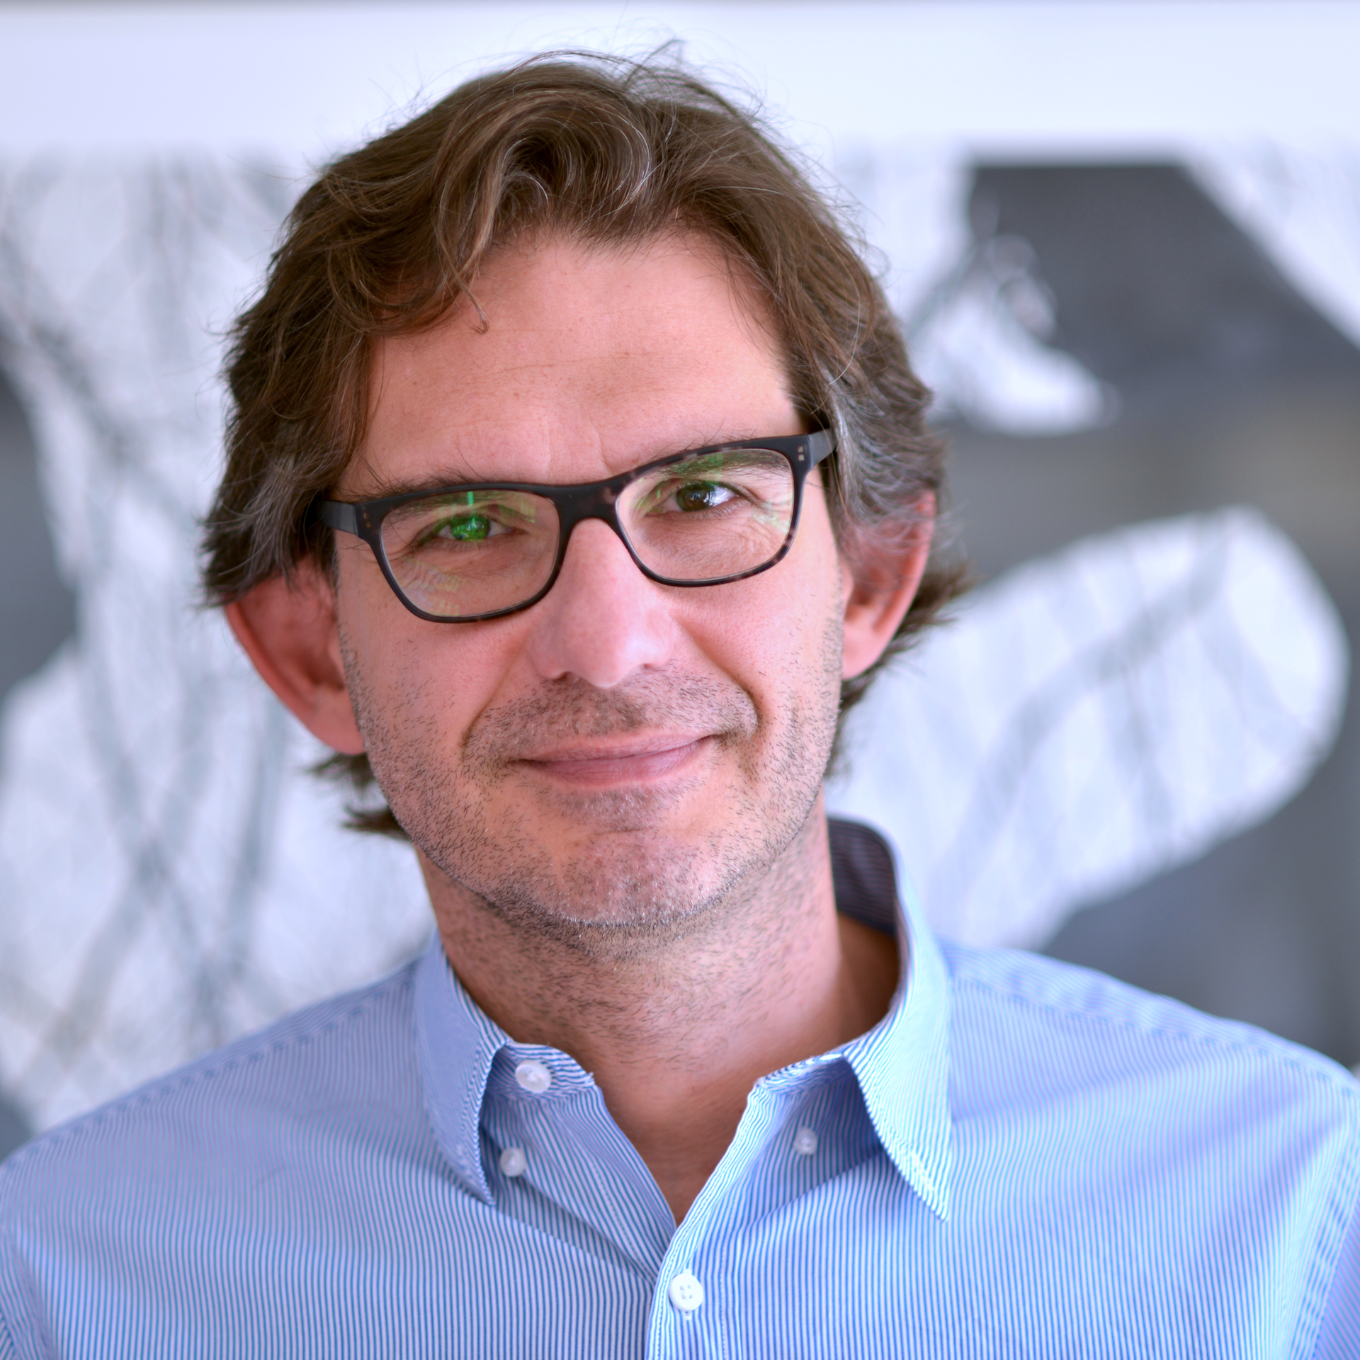
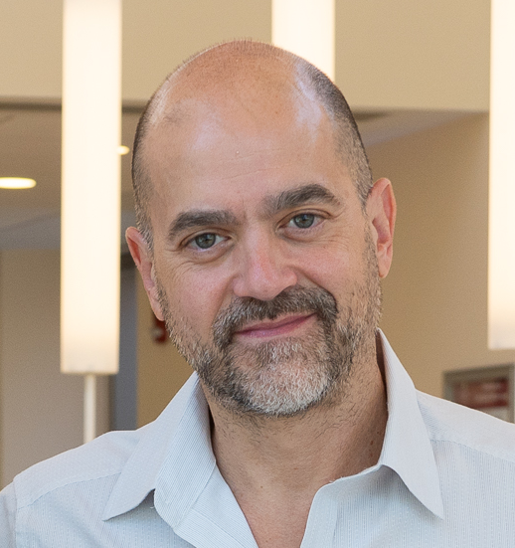



Gazeformer: Scalable, Effective and Fast Prediction of Goal-Directed Human Attention
Sounak Mondal
Zhibo Yang
Seoyoung Ahn
Dimitris Samaras
Gregory Zelinsky
Minh Hoai
TUE-AM-137
Notes:
Hi everyone! This is Sounak Mondal from Stony Brook University. I am excited to talk about our model Gazeformer which offers scalable, effective and fast gaze prediction for visual search.

Slide 2
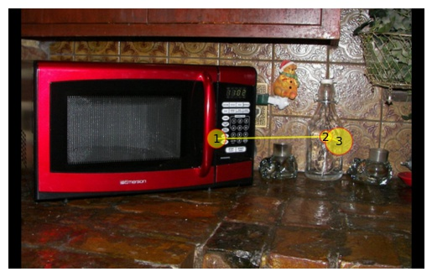
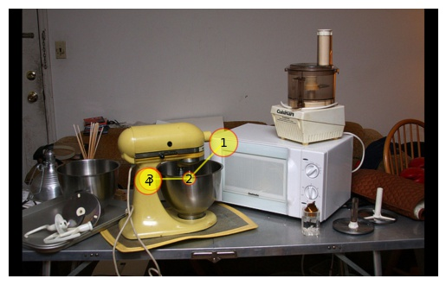
Motivation
We focus on gaze prediction for visual search
Previous models have needed, for each target category
  human gaze training data, and
  detectors to encode target
Hard to scale when gaze/detection annotation is unavailable for a target
find “bottle”
find “stand mixer”
Notes:
Gaze prediction for visual search involves predicting eye movements of a human searching for a target.
Previous gaze prediction models have required, for each target category,
gaze training data
and detectors.
Hence, these models do not scale well when gaze or detection annotation is unavailable

Slide 3
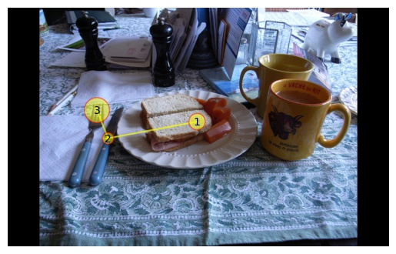
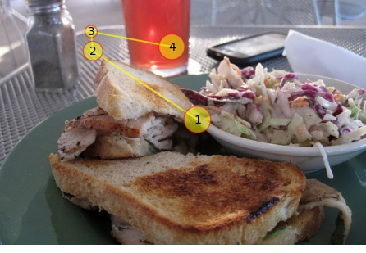
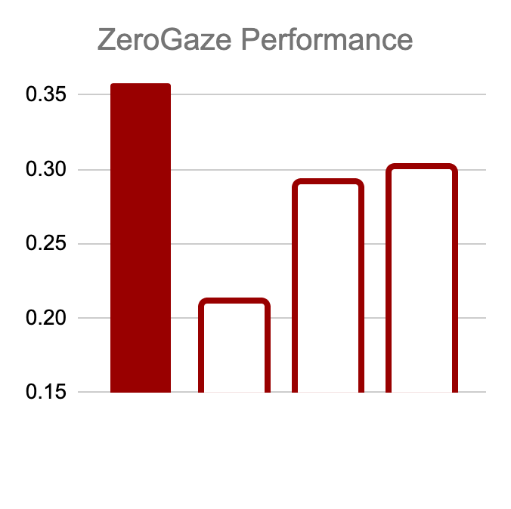
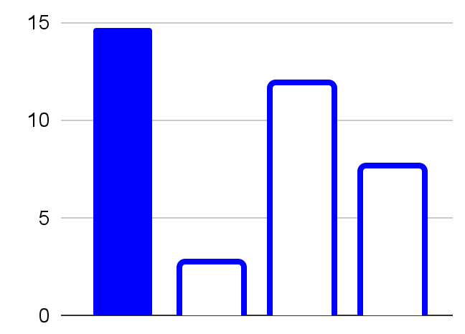
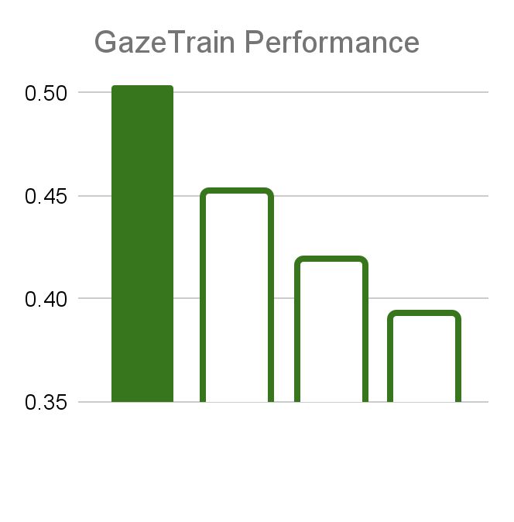
Proposed Solution
We propose a novel ZeroGaze task to evaluate scalability
We propose a novel Gazeformer model to solve ZeroGaze
  Gazeformer is more scalable, more effective and faster than previous methods
Search target
outside N categories
(ZeroGaze setting)
e.g. find “knife”
Performance for
search target
in N categories
(GazeTrain setting)
e.g. find “fork”
Inference
Throughput
Training Dataset:
search target in N categories
…
Gazeformer
Gazeformer
IRL
FFM
Gazeformer
Scanpath Similarity
Scanpath Similarity
Chen
Inferences per Second
IRL
IRL
Chen
FFM
find “fork”
find “cup”
Chen
FFM
“Scalable”
“Effective”
“Fast”
Training
Inference
Notes:
To this end, we first propose a novel ZeroGaze task which evaluates scalability of gaze prediction models.
We also propose a novel Gazeformer model to solve ZeroGaze.
Gazeformer is more scalable, more effective and faster than previous methods.

Slide 4
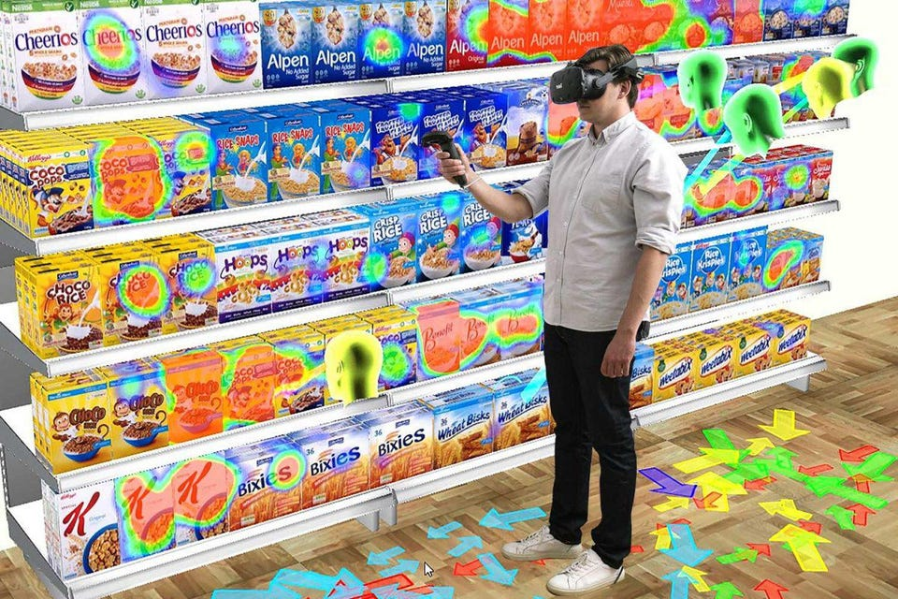
Gaze Prediction for HCI applications
Recently, gaze prediction models for visual search have been used in several HCI applications
  AR/VR
  Robotics
Besides being accurate and fast, these models must be scalable
  Must extend to new targets in the real world
    Collecting annotation for all possible targets is impractical!
Image courtesy: TOBII VR
Notes:
Recently, gaze prediction models for visual search have been applied to multiple HCI applications
such as Augmented or Virtual Reality
and robotics.
Besides being accurate and fast, these models must be scalable,
that is - they should extend to novel targets
This is necessary because collecting annotation for all possible targets is impractical and costly.

Slide 5
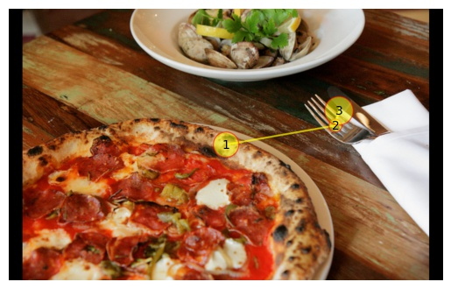
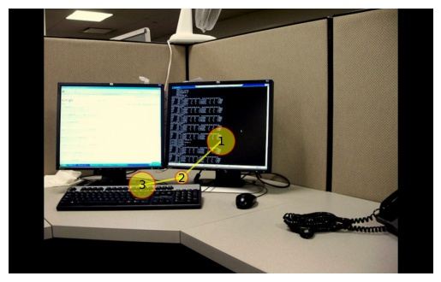
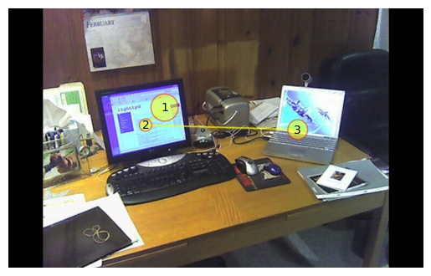
ZeroGaze
We introduce the ZeroGaze task
  Tests scalability of gaze prediction models for visual search
  Extends zero-shot learning to gaze prediction
find “fork”
Training Dataset:
Gaze data for N categories
find “fork”
find “keyboard”
find “cup”
GazeTrain
Search category in N categories
ZeroGaze
Search category outside N categories
find “laptop”
Notes:
As a result, we introduce the ZeroGaze task
This task tests the scalability of visual search models.
And essentially extends zero-shot learning to gaze prediction.
Specifically, for a training dataset with human scanpaths for a set of N categories,
under the conventional GazeTrain setting, the models are asked to search for category within that fixed set
whereas under ZeroGaze setting, the model must search for a category outside that set.

Slide 6
Gazeformer
We solve ZeroGaze with the novel Gazeformer model
  Improves scalability, effectiveness and efficiency of gaze prediction
Key components of Gazeformer
  Language-based Target Encoding
  Transformer Encoder-Decoder Architecture
  Fixation Modeling in Image Space
Notes:
In order to solve ZeroGaze problem, we propose the novel Gazeformer model which improves scalability, accuracy and efficiency of gaze prediction.
There are three key components of Gazeformer
Language-based Target Encoding
Transformer Encoder-Decoder Architecture, and
Fixation Modeling in Continuous Image Space

Slide 7
Language-based Target Encoding
Gazeformer uses a pre-trained language model to encode target name
  Scalable - can encode any target using its name
  Embodied semantics helps extending to unknown targets
“pizza cutter”
“car”
Language
Model (LM)
“sedan”
d
Notes:
In contrast to previous detector-reliant approaches, Gazeformer uses a pre-trained language model to encode the target name. This approach is scalable since it can encode any target.
Additionally, semantic content of the linguistic embedding can help extend to unknown targets.
Here, we use a pre-trained Language Model such as RoBERTa to encode category names to constant-sized embeddings. For example, we can create d-dimensional embeddings for car, sedan, and pizza cutter.

Slide 8
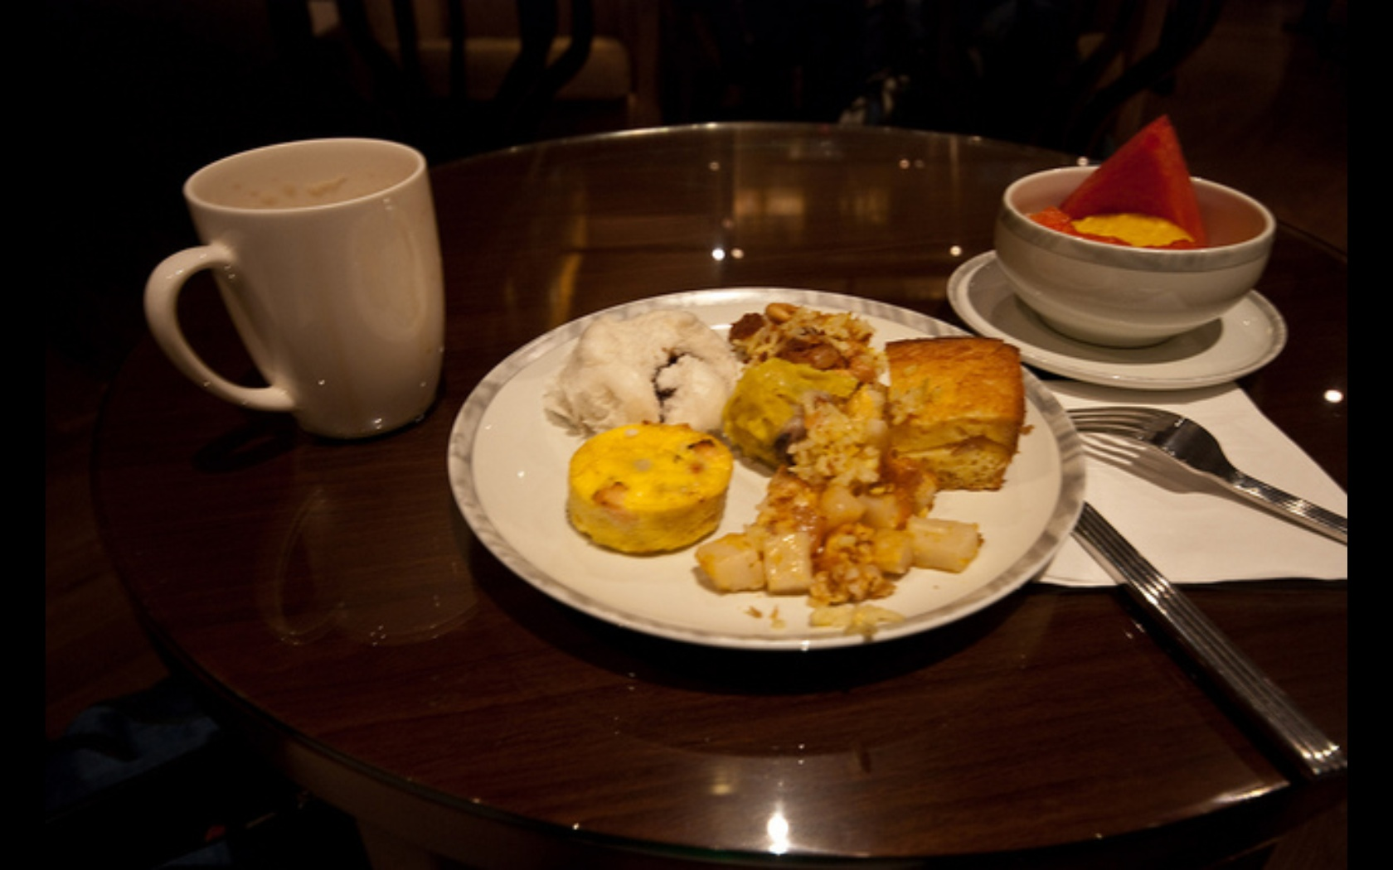
Transformer Encoder-Decoder Architecture
Gazeformer adopts a transformer encoder-decoder architecture
  Learns interactions between image and target semantics
  Models spatio-temporal context for scanpath generation
Visual-Semantic
Joint Embedding
i=0
i=1
i=L-1
…
Scanpath Prediction
Transformer
Encoder
F_{image}
…
CNN
d×hw
F_{joint}
Transformer
Decoder
ℝ^{d}→ ℝ^{d}
F_{target}
ℝ^{2d}→ ℝ^{d}
“cup”
LM
d×hw
…
Scanpath
Tile
tile
…
ℝ^{dtext}→ ℝ^{d}
0 1 L - 1
Fixation Queries
(for i = {0,1, …, L-1})
Notes:
For scanpath modeling, Gazeformer adopts a transformer encoder-decoder architecture.
This model learns interactions between image and semantics of the target and
also models spatio-temporal context required for scanpath generation.
In addition to encoding the target using a language model,
Gazeformer uses a CNN backbone and transformer encoder to generate a contextual representation of the image.
The image and target representations are jointly embedded in the next step to endow image features with target semantics.
Along with joint visual-semantic representation, the transformer decoder module operates on L fixation queries where L is the maximum scanpath length.
The decoder generates L latent vectors for final scanpath prediction all at once. Note that we apply right-side padding for scanpaths of lengths less than L.

Slide 9
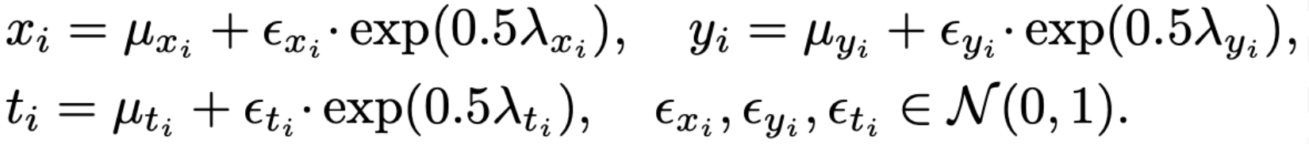
Fixation Modeling in Image Space
Previous methods predicted fixation probabilities over patches
  Does not penalize distance of predicted fixations from ground truth
We regress fixation parameters using Gaussian distributions
Scanpath Prediction
Fixation Parameters(x_{i}, y_{i,} t_{i})
μ^{(i)}_{x}
λ^{(i)}_{x}
Gazeformer learns scanpath termination
  Separate MLP learns if a latent vector corresponds to a valid fixation or padding
μ^{(i)}_{y}
λ^{(i)}_{y}
μ^{(i)}_{t}
λ^{(i)}_{t}
Valid Fixation or Padding
v^{(i)} = P(valid|i)
Notes:
Previous methods learnt a probability distribution over image patches.
However, this method does not penalize the actual distance between the prediction and ground truth fixations since all patches are considered as discrete entities.
Instead, we directly regress the fixation parameters of each fixation, by sampling from Gaussian distributions using the reparameterization trick.
Gazeformer also learns scanpath termination by predicting if a latent vector corresponds to a valid fixation or padding

Slide 10
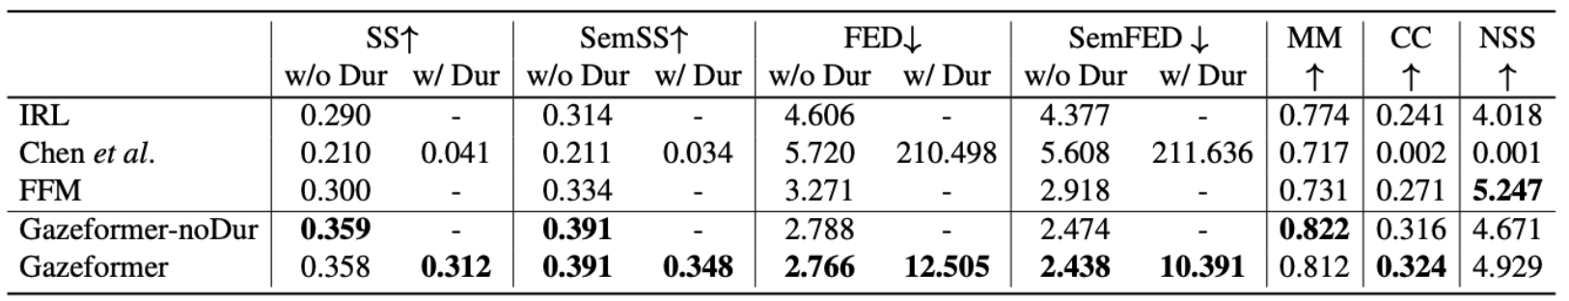
Experimental Results: ZeroGaze
We implement ZeroGaze setting on COCO-Search18 using Leave-One-Out scheme
Gazeformer outperforms baselines in ZeroGaze setting on multiple metrics
Notes:
Here we present the results of Gazeformer in two variants - without and with duration prediction as compared to other baseline models under the ZeroGaze setting on the COCO-Search18. Gazeformer outperforms other baselines on multiple metrics, thereby proving to be more scalable.

Slide 11
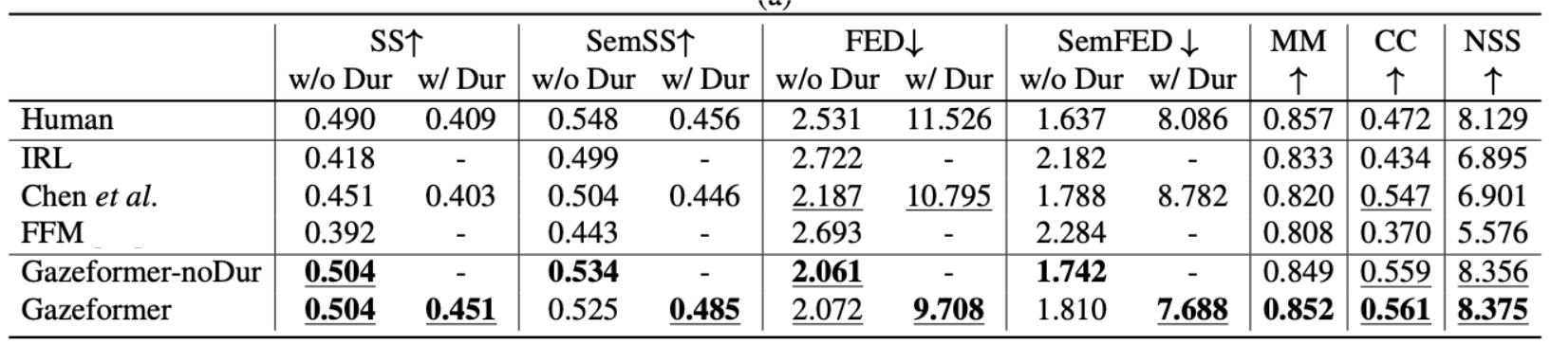
Experimental Results: GazeTrain
Gazeformer outperforms baselines under the GazeTrain setting on COCO-Search18
Notes:
Under the conventional GazeTrain setting on COCO-Search18 dataset, Gazeformer again outperforms other baselines while exceeding human consistency scores on multiple metrics. This shows the effectiveness of Gazeformer.

Slide 12
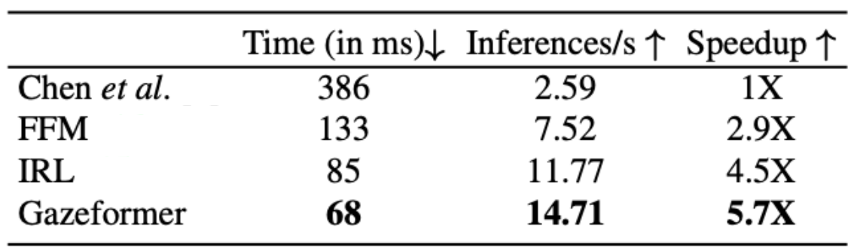
Experimental Results: Inference Time
Gazeformer is several times faster than baselines
Notes:
In addition to being more scalable and effective, Gazeformer is multiple times faster owing to its ability to generate an entire scanpath in one pass.

Slide 13
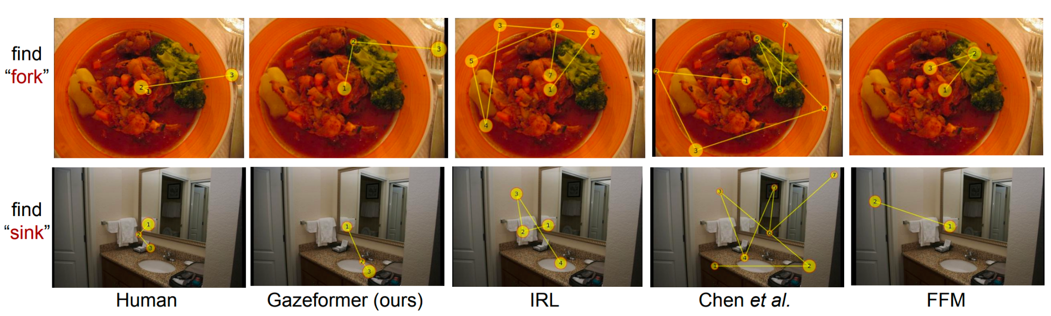
Experimental Results: Qualitative
Gazeformer extends to new categories in ZeroGaze setting
Notes:
Here, we show some qualitative results showing the generalizability of Gazeformer for target categories it has not been trained on. We find the Gazeformer manages to generate human-like scanpaths despite not being trained on gaze data for fork and sink.

Slide 14
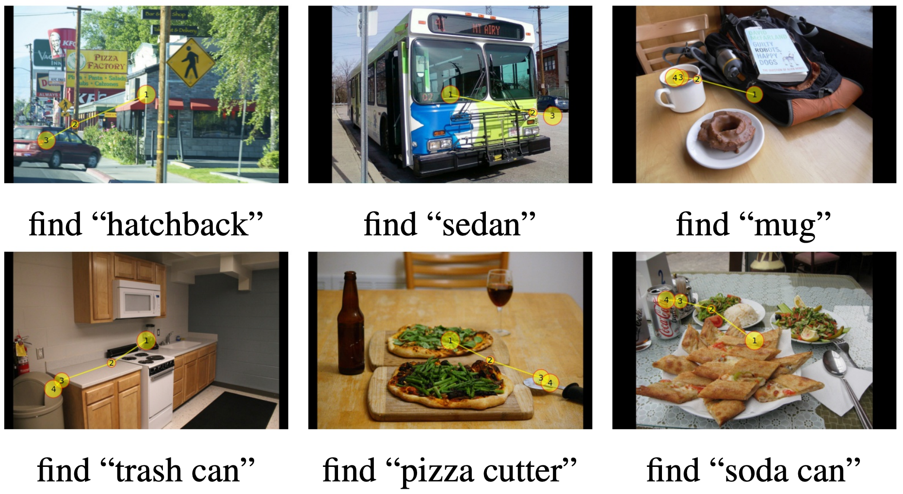
Extensibility to Uncommon Categories
Hyponyms or synonyms of target names
No annotation in COCO dataset
Gazeformer extends to unknown and uncommon targets
Notes:
In a more challenging setting, we ask Gazeformer to generate scanpaths for synonyms or hyponyms of known target categories such as “sedan” instead of “car” or “mug” instead of “cup”. Owing to linguistic embeddings, Gazeformer robustly manages to generate reasonable scanpaths.
Gazeformer is also able to generate scanpaths for uncommon target categories that are not annotated in COCO dataset which is used to train object detector modules in previous gaze prediction methods.

Slide 15

Conclusion and Future Work
We introduced the ZeroGaze task
We proposed the novel Gazeformer model
Gazeformer is more scalable, effective and efficient than previous approaches
We hope Gazeformer will be extended to other visual tasks such as VQA and real-world HCI applications
Code available at https://github.com/cvlab-stonybrook/Gazeformer
Notes:
To sum it up, we introduced the ZeroGaze task to test scalability in scanpath prediction
and subsequently proposed a novel Gazeformer model to solve it.
Gazeformer is not only more scalable, but also more effective and efficient than previous methods.
We hope Gazeformer will be extended to more visual tasks like Visual Question Answering and be applied to real-world HCI applications.

