Slide 1




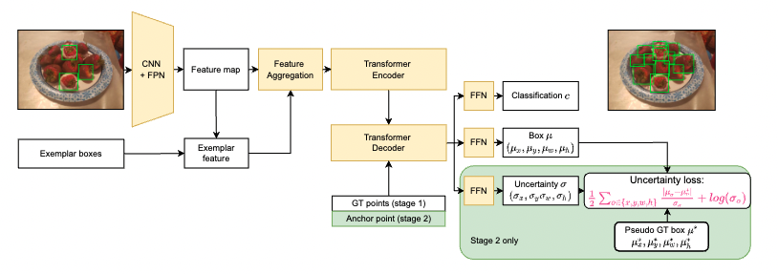
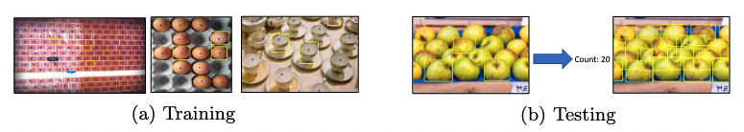
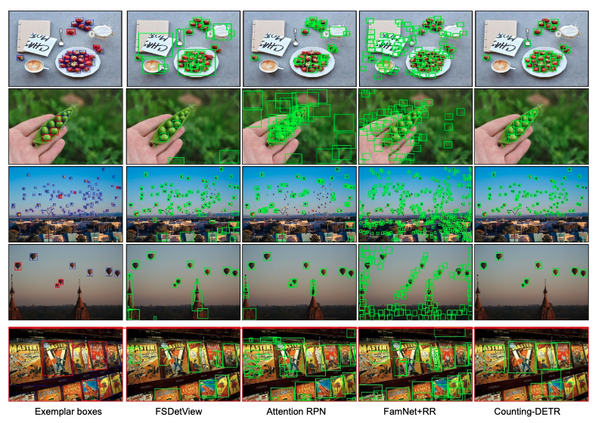
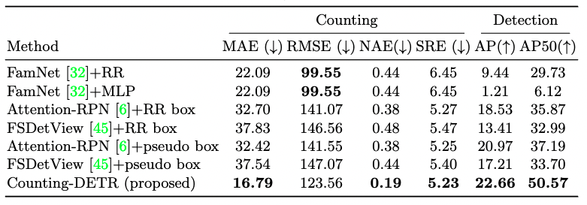
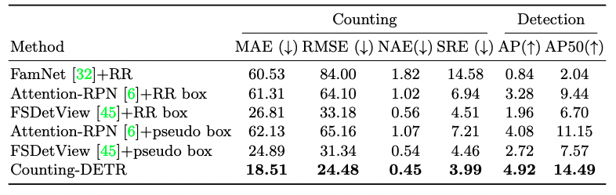
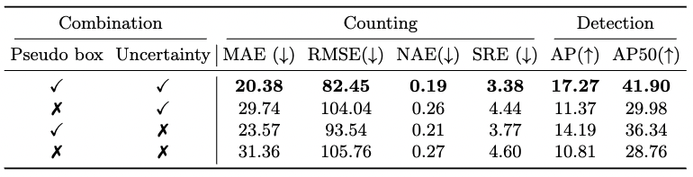

Few Shot Object Counting and Detection
Thanh Nguyen*, Chau Pham*, Khoi Nguyen, Minh Hoai
Problem Statement
Our Approach: Counting DETR
In training: Each image has 3 annotated bounding boxes of a class (exemplars) and the dots for remaining objects.
In testing: Each image has 3 exemplars. Our task: Detect and count all objects share the same category of the exemplars.
Prior Work
Few shot object Counting (e.g. Famnet): Counting the number of object with the same exemplars
Limitation
Only produce density map to count, lack of bounding boxes associated with each object to easily interpret and verify the counting results
Contribution
Introduce a new problem of counting and detection.
Introduce new datasets: FSCD-147 and FSCD-LVIS.
Propose two-stage training strategy: generating pseudo bounding boxes from dot annotations and train a few-shot object detector with the new pseudo bounding boxes.
Propose an uncertain-aware point-based few-shot object detector taking into account the imperfection of pseudo bounding boxes.
Few-shot Object Detection
(e.g. FsDetview, Attention RPN)
Detect all the objects within the same category as the exemplars
Limitation
Require the full bounding box supervision for training (more supervision)
Experimental Results
Table 1: Compare with strong baselines on FSCD-147 dataset
Table 2: Comparison with strong baselines on FSCD-LVIS dataset
Table 3: Ablation study on each component contribution to the final results
Table 4: Ablation study for the uncertainty loss
* Denotes equal contribution

