Slide 1


Interactive Class-Agnostic Object Counting
ICCV 2023
Yifeng Huang¹, Viresh Ranjan^{2*}, Minh Hoai^{1,3}
¹Stony Brook University
²Amazon ³VinAI Research
*Work done at Stony Brook University, prior to joining Amazon

Slide 2
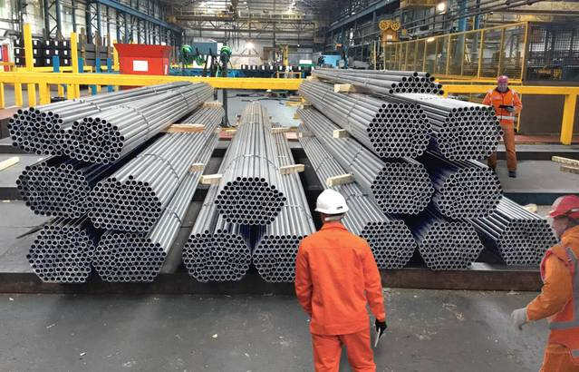
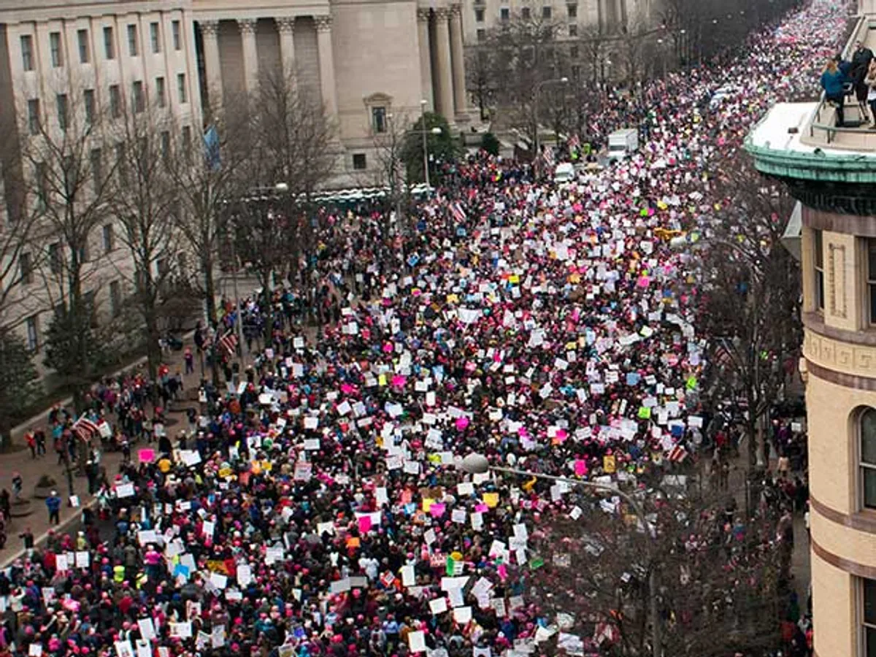
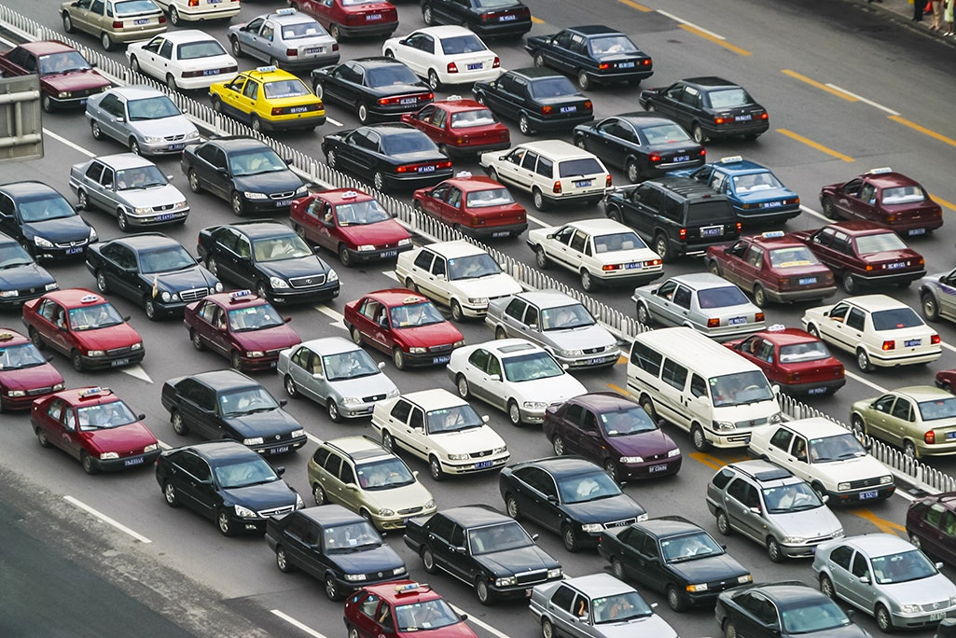
Applications of Visual Counting
Manufacturing
Security
Traffic
2

Slide 3
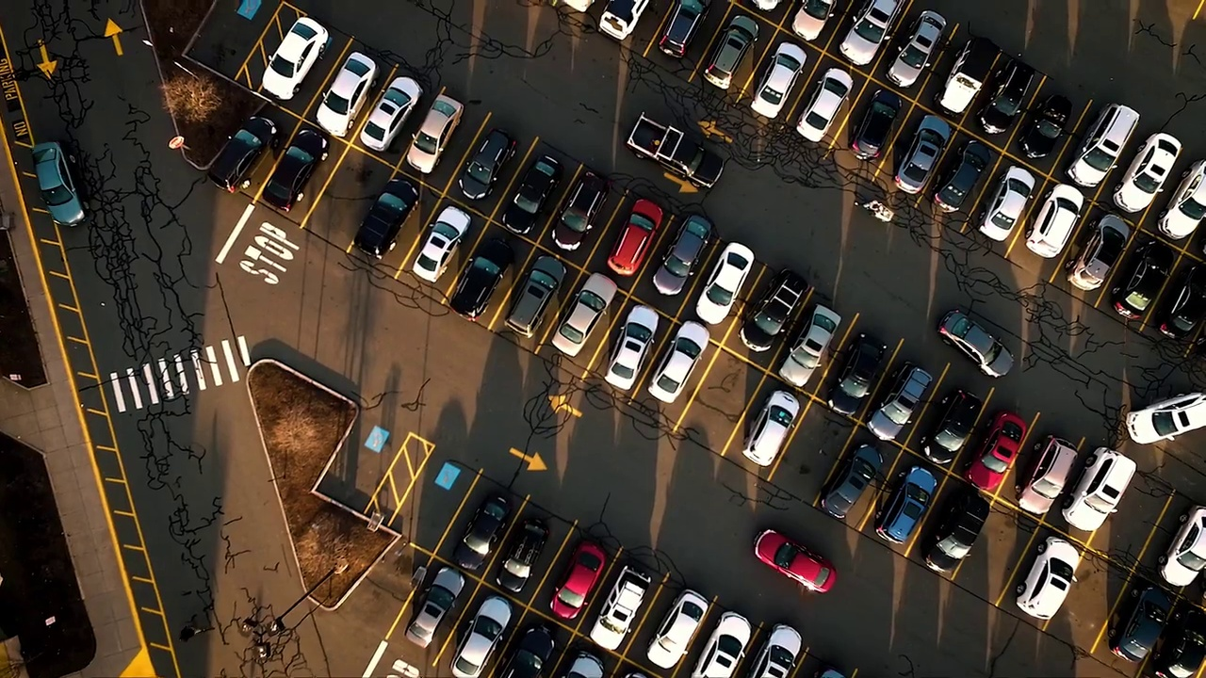
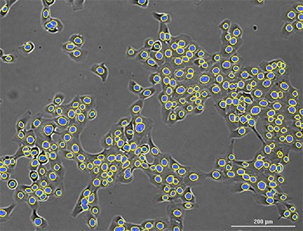
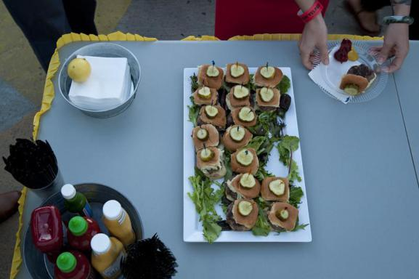
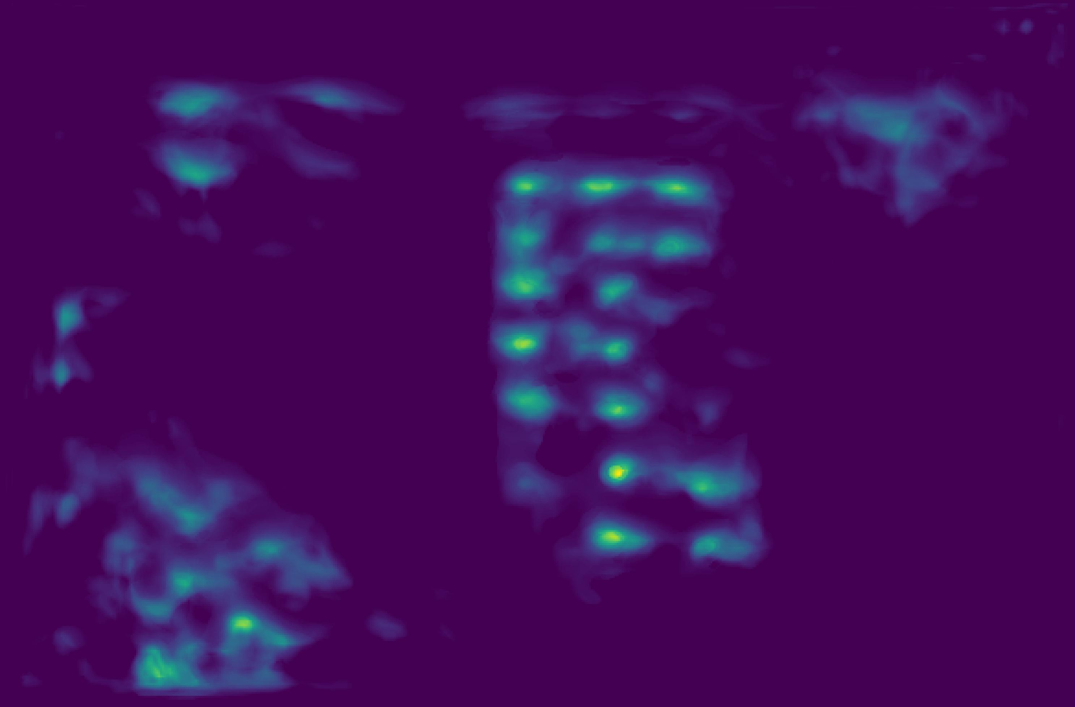
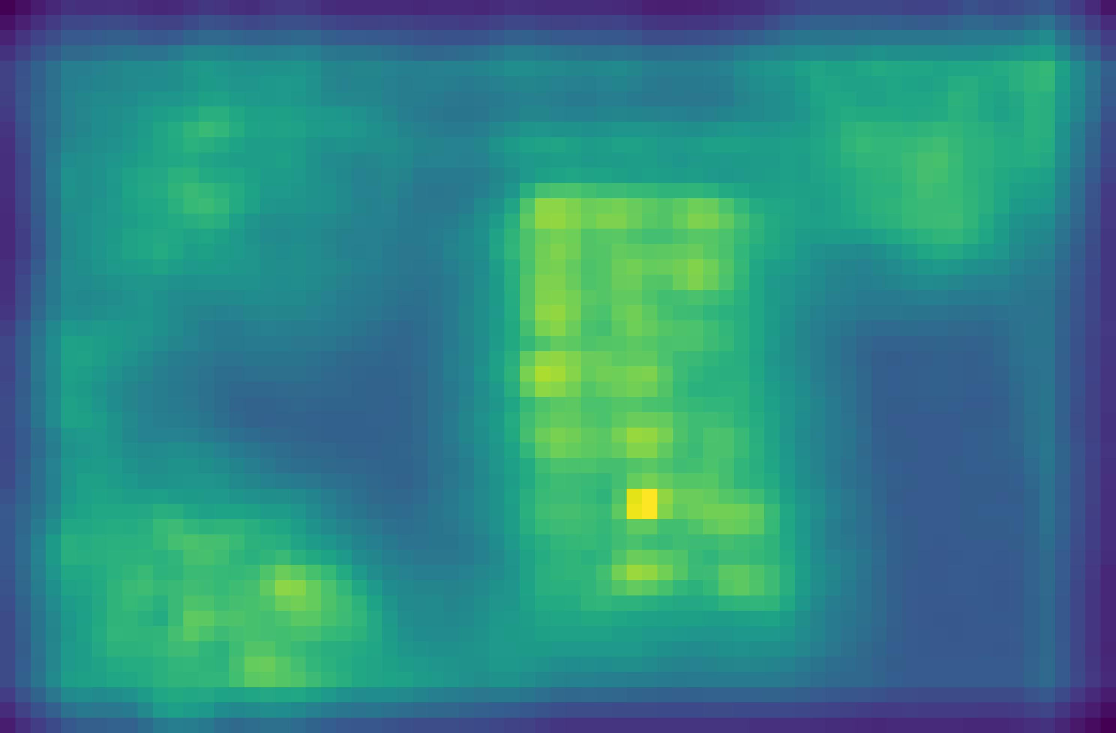
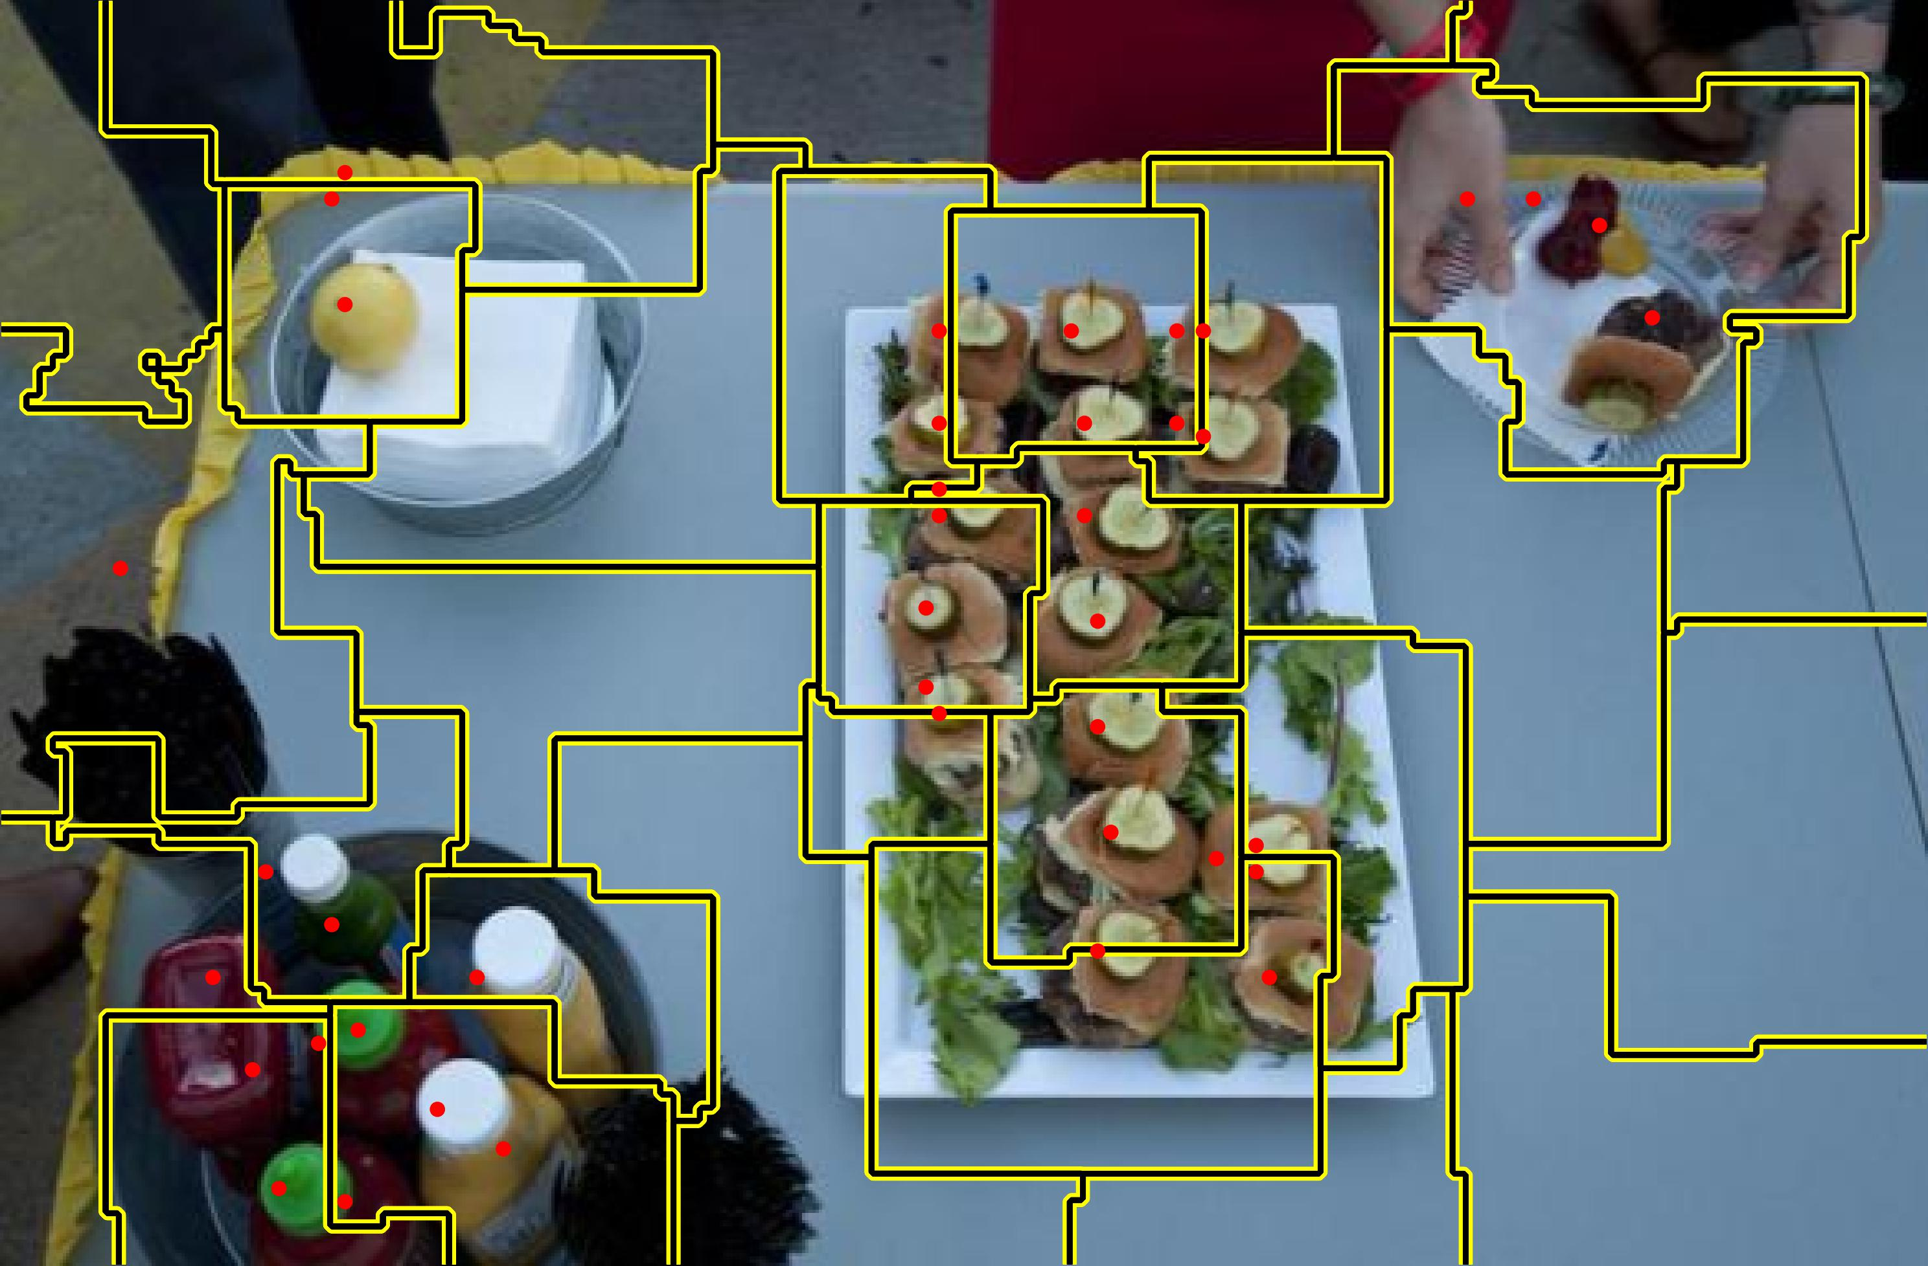
Existing Works for Visual Counting
Category specific: Require millions of dot annotations for
thousands of training samples for one category
Category agnostic: Imprecise spatial similarity map due to
various sizes/shapes/colors, large density, and occlusion
MCNN (CVPR2016)
Counting in the wild (ECCV2016)
ic-CNN (ECCV2018)
TEDnet (CVPR2019)
CTN (ACCV2020)
DM-Count (NeurIPS 2020)
……
Exemplar denoting category of interest
Initial Count
Cars
Cells
FamNet (CVPR2021)
CFOCNet (WACV2021)
VCN (CVPR2022 Workshop)
BMNet (CVPR2022)
SAFECount (WACV2023)
……
Model Adaptation
Result Interpretation
41
Spatial
Similarity
Count
Feedback Providing
Adaptation Loss
3

Slide 4
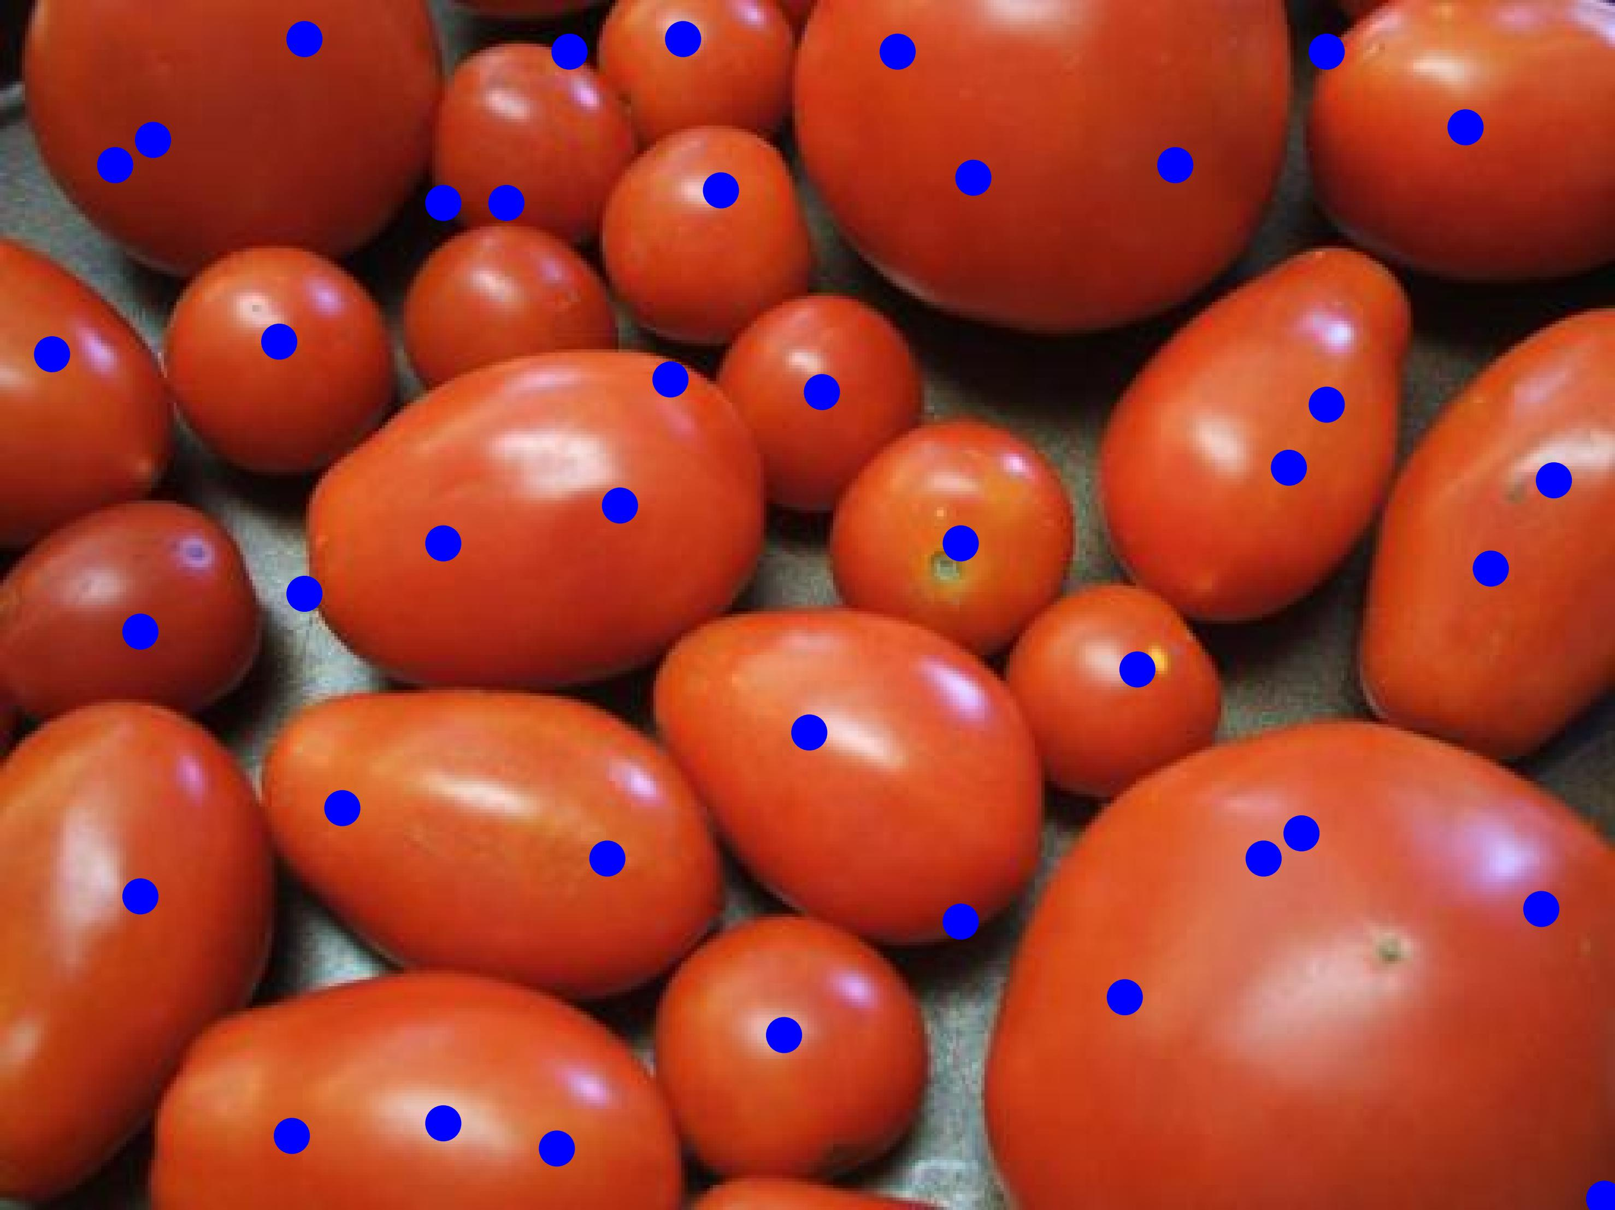
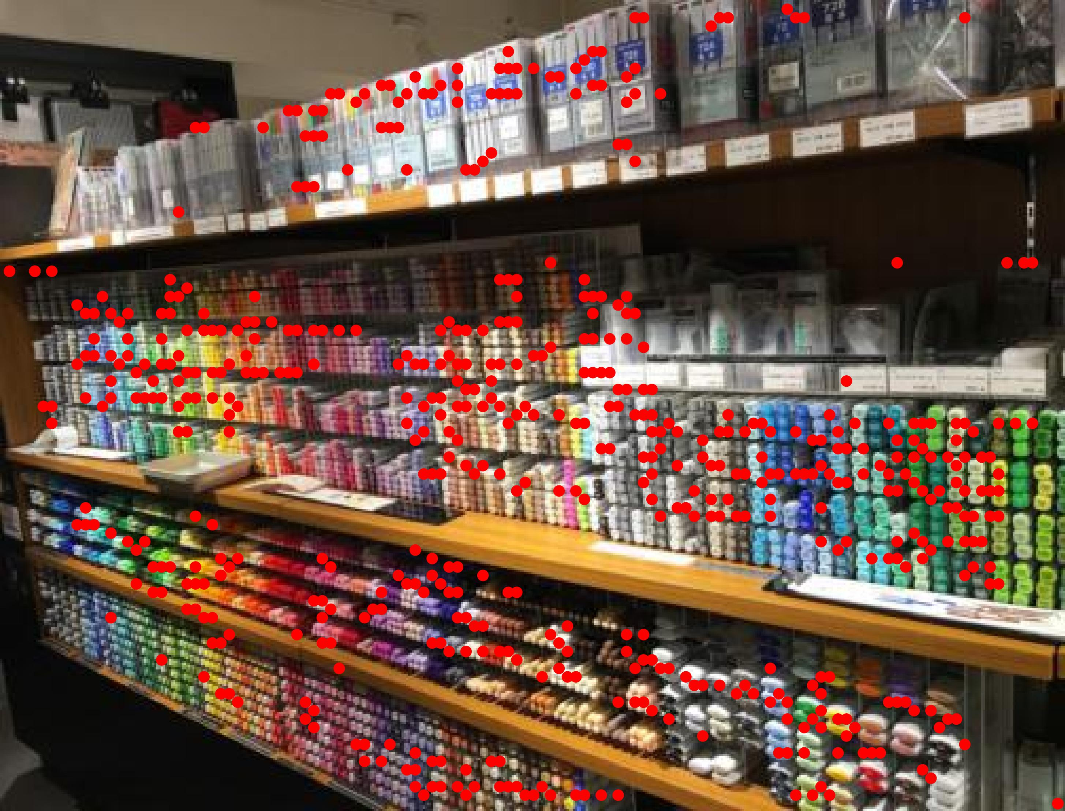
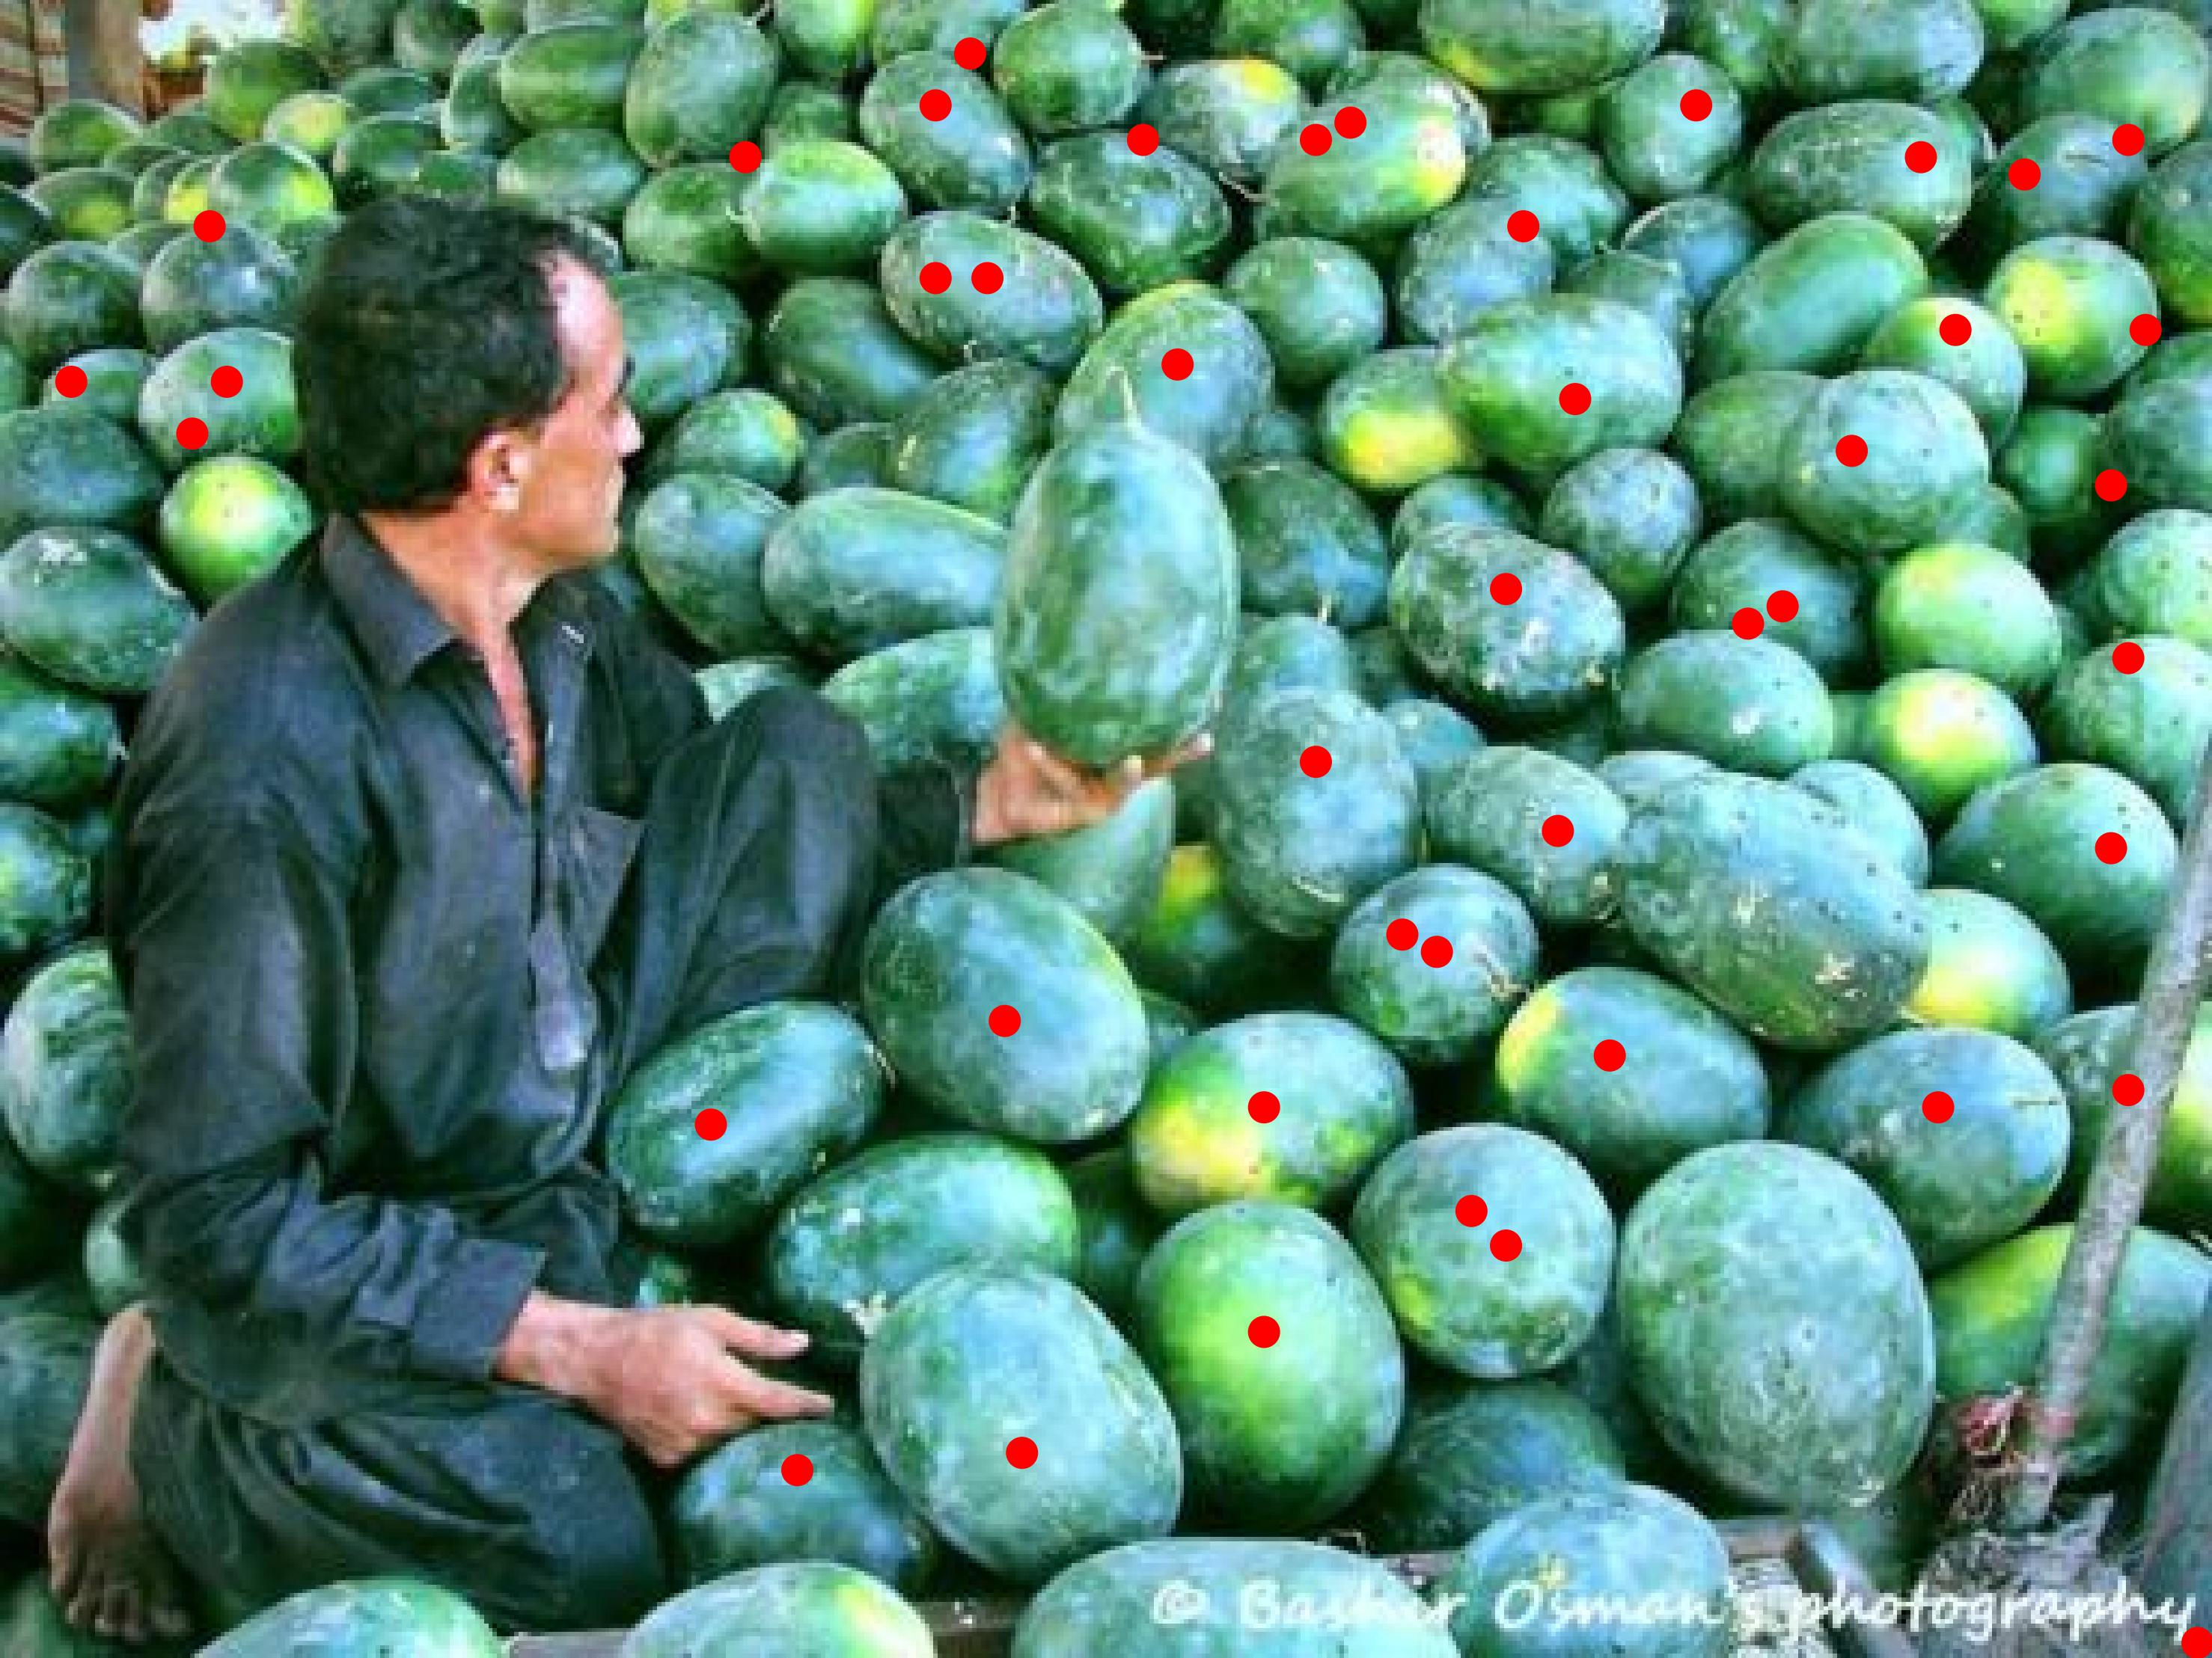
Objective of Our Work
1. Previous category-specific counting method requires millions of dot annotations for thousands of training samples for one category.
2. Imprecise spatial similarity map due to various sizes/shapes/colors
2. Imprecise spatial similarity map due to various sizes/shapes/colors, large density
2. Imprecise spatial similarity map due to various sizes/shapes/colors, large density, and occlusion makes the category-agnostic counter still makes a lot of mistake.
Various Size/Shape
(Blue Dot is the Prediction)
Large Density
(Red Dot is the Prediction)
Occlusion
(Red Dot is the Prediction)

Slide 5
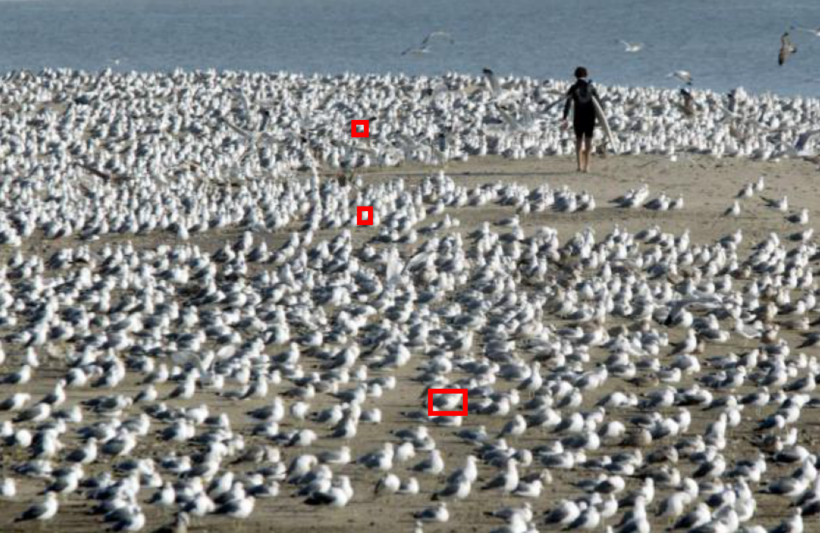
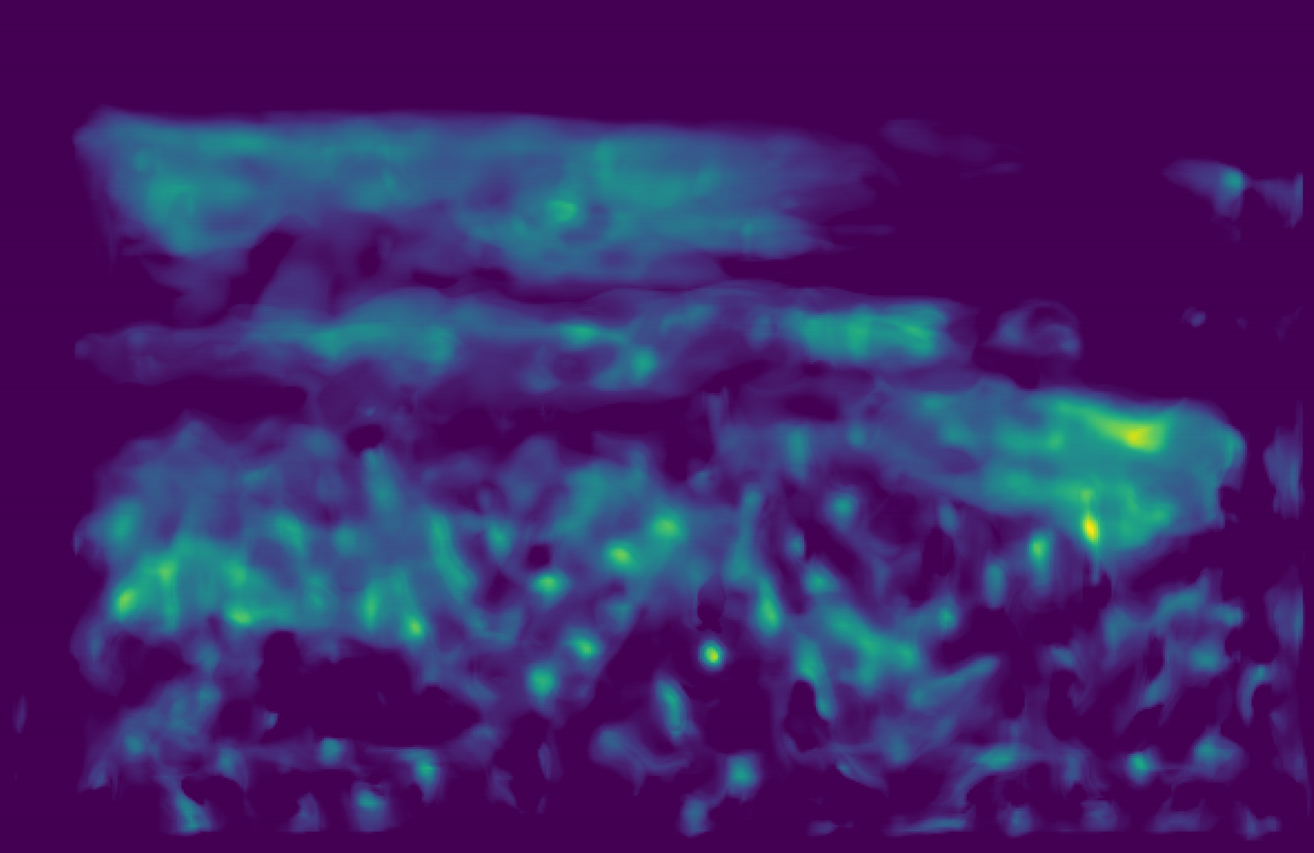
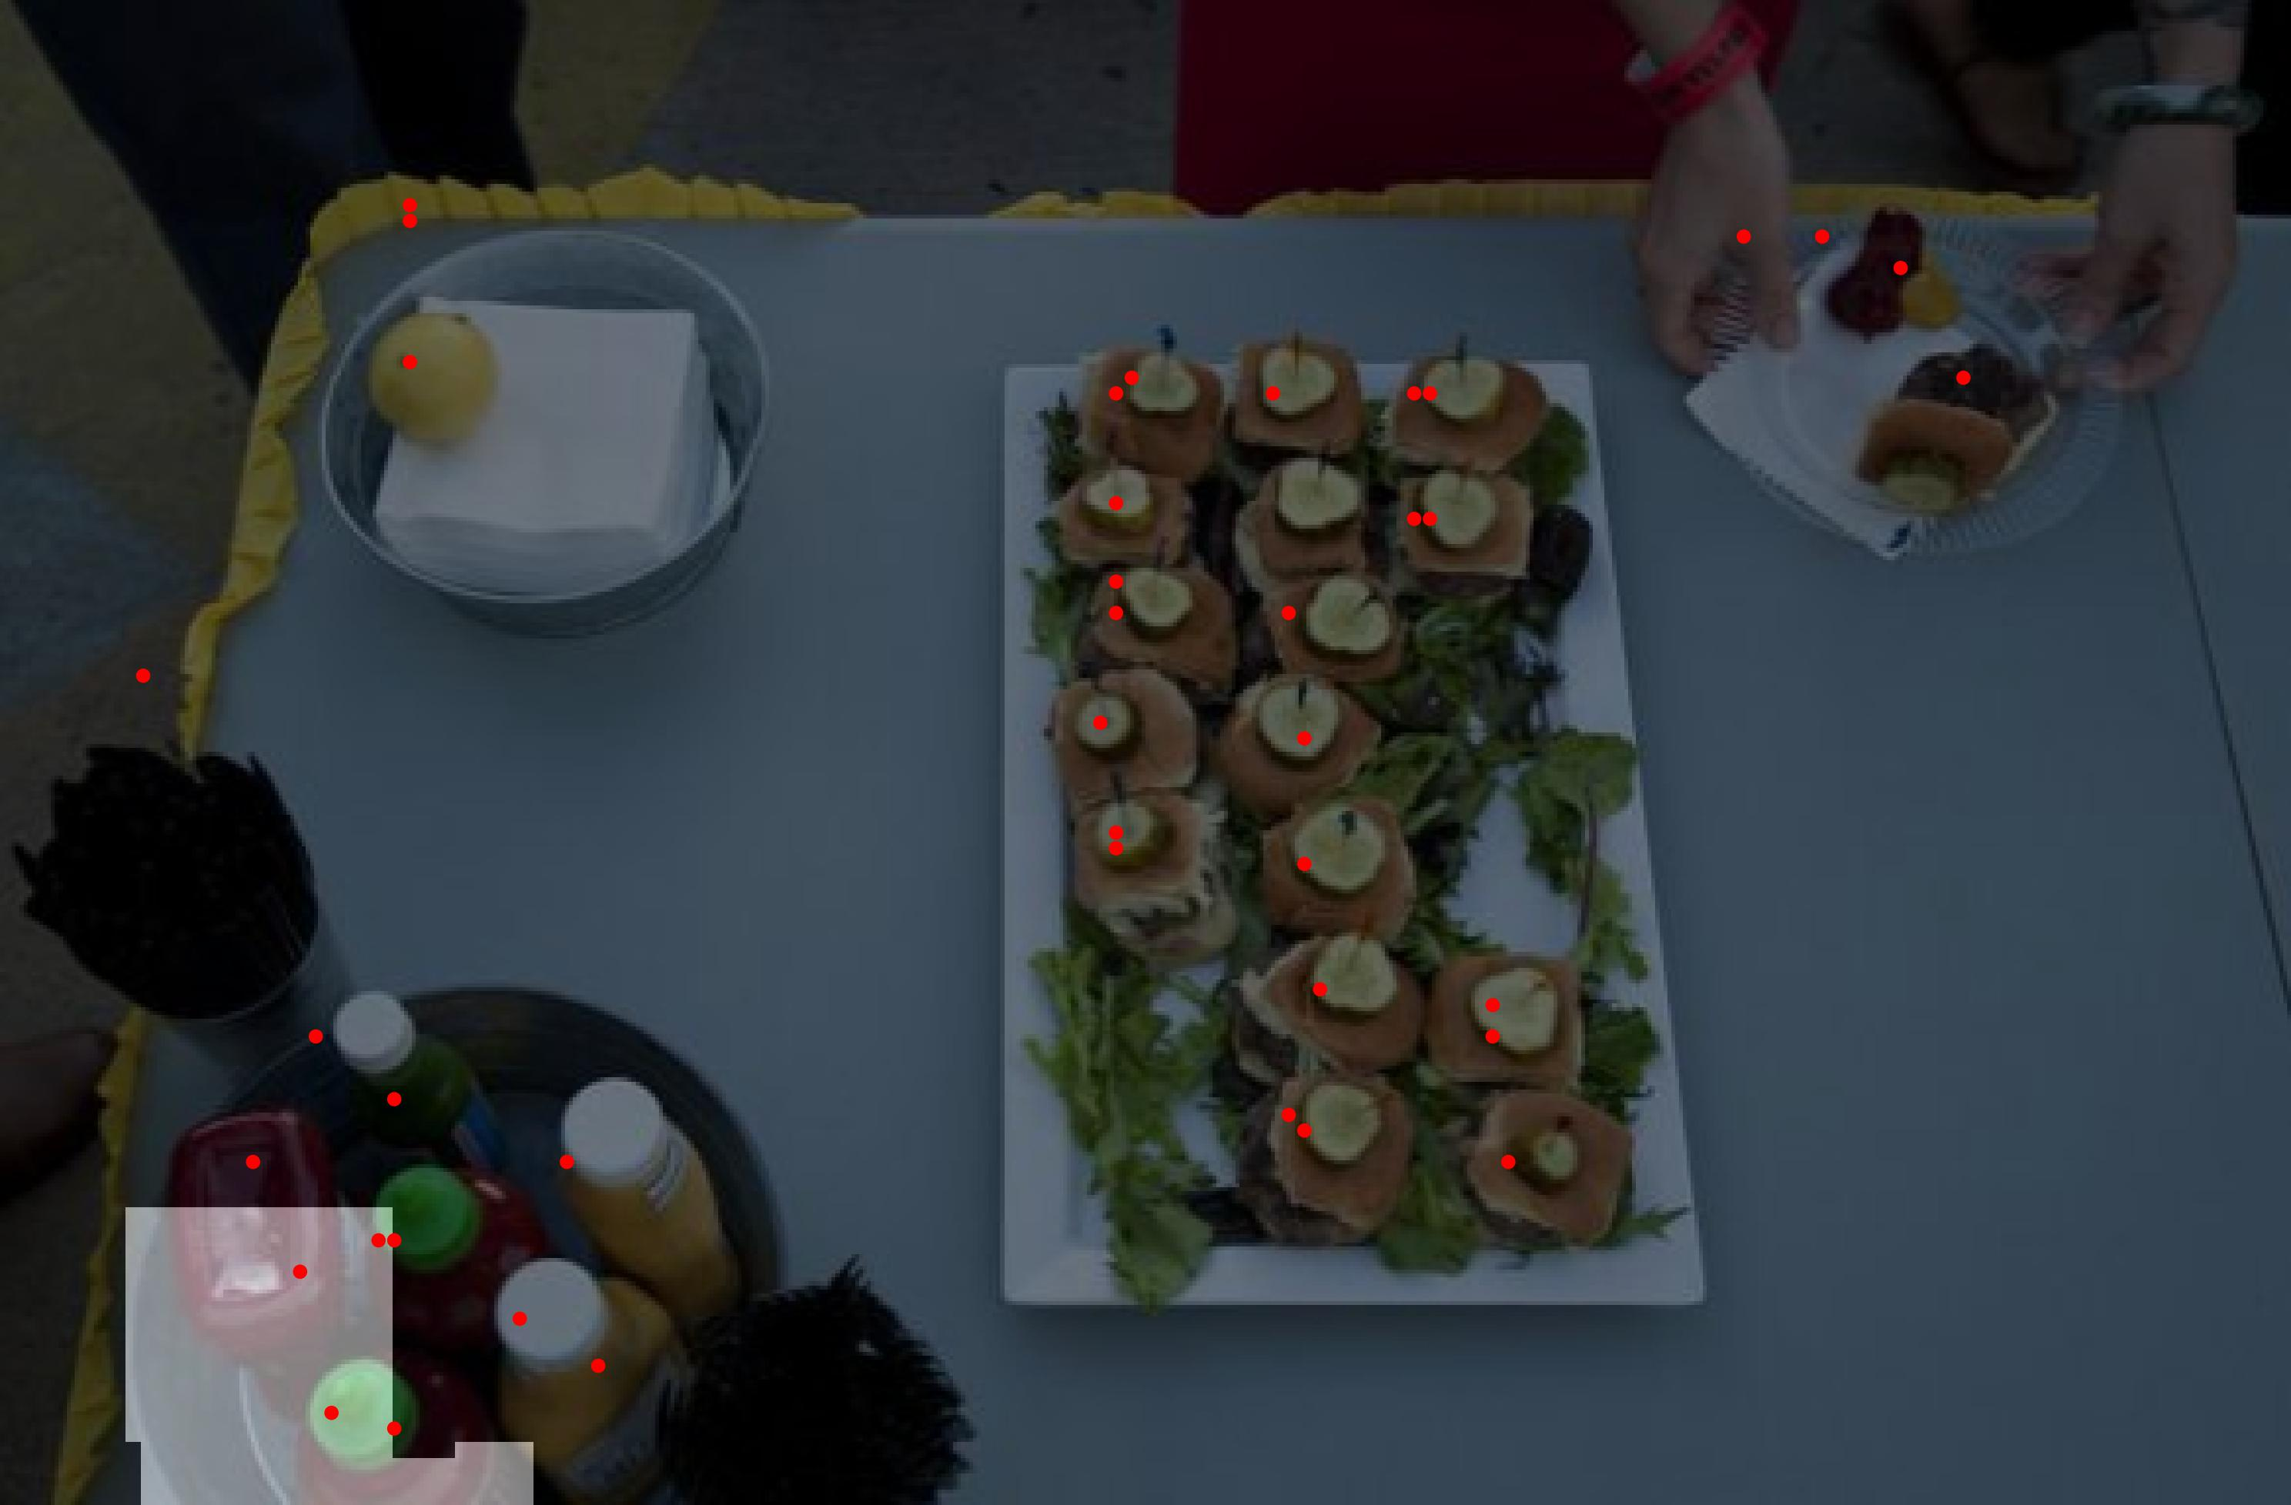
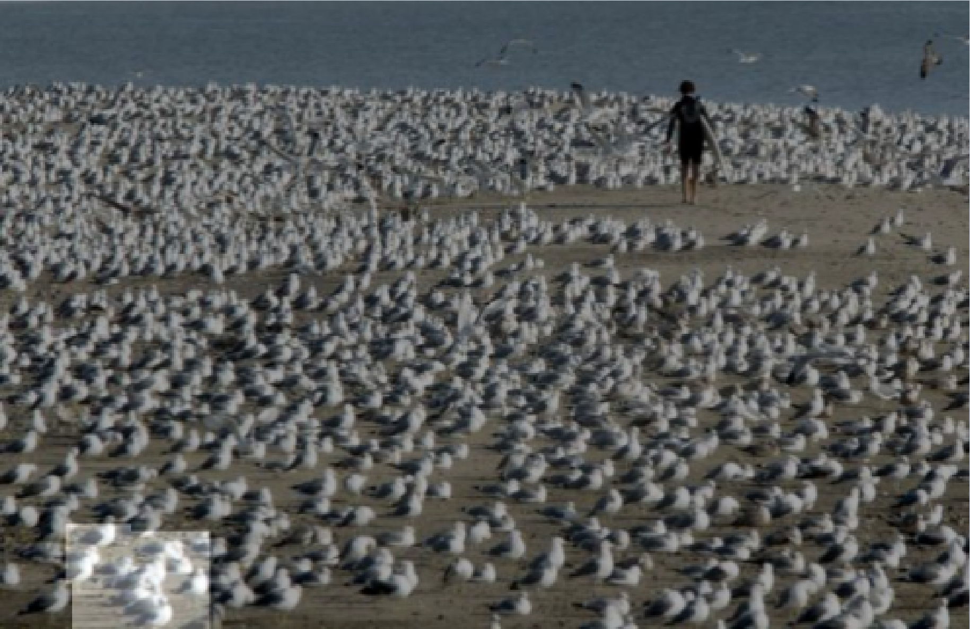
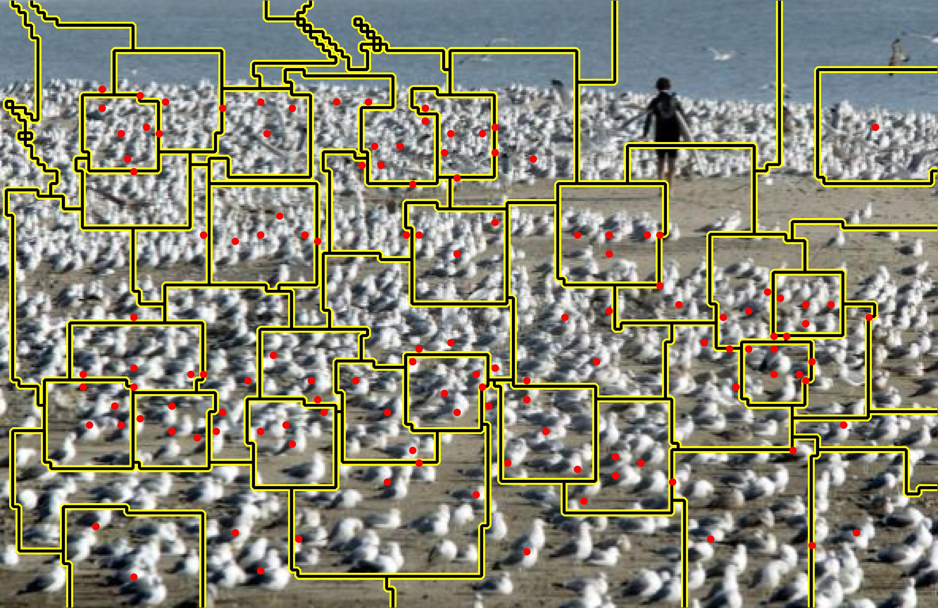

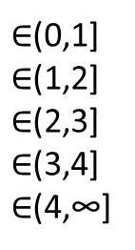
Objective of Our Work
Design an interactive framework that allows a human user to quickly detect mistakes
and improve performance based on the identified errors.
Visual
Counter
Density
Estimation
Input Image
with Exemplars
Adaptation
Segmentation
& Visualization
#Objs
Range
$$∈\left\{0\right\}$$
Region selection
& Range specification
$∈$(0,1]
$∈$(1,2]
$∈$(2,3]
$∈$(3,4]
$∈$(4,∞]
Interactive Loop
5

Slide 6

Existing Works for Interactive Computer Vision
Interpret the prediction into an intuitive result.
Input
Model
Prediction
Interpret
Generate adaptation loss with user feedback.
Adapt
Feedback
Update the model with adaptation loss.
BRS (CVPR2019)
f-BRS (CVPR2020)
C3Det(CVPR2021)
FocusCut (CVPR2022)
iSegFormer (MICCAI 2022)
……
Adaptation Loss
Intuitive Result
6

Slide 7
Our Contribution
Interpret: A segmentation method that segments density maps into regions with near-integer density values, enhances the interpretability of predicted density map.
Feedback: An innovative user feedback scheme that requires minimal user effort.
Adapt: An effective adaptation approach that incorporates the user's feedback into the visual counter.
7

Slide 8
Outline
1. Density map Interpretation.
2. Feedback Collection.
3. Visual Counter Adaptation.
4. Result.
8

Slide 9
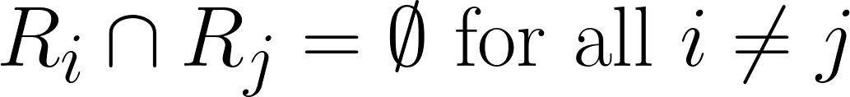
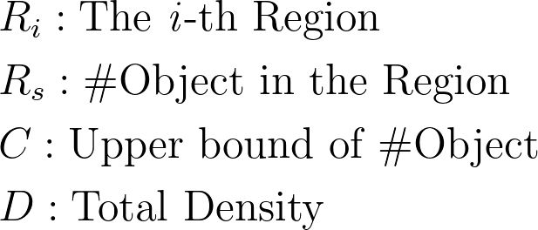
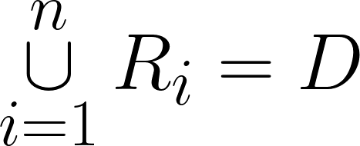
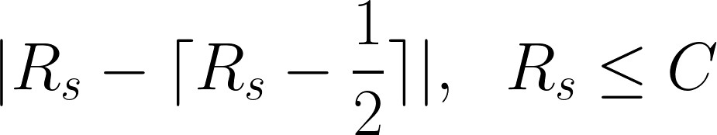
Iterative Peak Selection and Expansion (IPSE) density map segmentation
Given a Density map, we segment the density map into multiple regions with the following consideration:
1. Non-overlapping:
2. Total coverage:
3. Integrity and limited integral:
4. Moderate size.
9

Slide 10
Iterative Peak Selection and Expansion (IPSE) density map segmentation
Gaussian smooth
& Downsampling
Expansion
Select the peak
Iteratively
select & expand
10

Slide 11
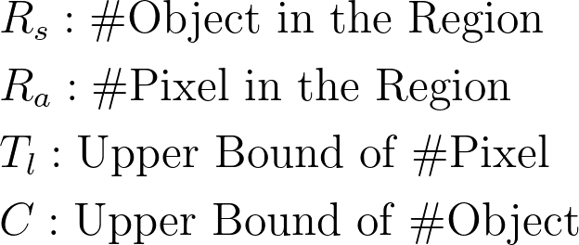
Iterative Peak Selection and Expansion (IPSE) density map segmentation
Expansion to Minimize:
a) Integrity.
b) Moderate size.
c) Limited object num.
11

Slide 12
Outline
1. Density map Interpretation.
2. Feedback Collection.
3. Visual Counter Adaptation.
4. Result.
12

Slide 13

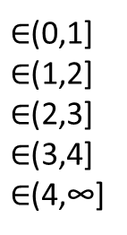
Feedback Collection
#Objs
Range
$$∈\left\{0\right\}$$
$∈$(0,1]
$∈$(1,2]
$∈$(2,3]
$∈$(3,4]
$∈$(4,∞]
Region selection
Range specification
The limited integral constrain ensure the #Object of each region smaller or equal than four^{[1]} in this example.
[1] Lana M. et al., ’Why are small and large numbers enumerated differently? A limited-capacity preattentive stage in vision.’, Psychological review, 1994.
13

Slide 14
Outline
1. Density map Interpretation.
2. Feedback Collection.
3. Visual Counter Adaptation.
4. Result.
14

Slide 15
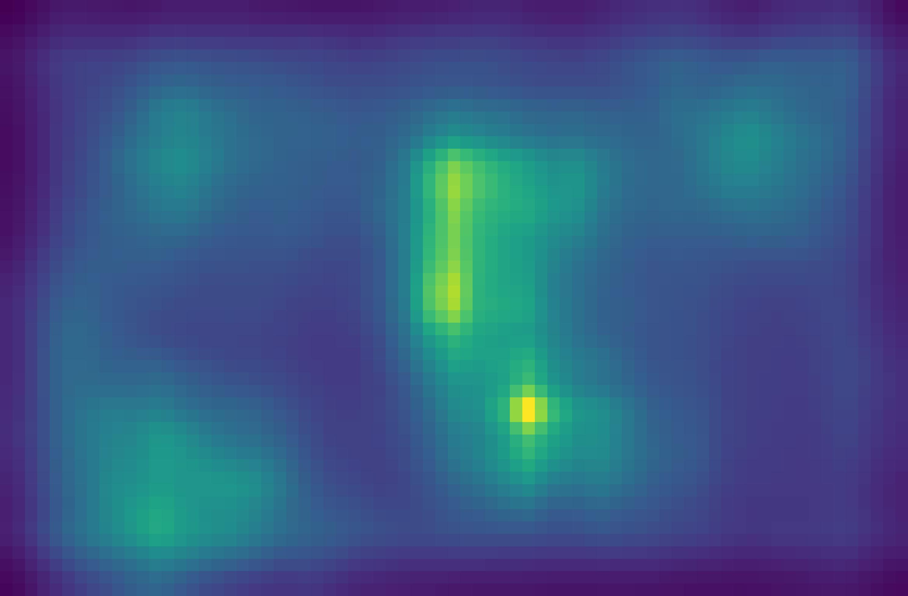

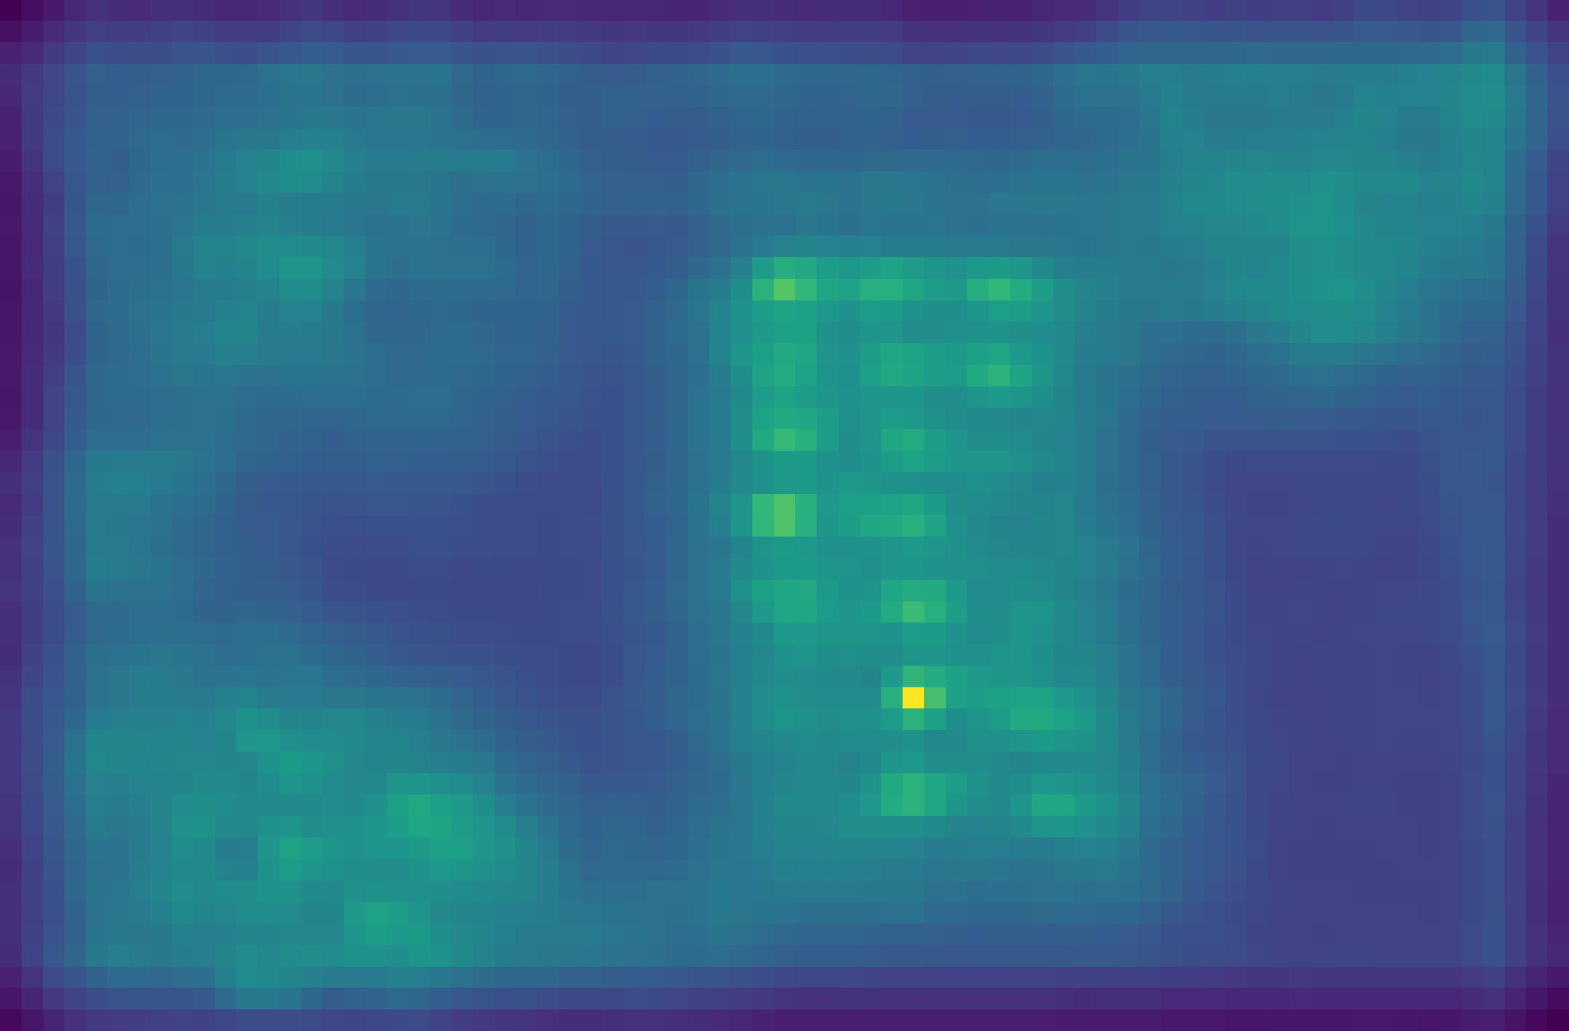
Feature Refinement Module
Regression head
Similarity map
Density map
Background,
should be zero density
Imprecise similarity map/intermediate
feature leads to the wrong prediction.
Motivated by this, we refine the imprecise similarity map/intermediate directly.
15
15

Slide 16
Feature Refinement Module
Naïve Adaptation in Regression Head
……
Adaptation
Loss
Conv / Upsampling
Conv / Upsampling
Conv / Upsampling
Feature Refinement Adaptation in Regression Head
……
Adaptation
Loss
Conv / Upsampling
Conv / Upsampling
Conv / Upsampling
Channel-wise
Refinement
Spatial-wise
Refinement
16

Slide 17
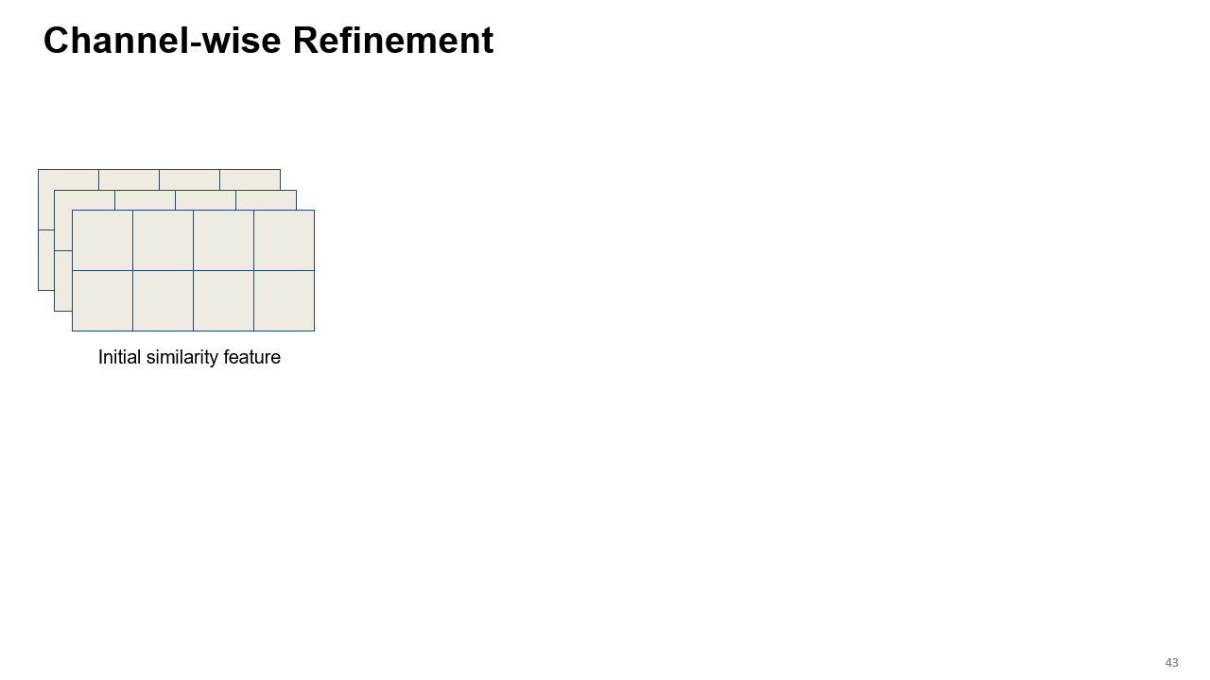
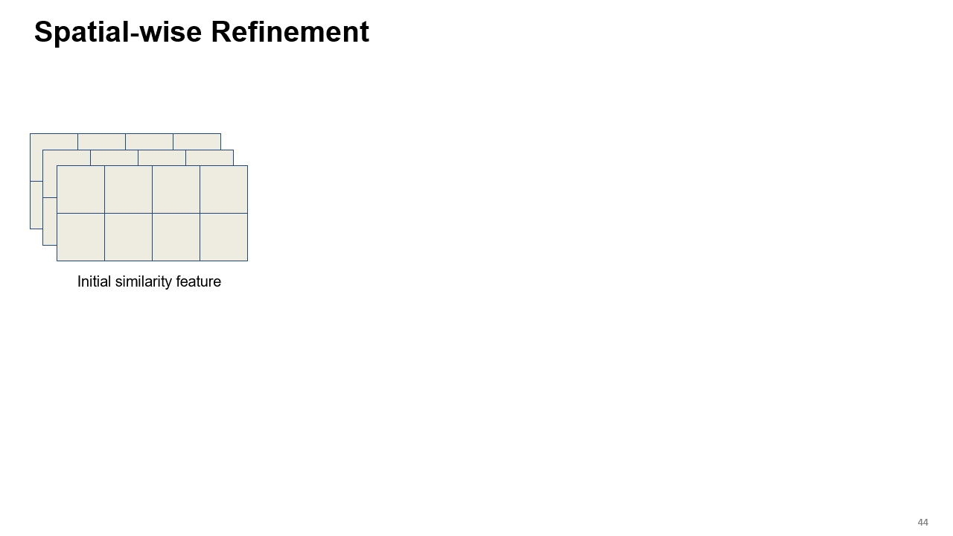
Feature Refinement Module
17
17

Slide 18
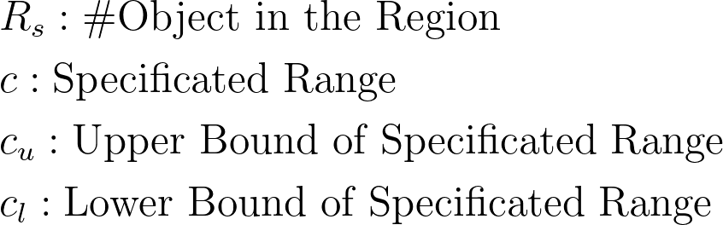
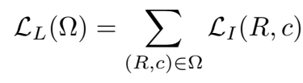
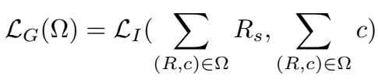
Adaptation Loss
Treat each region individually:
Our adaptation loss simply force the prediction within the provided range.
Treat each region as a whole:
18
18

Slide 19
Adaptation Loss
Final loss:
Regularization Term
19
19

Slide 20
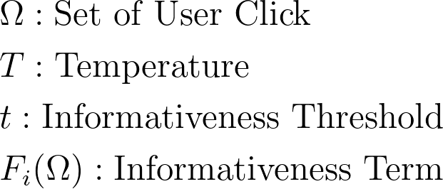

Using Confidence to Adjust Learning Rate and Gradient Steps.
Assumption 1: The more click, the larger confidence:
20
20

Slide 21
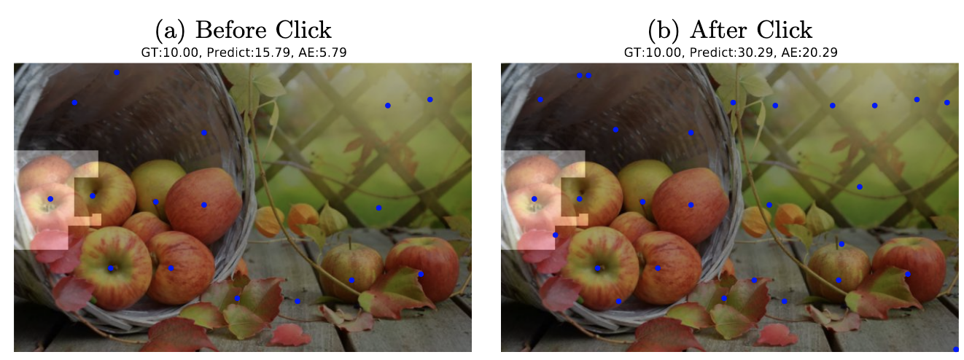

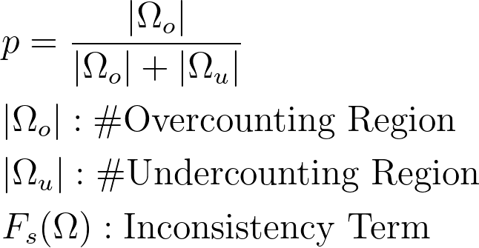
Using Confidence to Adjust Learning Rate and Gradient Steps.
Assumption 2: The less inconsistency, the larger confidence:
Failure due to inconsistency
21
21

Slide 22



Using Confidence to Adjust Learning Rate and Gradient Steps.
Total confidence:
Gradient Steps:
Learning Rate:
22
22

Slide 23
Outline
1. Density map Interpretation.
2. Feedback Collection.
3. Visual Counter Adaptation.
4. Result.
23

Slide 24
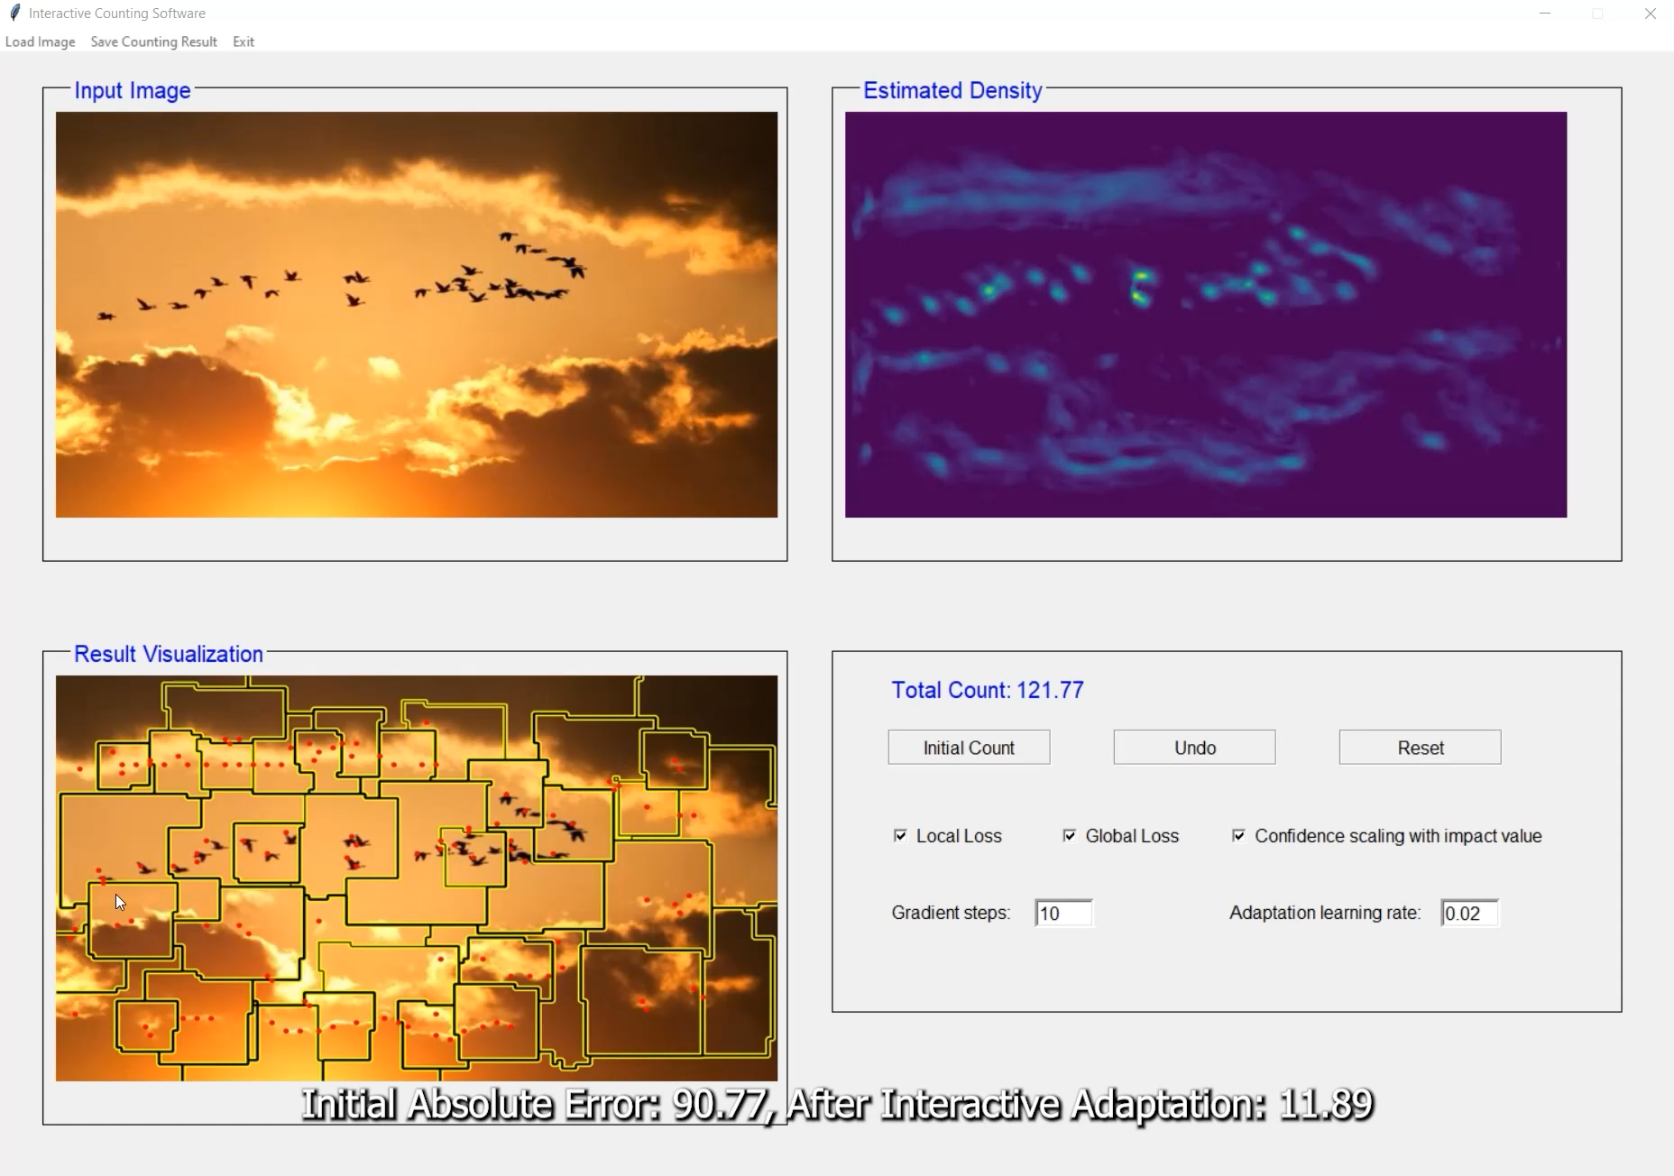
A Quick Demo
24

Slide 25
Quantitative Evaluation Criteria
Mean Absolute Error (MAE):
Root Mean Square Error (RMSE):

Slide 26
Comparison with Additional Exemplar Providing
 | FSC-147 Test Set |  | FSCD-LVIS Test Set
 | MAE | RMSE | MAE | RMSE
FamNet | 22.08 | 99.54 | 41.26 | 57.87
+5 Exemplar | 21.52↓2% | 98.10↓1% | 40.36↓2% | 57.85↓0%
+5 Our feedback | 11.75↓47% | 75.37↓24% | 21.18↓49% | 34.13↓41%
SAFECount | 13.56 | 91.31 | 15.45 | 28.73
+5 Exemplar | 13.01↓4% | 99.42↑3% | 14.83↓4% | 29.01↓2%
+5 Our feedback | 9.42↓31% | 80.69↓12% | 10.45↓32% | 18.42↓36%
BMNet+ | 14.62 | 91.83 | 17.49 | 29.76
+5 Exemplar | 14.40↓2% | 91.56↓0% | 17.27↓1% | 29.60↓1%
+5 Our feedback | 9.51↓35% | 84.66↓8% | 13.43↓23% | 22.39↓25%
26

Slide 27
Comparison with Additional Exemplar Providing
 | FSC-147 Test Set |  | FSCD-LVIS Test Set
 | MAE | RMSE | MAE | RMSE
FamNet | 22.08 | 99.54 | 41.26 | 57.87
+5 Exemplar | 21.52↓2% | 98.10↓1% | 40.36↓2% | 57.85↓0%
+5 Our feedback | 11.75↓47% | 75.37↓24% | 21.18↓49% | 34.13↓41%
SAFECount | 13.56 | 91.31 | 15.45 | 28.73
+5 Exemplar | 13.01↓4% | 99.42↑3% | 14.83↓4% | 29.01↓2%
+5 Our feedback | 9.42↓31% | 80.69↓12% | 10.45↓32% | 18.42↓36%
BMNet+ | 14.62 | 91.83 | 17.49 | 29.76
+5 Exemplar | 14.40↓2% | 91.56↓0% | 17.27↓1% | 29.60↓1%
+5 Our feedback | 9.51↓35% | 84.66↓8% | 13.43↓23% | 22.39↓25%
27

Slide 28
Comparison with Additional Exemplar Providing
 | FSC-147 Test Set |  | FSCD-LVIS Test Set
 | MAE | RMSE | MAE | RMSE
FamNet | 22.08 | 99.54 | 41.26 | 57.87
+5 Exemplar | 21.52↓2% | 98.10↓1% | 40.36↓2% | 57.85↓0%
+5 Our feedback | 11.75↓47% | 75.37↓24% | 21.18↓49% | 34.13↓41%
SAFECount | 13.56 | 91.31 | 15.45 | 28.73
+5 Exemplar | 13.01↓4% | 99.42↑3% | 14.83↓4% | 29.01↓2%
+5 Our feedback | 9.42↓31% | 80.69↓12% | 10.45↓32% | 18.42↓36%
BMNet+ | 14.62 | 91.83 | 17.49 | 29.76
+5 Exemplar | 14.40↓2% | 91.56↓0% | 17.27↓1% | 29.60↓1%
+5 Our feedback | 9.51↓35% | 84.66↓8% | 13.43↓23% | 22.39↓25%
28

Slide 29
Comparison with Additional Exemplar Providing
 | FSC-147 Test Set |  | FSCD-LVIS Test Set
 | MAE | RMSE | MAE | RMSE
FamNet | 22.08 | 99.54 | 41.26 | 57.87
+5 Exemplar | 21.52↓2% | 98.10↓1% | 40.36↓2% | 57.85↓0%
+5 Our feedback | 11.75↓47% | 75.37↓24% | 21.18↓49% | 34.13↓41%
SAFECount | 13.56 | 91.31 | 15.45 | 28.73
+5 Exemplar | 13.01↓4% | 99.42↑3% | 14.83↓4% | 29.01↓2%
+5 Our feedback | 9.42↓31% | 80.69↓12% | 10.45↓32% | 18.42↓36%
BMNet+ | 14.62 | 91.83 | 17.49 | 29.76
+5 Exemplar | 14.40↓2% | 91.56↓0% | 17.27↓1% | 29.60↓1%
+5 Our feedback | 9.51↓35% | 84.66↓8% | 13.43↓23% | 22.39↓25%
29

Slide 30
Comparison with Additional Exemplar Providing
 | FSC-147 Test Set |  | FSCD-LVIS Test Set
 | MAE | RMSE | MAE | RMSE
FamNet | 22.08 | 99.54 | 41.26 | 57.87
+5 Exemplar | 21.52↓2% | 98.10↓1% | 40.36↓2% | 57.85↓0%
+5 Our feedback | 11.75↓47% | 75.37↓24% | 21.18↓49% | 34.13↓41%
SAFECount | 13.56 | 91.31 | 15.45 | 28.73
+5 Exemplar | 13.01↓4% | 99.42↑3% | 14.83↓4% | 29.01↓2%
+5 Our feedback | 9.42↓31% | 80.69↓12% | 10.45↓32% | 18.42↓36%
BMNet+ | 14.62 | 91.83 | 17.49 | 29.76
+5 Exemplar | 14.40↓2% | 91.56↓0% | 17.27↓1% | 29.60↓1%
+5 Our feedback | 9.51↓35% | 84.66↓8% | 13.43↓23% | 22.39↓25%
30

Slide 31
Comparison with Additional Exemplar Providing
 | FSC-147 Test Set |  | FSCD-LVIS Test Set
 | MAE | RMSE | MAE | RMSE
FamNet | 22.08 | 99.54 | 41.26 | 57.87
+5 Exemplar | 21.52↓2% | 98.10↓1% | 40.36↓2% | 57.85↓0%
+5 Our feedback | 11.75↓47% | 75.37↓24% | 21.18↓49% | 34.13↓41%
SAFECount | 13.56 | 91.31 | 15.45 | 28.73
+5 Exemplar | 13.01↓4% | 99.42↑3% | 14.83↓4% | 29.01↓2%
+5 Our feedback | 9.42↓31% | 80.69↓12% | 10.45↓32% | 18.42↓36%
BMNet+ | 14.62 | 91.83 | 17.49 | 29.76
+5 Exemplar | 14.40↓2% | 91.56↓0% | 17.27↓1% | 29.60↓1%
+5 Our feedback | 9.51↓35% | 84.66↓8% | 13.43↓23% | 22.39↓25%
31

Slide 32
Comparison with other density map segmentation method
Result on FamNet
 | FSC-147 Test Set |  | FSCD-LVIS Test Set
 | MAE | RMSE | MAE | RMSE
Initial Error | 22.08 | 99.54 | 41.26 | 57.87
MSER | 16.46 | 86.06 | 30.61 | 44.57
Watershed | 18.95 | 74.08 | 27.35 | 43.21
K-means | 15.32 | 86.49 | 32.70 | 47.80
DBSCAN | 19.69 | 78.26 | 41.26 | 57.87
IPSE(proposed) | 11.75 | 75.37 | 21.18 | 34.13
32

Slide 33
Comparison with other density map segmentation method
Result on FamNet
 | FSC-147 Test Set |  | FSCD-LVIS Test Set
 | MAE | RMSE | MAE | RMSE
Initial Error | 22.08 | 99.54 | 41.26 | 57.87
MSER | 16.46 | 86.06 | 30.61 | 44.57
Watershed | 18.95 | 74.08 | 27.35 | 43.21
K-means | 15.32 | 86.49 | 32.70 | 47.80
DBSCAN | 19.69 | 78.26 | 41.26 | 57.87
IPSE(proposed) | 11.75 | 75.37 | 21.18 | 34.13
33

Slide 34
Ablation on Adaptation Scheme
Effectiveness(On FSC-147 Validation Set):
Adaptation Scheme | MAE | RMSE
Local Correction | 20.74 | 64.58
Adapt All Parameters | 17.07 | 61.61
Our Adaptation Scheme | 12.79 | 47.21
34

Slide 35
Ablation on Adaptation Scheme
Effectiveness(On FSC-147 Validation Set):
Adaptation Scheme | MAE | RMSE
Local Correction | 20.74 | 64.58
Adapt All Parameters | 17.07 | 61.61
Our Adaptation Scheme | 12.79 | 47.21
Efficiency(Seconds):
Adaptation Scheme | FSC-147 Val | FSCD-LVIS Val
Adapt All Parameters | 0.179 | 0.56
Our Adaptation Scheme | 0.160 | 0.51
35

Slide 36
Ablation on Adaptation Scheme
Effectiveness(On FSC-147 Validation Set):
Adaptation Scheme | MAE | RMSE
Local Correction | 20.74 | 64.58
Adapt All Parameters | 17.07 | 61.61
Our Adaptation Scheme | 12.79 | 47.21
Efficiency(Seconds):
Adaptation Scheme | FSC-147 Val | FSCD-LVIS Val
Adapt All Parameters | 0.179 | 0.56
Our Adaptation Scheme | 0.160 | 0.51
36

Slide 37
Ablation on Refinement Module
Result on FSC-147 Validation Set
Refinement Component | FamNet |  | SAFECount
 | MAE | RMSE | MAE | RMSE
Spatial | 21.63 | 67.84 | 13.90 | 10.67
Channel | 13.72 | 52.99 | 9.46 | 13.01
Spatial + Channel | 12.84 | 45.85 | 9.98 | 36.15
Channel + Spatial | 12.79 | 47.21 | 9.29 | 33.83
37

Slide 38
Ablation on Refinement Module
Result on FSC-147 Validation Set
Refinement Component | FamNet |  | SAFECount
 | MAE | RMSE | MAE | RMSE
Spatial | 21.63 | 67.84 | 13.90 | 10.67
Channel | 13.72 | 52.99 | 9.46 | 13.01
Spatial + Channel | 12.84 | 45.85 | 9.98 | 36.15
Channel + Spatial | 12.79 | 47.21 | 9.29 | 33.83
38

Slide 39
Ablation on Adaptation Loss
Result on FSC-147 Validation Set with FamNet
Local Loss | √ | × | √ | √
Global Loss | × | √ | √ | √
Learning R/Gradient step scaling with Confidence | × | × | × | √
MAE | 15.41 | 14.21 | 13.25 | 12.70
RMSE | 55.72 | 52.94 | 48.44 | 47.21
39

Slide 40
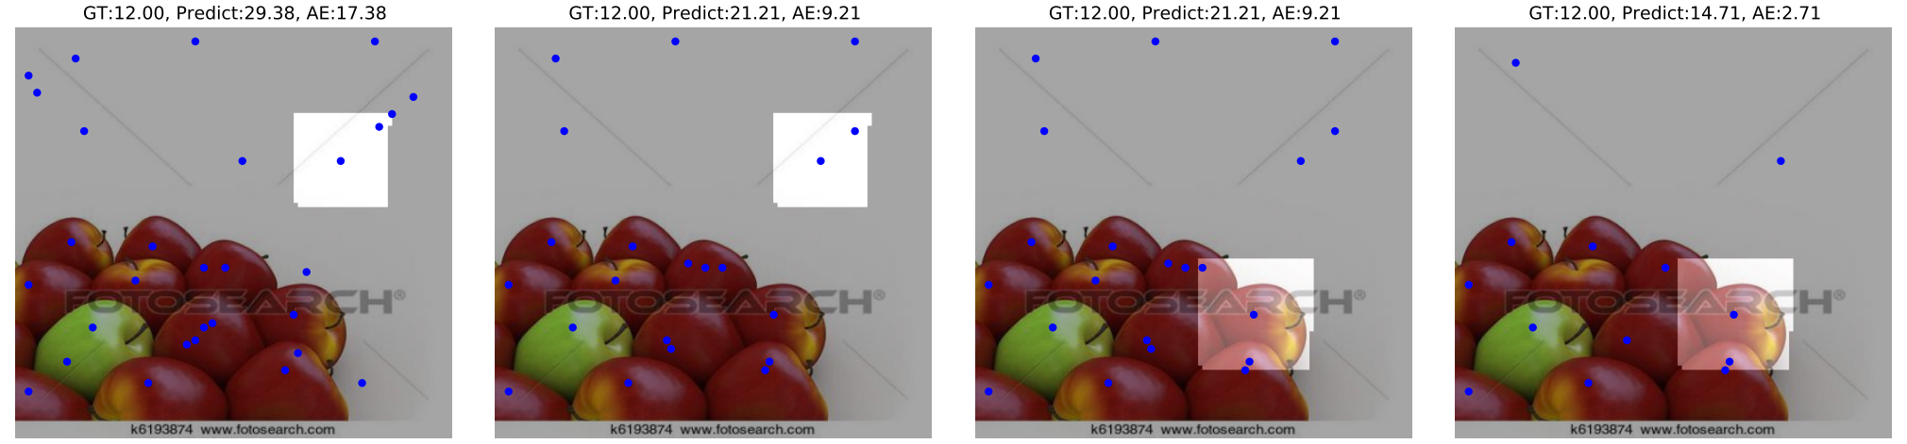
Qualitive Results
Adaptation
Select new
Region
Adaptation
40

Slide 41
Failure Cases
Failure due to the inconsistency between local error and global error.
41

Slide 42
Summary
An interactive framework that allows a human user to quickly detect mistakes
and improve performance based on the identified errors.
Visual
Counter
Density
Estimation
Input Image
with Exemplars
Adaptation
Segmentation
& Visualization
#Objs
Range
$$∈\left\{0\right\}$$
Region selection
& Range specification
$∈$(0,1]
$∈$(1,2]
$∈$(2,3]
$∈$(3,4]
$∈$(4,∞]
Interactive Loop
42

