Slide 1


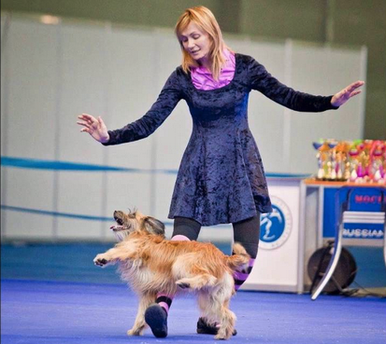


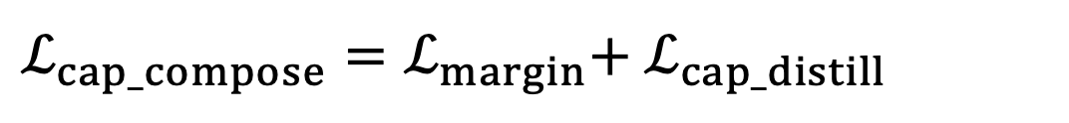
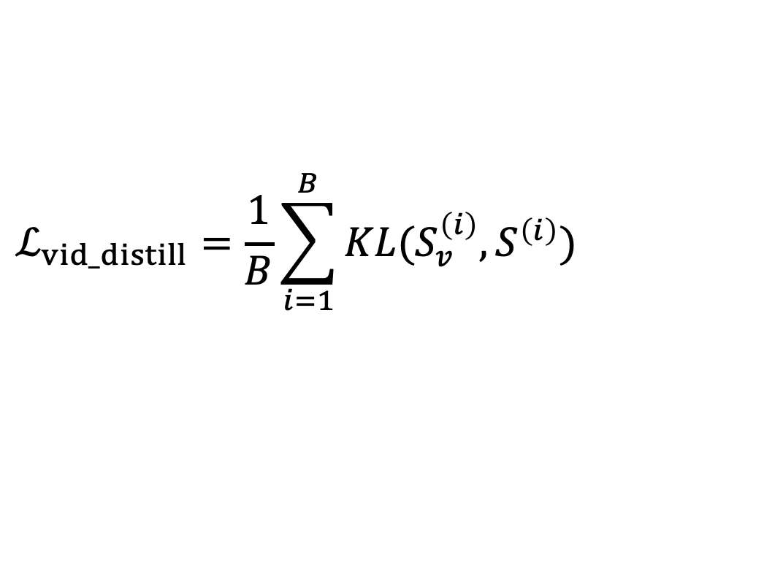
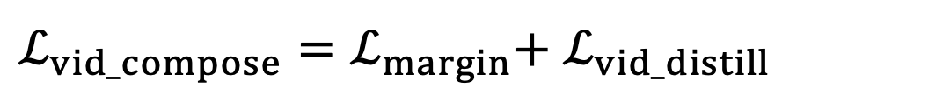
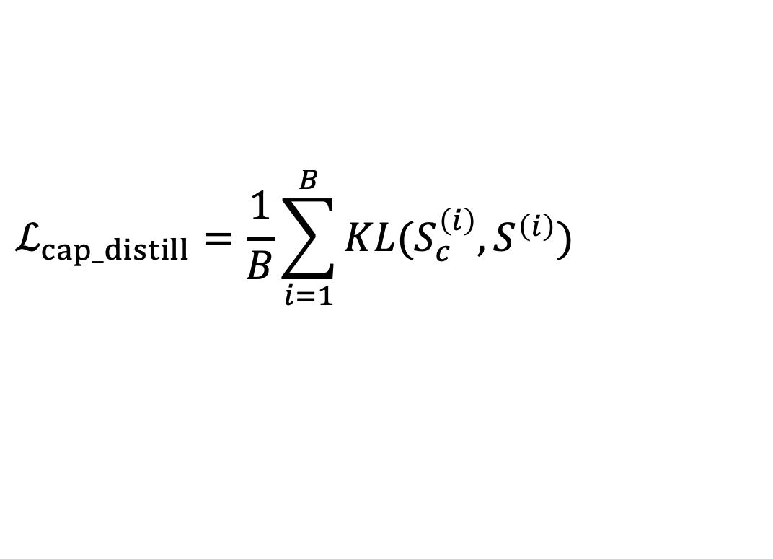
From Within to Between: Knowledge Distillation for Cross Modality Retrieval
Vinh Tran, Niranjan Balasubramanian, and Minh Hoai
Stony Brook University
#629
Text-Video Retrieval
Proposed Text-Video Retrieval Framework
Experimental Results
Text-to-video retrieval
Query: “A woman is dancing with her dog”
Top retrieved videos:
MSRVTT 1k-A
Methods | Rec@1 | Rec@5 | MnR↓
TT-CE+ | 29.6 | 61.6 | -
Frozen | 31.0 | 59.5 | -
MDMMT | 38.9 | 69.0 | 16.5
Clip4clip | 44.5 | 71.4 | 15.3
Ours | 46.2 | 73.1 | 13.2
✗
✔︎
✗
MSVD
Video-to-text retrieval
Query: Top retrieved captions:
Methods | Rec@1 | Rec@5 | MnR↓
CE+ | 25.1 | 56.5 | 17.8
TT-CE+ | 25.1 | 56.8 | 16.8
Frozen | 33.7 | 64.7 | -
Clip4clip | 46.2 | 76.1 | 10.0
Ours | 48.8 | 79.2 | 8.7
✗ A blue sky with an ocean view
✗ Ocean waves hitting the shore
✔️ A bird is flying over the open sea
✗ Big wave hit the rocks
The distillation can be efficiently performed within each training batch
The method is self-supervised and and require no external training data
Motivation
Combined Training Loss
Summary
$$ℒ_{cap_distill}=\frac{1}{B}\sum_{i=1}^{B}{KL(S_{c}^{\left(i\right)},S^{\left(i\right)})}$$
A novel knowledge distillation loss for cross modal retrieval
The loss is self-supervision and can be computed efficiently within each training batch
Neither addtional data or external teacher models are required for training
Framework agnostic, applicable for many retrieval frameworks
Text-distillation:
Video-distillation:
$$ℒ_{vid_distill}=\frac{1}{B}\sum_{i=1}^{B}{KL(S_{v}^{\left(i\right)},S^{\left(i\right)})}$$
Composition loss :
$ℒ_{cap_compose}=ℒ_{margin}$+ $ℒ_{cap_distill}$
Observation: The similarity in the same domain is more reliable than across domains.
Idea 💡 : Knowledge distillation from within domain to between domains
$ℒ_{vid_compose}=ℒ_{margin}$+ $ℒ_{vid_distill}$
Acknowledgements
This material is based on research that is supported in part by the Air Force Research Laboratory (AFRL), DARPA, for the KAIROS program under agreement number FA8750-19-2-1003.

