Slide 1


Slide 2



VinMap
Detecting Omissions in Geographic Maps through Computer Vision
1
2
1
Phuc Nguyen
Anh Do
Minh Hoai
(1) VinAI Research
(2) Ministry of Information and Communications, Vietnam

Slide 3
Contents
Introduction
VinMap Dataset
Our Approach
Results
Conclusion

Slide 4
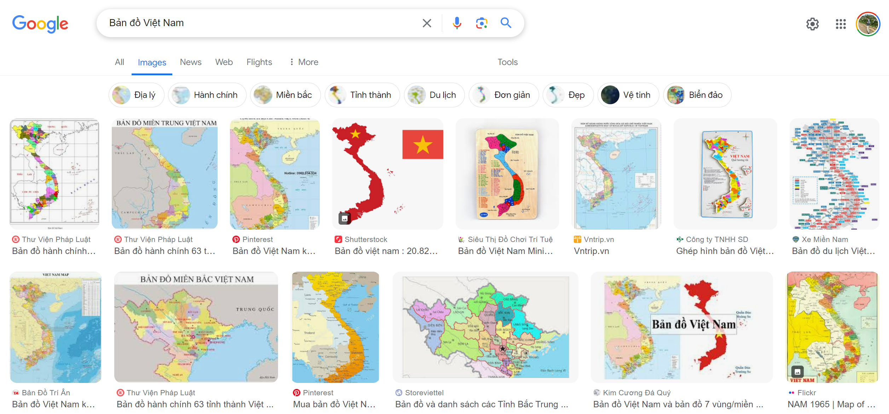
Introduction

Slide 5
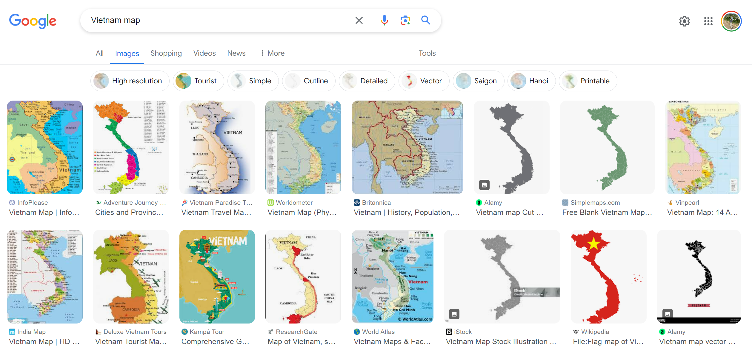
Introduction

Slide 6
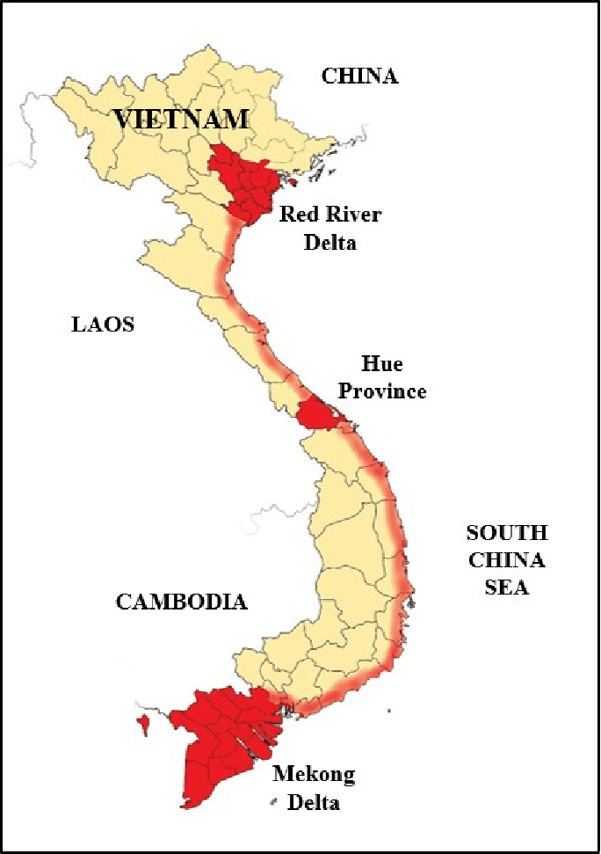



Introduction
We (the Vietnamese people) introduce the problem of Vietnam Map Validity
VinAI Research - MIC employs Technology for validating Vietnam Map

Slide 7
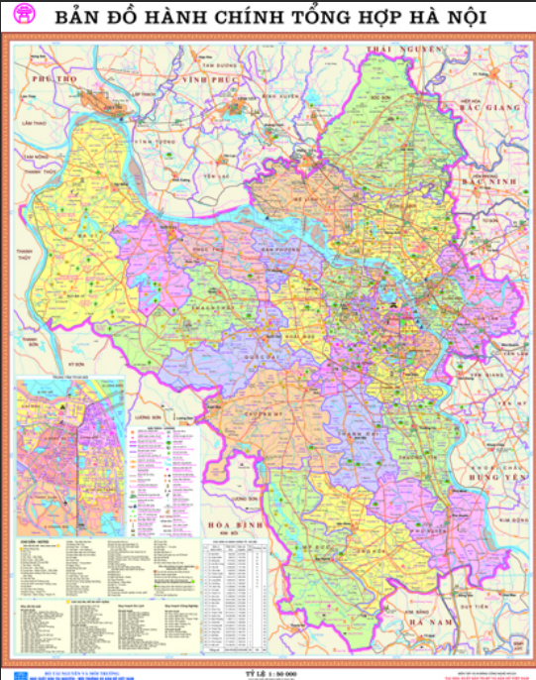
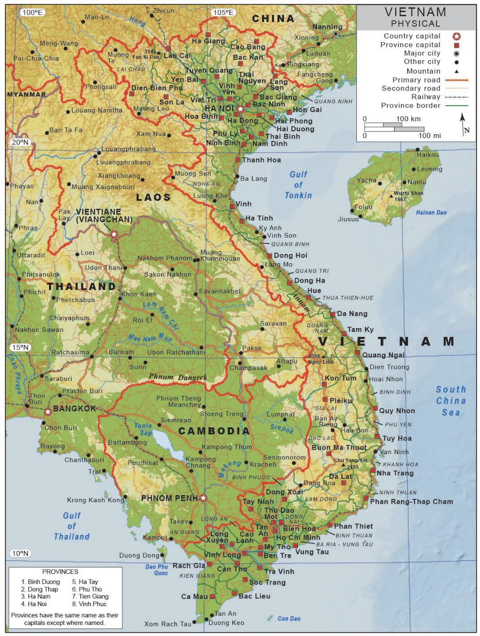
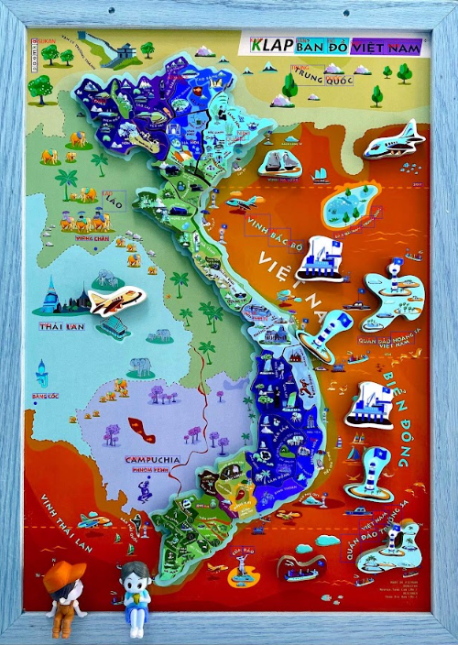
Introduction
Typical challenges for understanding map images:
  Extremely small texts
  Blurry map
  Colorful map
  …

Slide 8
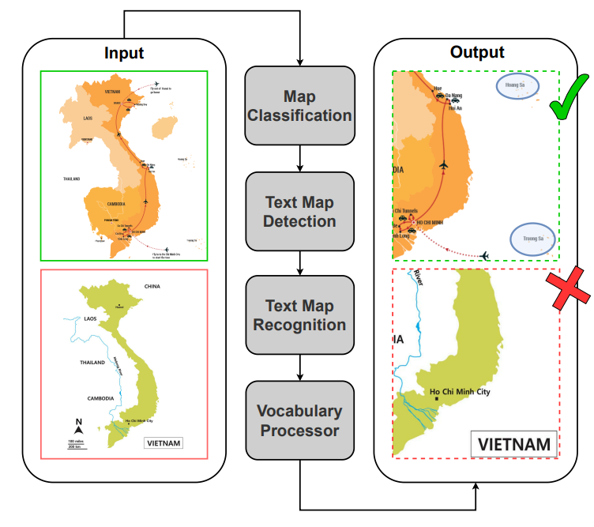
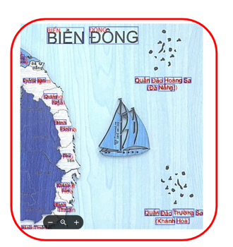
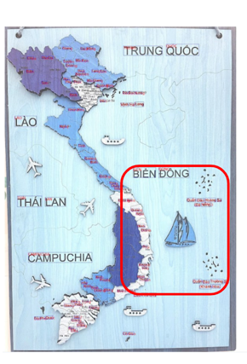
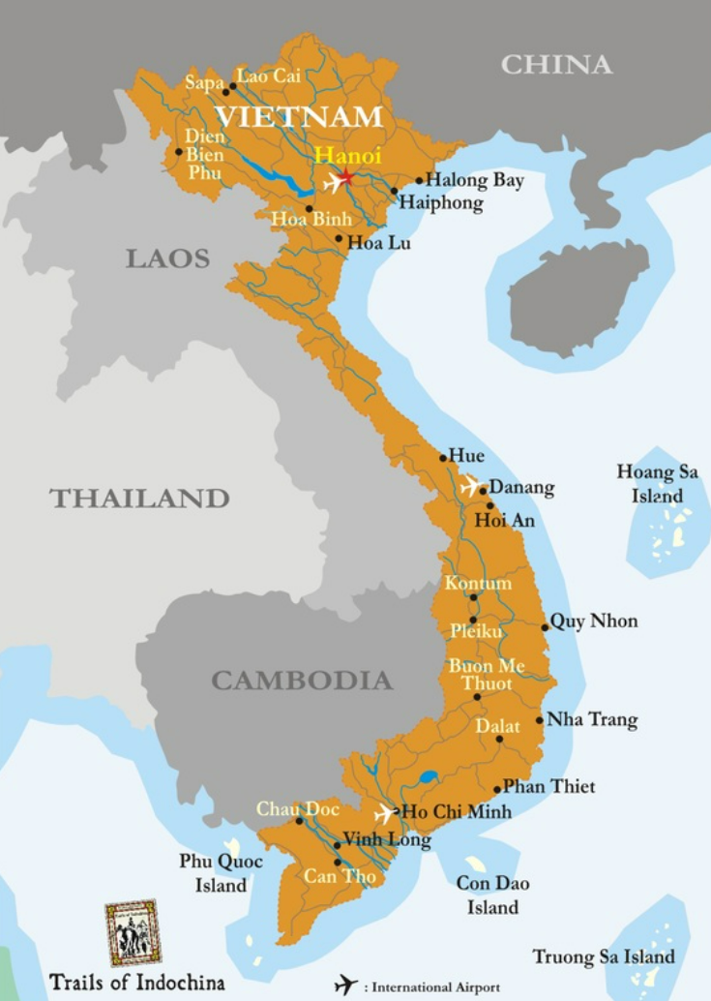
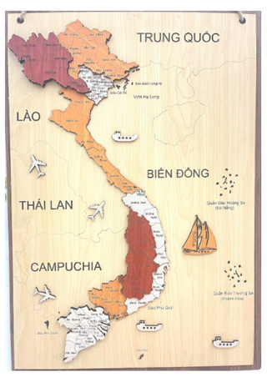
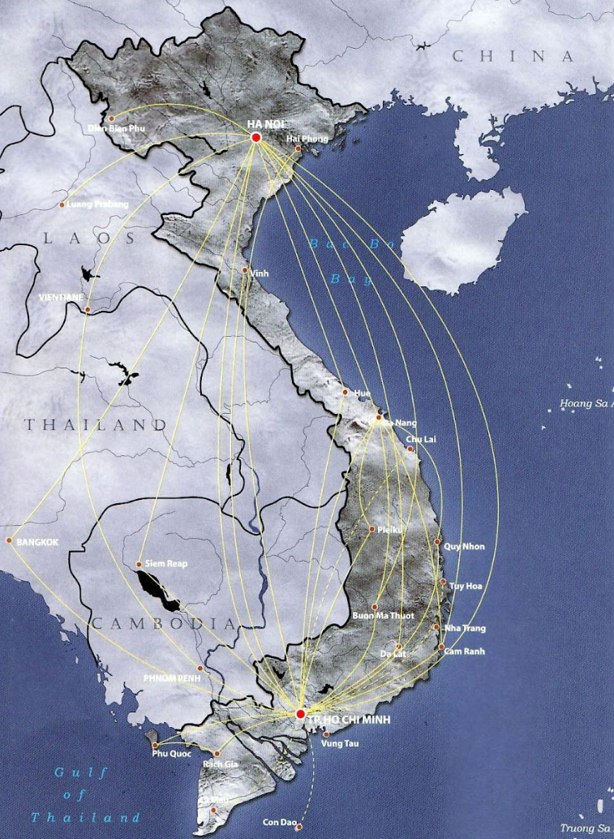
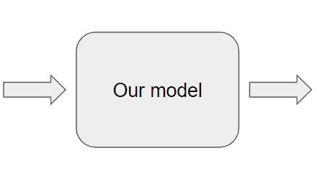
Introduction
Introducing an avenue in map analysis, area for investigation with potential impact
Developing the complete program using Computer Vision technologies

Slide 9
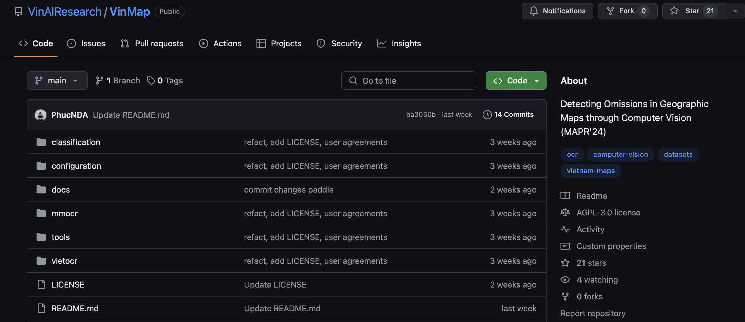
Introduction
Introducing the VinMap dataset, a comprehensive collection of thousands of annotated map images

Slide 10
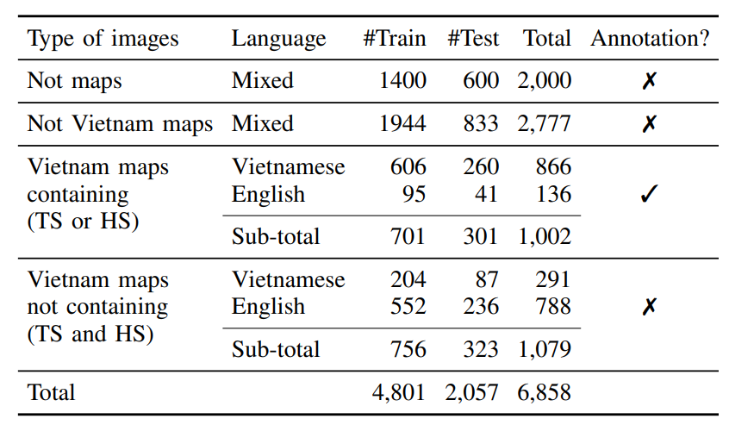
VinMap Dataset
Total 6,858 images
TABLE I: Statistics of the VinMap dataset

Slide 11
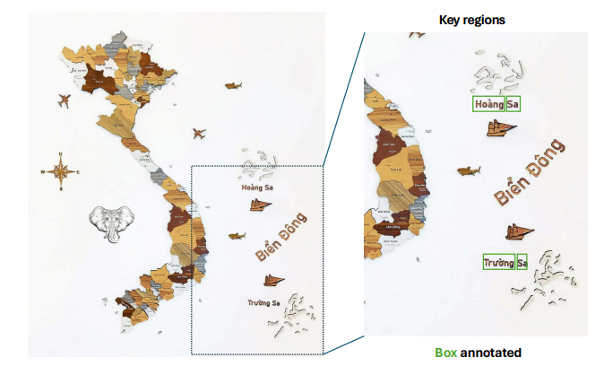
VinMap Dataset
Total 6,858 images
TABLE I: Statistics of the VinMap dataset

Slide 12
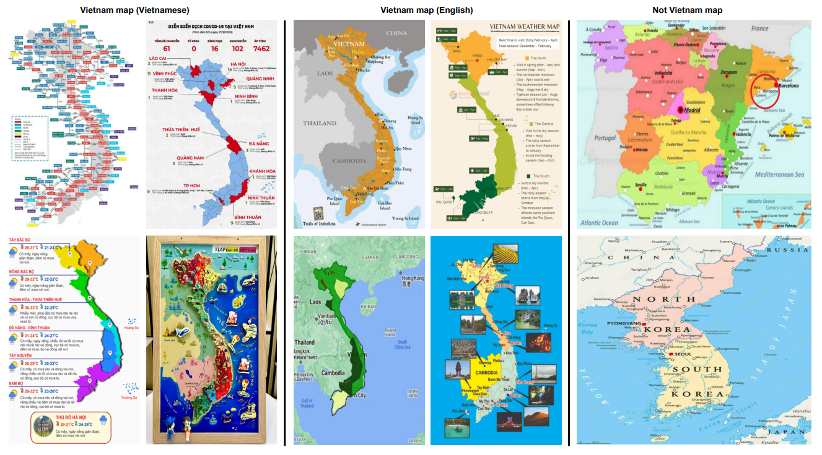
VinMap Dataset

Slide 13
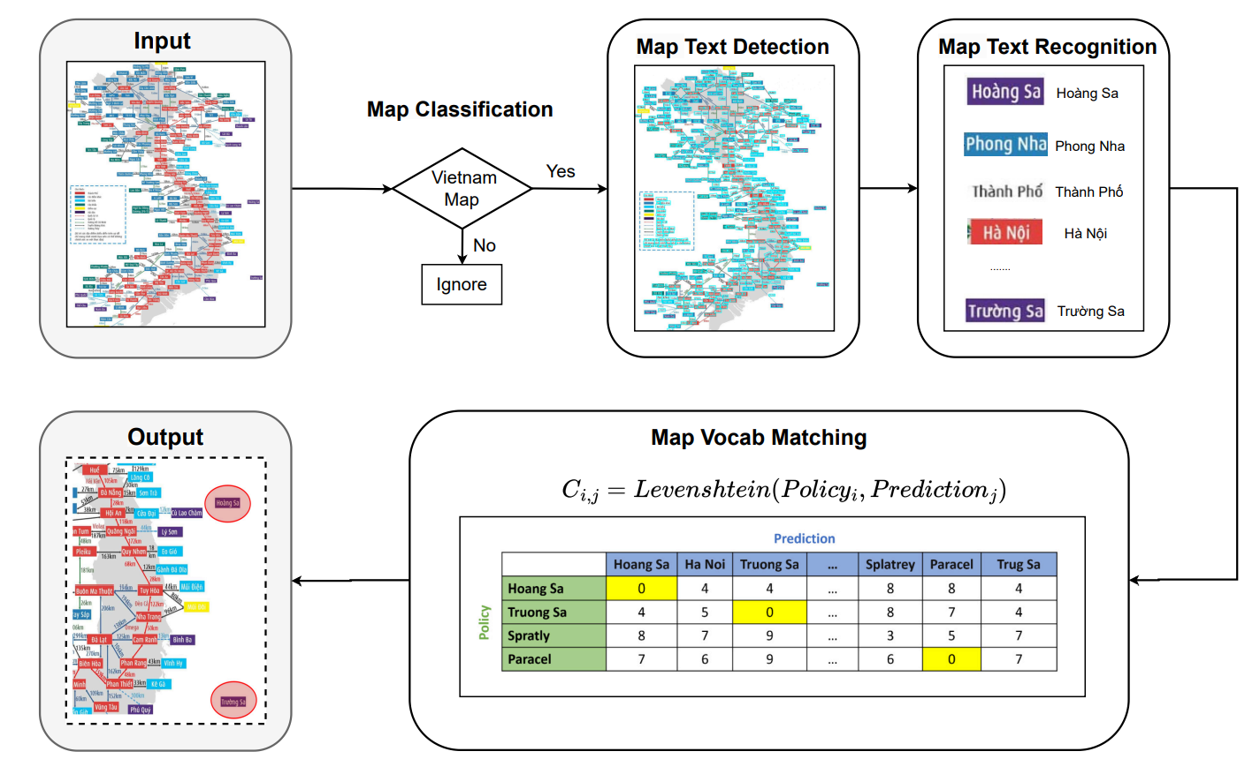
Our Approach

Slide 14
Our Approach
TW ICDAR2015
FW VinText
FW VinMap
TW notmap / map
TW notVN / VN
VietOCR
Trained with: TW
Finetuned with: FW

Slide 15
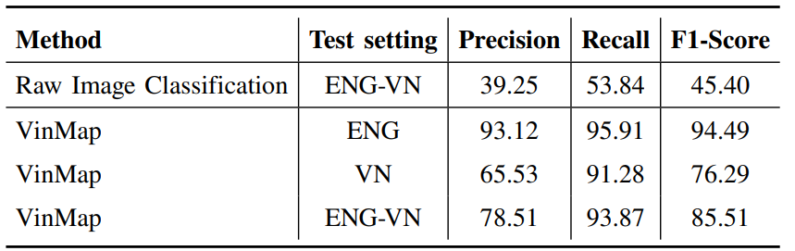
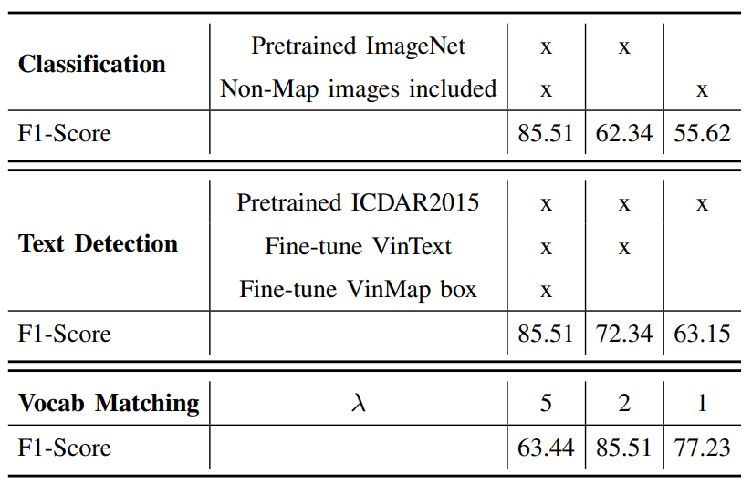
Quantitative Results
TABLE II: Our proposed pipeline and the naive image classification approach
TABLE III: Ablation study
GPU resources: 11GB GeForce GTX 1080 Ti
Runtime: 2-5s / image

Slide 16
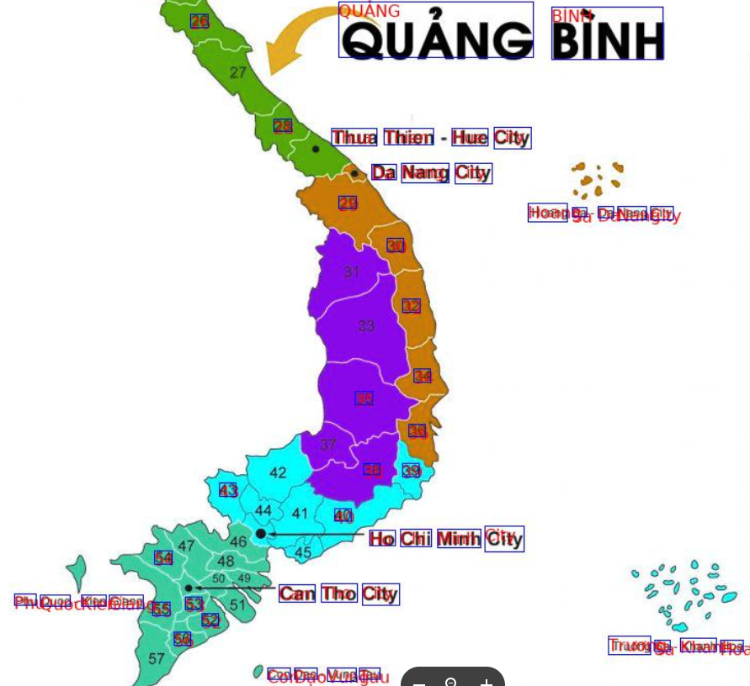
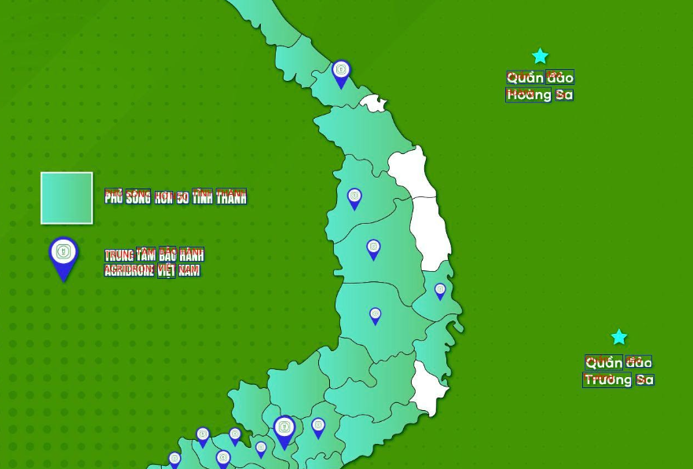
Qualitative Results

Slide 17

Qualitative Results

Slide 18
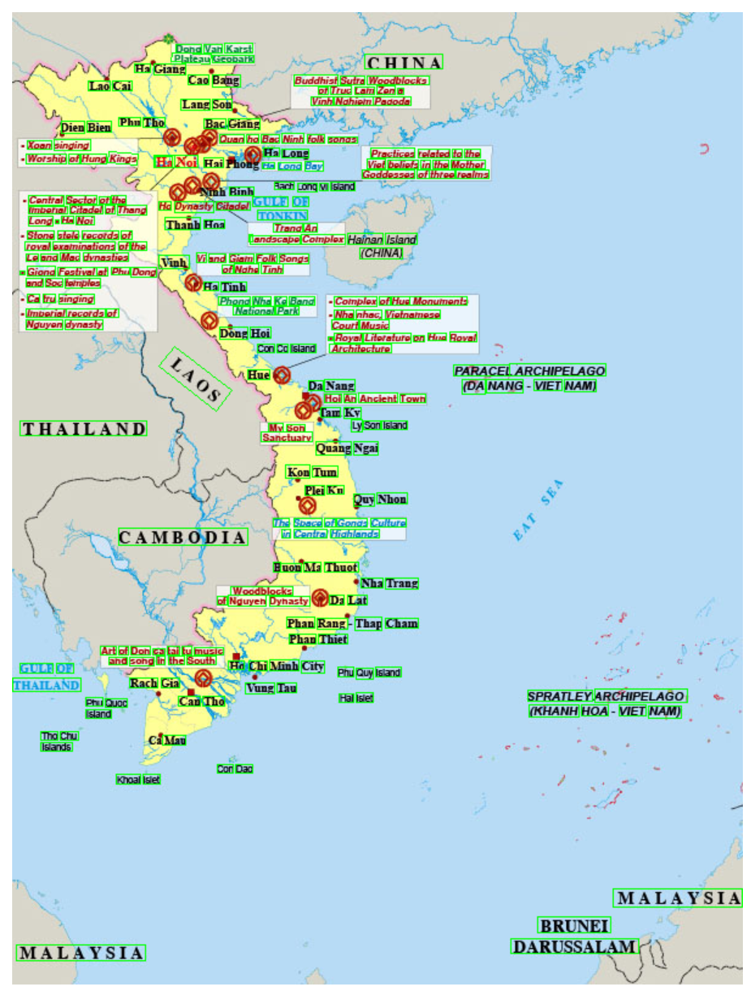
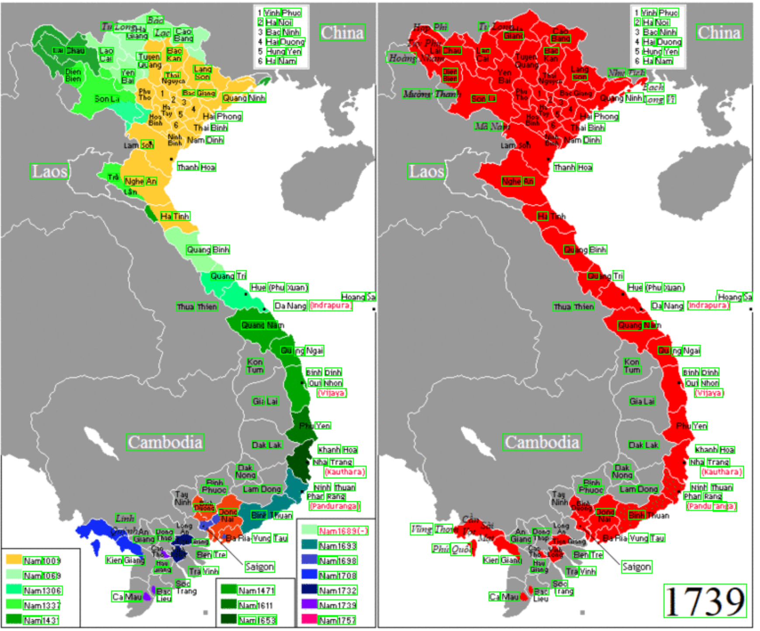
Qualitative Results

Slide 19
Conclusion
Having deployed for real-time website moderator.
Future studies for the VinMap-v2.
Integrating Multimodal Large Language Models for Enhanced Reasoning Capabilities.

Slide 20

VinMap
Detecting Omissions in Geographic Maps through Computer Vision
1
2
1
Phuc Nguyen
Anh Do
Minh Hoai
(1) VinAI Research
(2) Ministry of Information and Communications, Vietnam

