Slide 1
Whose Hands Are These? Hand Detection and Hand-Body Association in the Wild
Supreeth Narasimhaswamy, Thanh Nguyen, Mingzhen Huang, Minh Hoai

Slide 2
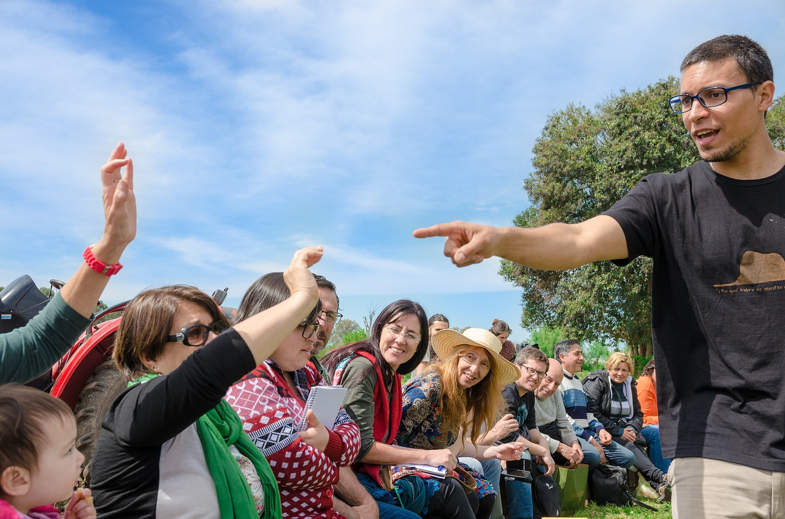
Goal: Detect Hands

Slide 3
Goal: Detect Hands + Localize Corresponding People

Slide 4
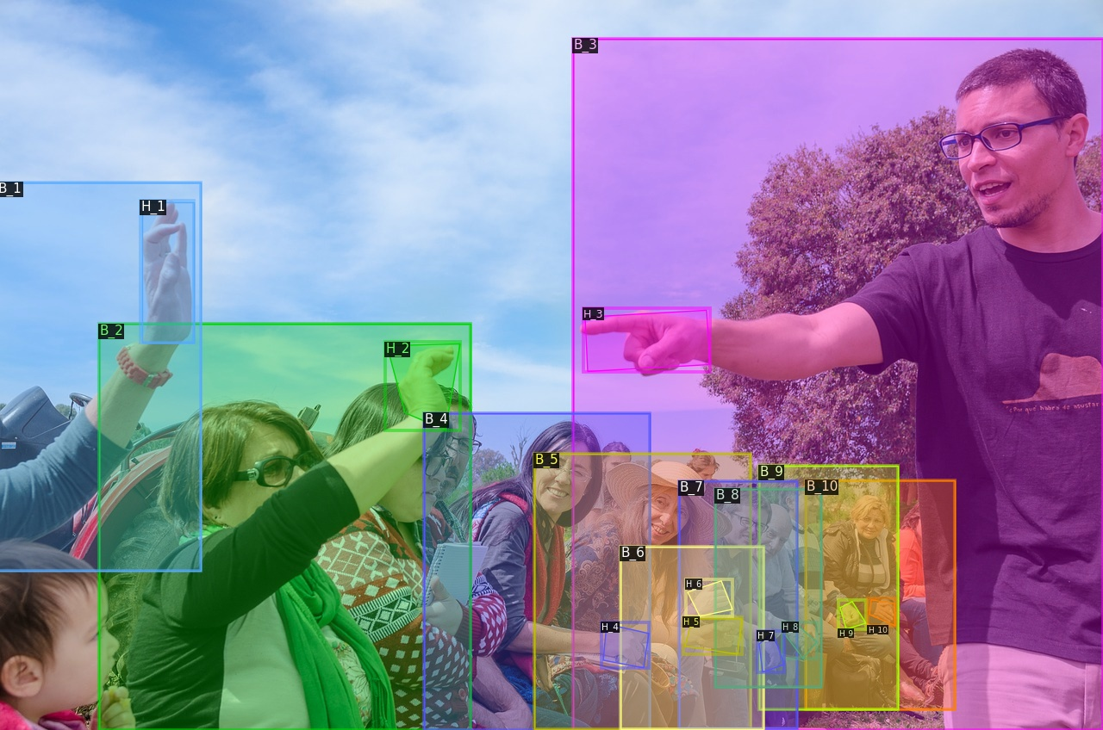
Goal: Detect Hands + Localize Corresponding People
Hands and bodies belonging to the same person have same color and identification numbers

Slide 5
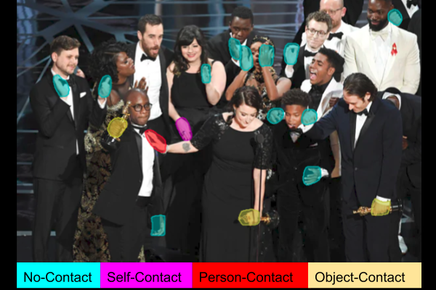
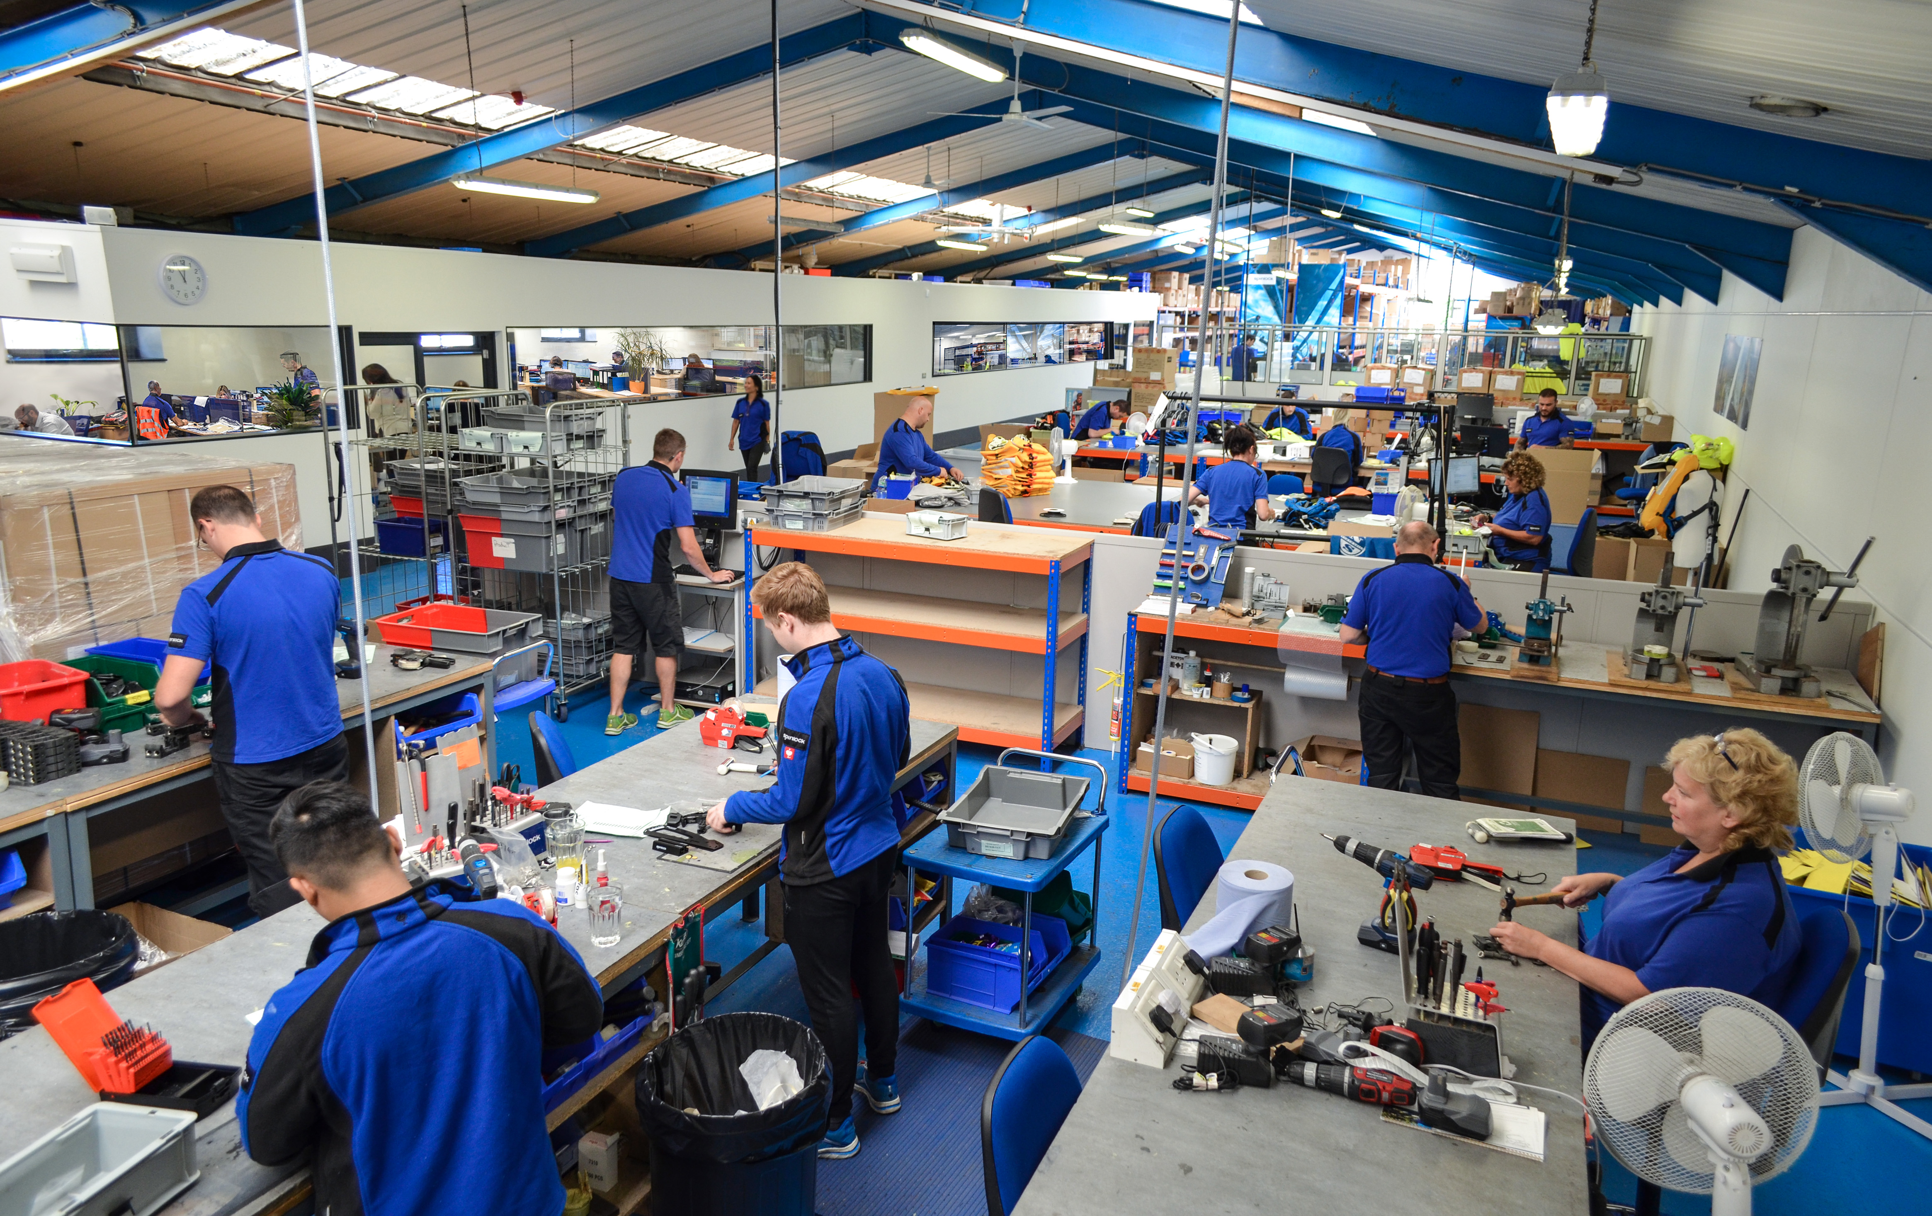
Why is Hand-Body Association important?
Hand Contact Recognition
Safety Applications
Hand Tracking

Slide 6
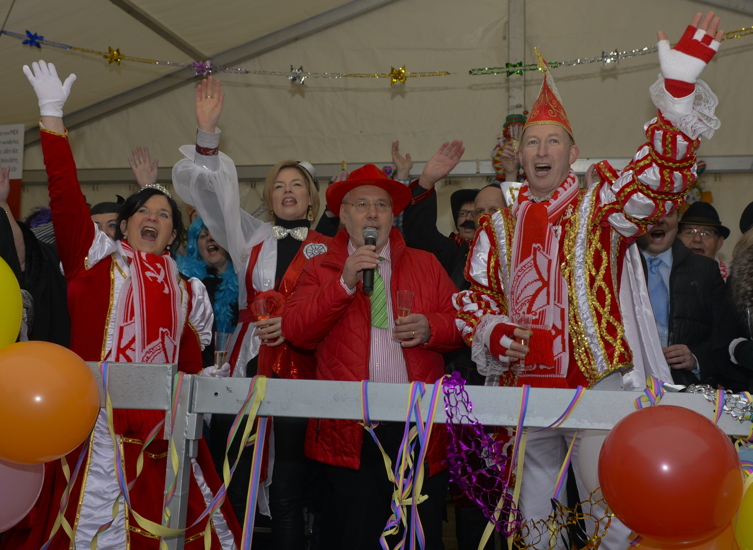
Challenges for Hand-Body Association
Heuristics based on sizes, distances, and overlaps does not work well
Hand box of one person completely overlaps with body box of another person
Large variation in
relative hand-body scales between different people

Slide 7
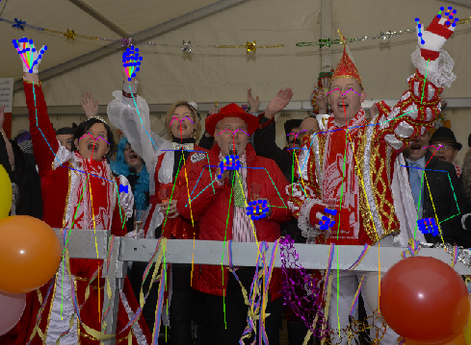
Challenges for Hand-Body Association
Pose-based approaches are not robust
Detected skeletons are mixed up between people
Poses are not detected for occluded people

Slide 8
Contributions
A CNN architecture to jointly detect hands and their corresponding people

Slide 9
Contributions
A CNN architecture to jointly detect hands and their corresponding people
BodyHands dataset: 20K in-the-wild images with annotations for hand and person locations

Slide 10
Method
Based on RCNN framework

Slide 11
Method
Based on RCNN framework
Backbone features

Slide 12
Method
Based on RCNN framework
Hand proposal
b
h
Backbone features
Body proposal

Slide 13
Method
Based on RCNN framework
Hand proposal
b
Hand Box & Mask
h
Body Box & Mask
Backbone features
Body proposal

Slide 14
Method
Based on RCNN framework
Hand proposal
b
Hand Box & Mask
h
Body Box & Mask
Backbone features
Body proposal
Hand-Body Association Module
P(b|h)

Slide 15
Method
Based on RCNN framework
Hand proposal
b
Hand Box & Mask
h
Body Box & Mask
Backbone features
Body proposal
Hand-Body Association Module
P(b|h)
Hungarian
Matching
Hand-Body
Assignment

Slide 16
Hand-Body Association Module
h
Hand-Body Association Module
P(b|h)
b

Slide 17
Hand-Body Association Module
h
Hand-Body Association Module
P(b|h)
b
Under some assumptions: P(b|h) = P(I_{h,b} = 1) P(b | h, I_{h,b} = 1)
Overlap between h & b
Positional density over b

Slide 18
Hand-Body Association Module
Hand-Body Association Module
Overlap Estimation Module
h
P(b|h)
b
Positional Density Module
Under some assumptions: P(b|h) = P(I_{h,b} = 1) P(b | h, I_{h,b} = 1)
Overlap between h & b
Positional density over b

Slide 19
Hand-Body Association Module
Overlap Estimation Module
For each hand h and body b, estimate the probability that they overlap: P(I_{h,b} = 1)

Slide 20
Hand-Body Association Module
Overlap Estimation Module
For each hand h and body b, estimate the probability that they overlap: P(I_{h,b} = 1)
Learn P(I_{h,b} = 1) using the appearance features of h and b

Slide 21
Hand-Body Association Module
Positional Density Module
For each detected hand h, estimate P(b | h, I_{h,b} = 1) over all detected bodies b

Slide 22
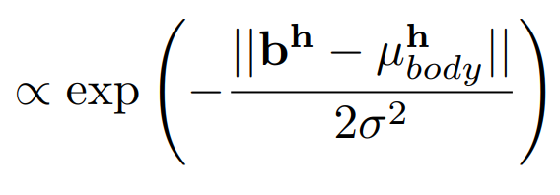
Hand-Body Association Module
Positional Density Module
For each detected hand h, estimate P(b | h, I_{h,b} = 1) over all detected bodies b
Model
P(b | h, I_{h,b} = 1)
Mean body location for the hand h
Learn using the location and appearance features of h

Slide 23
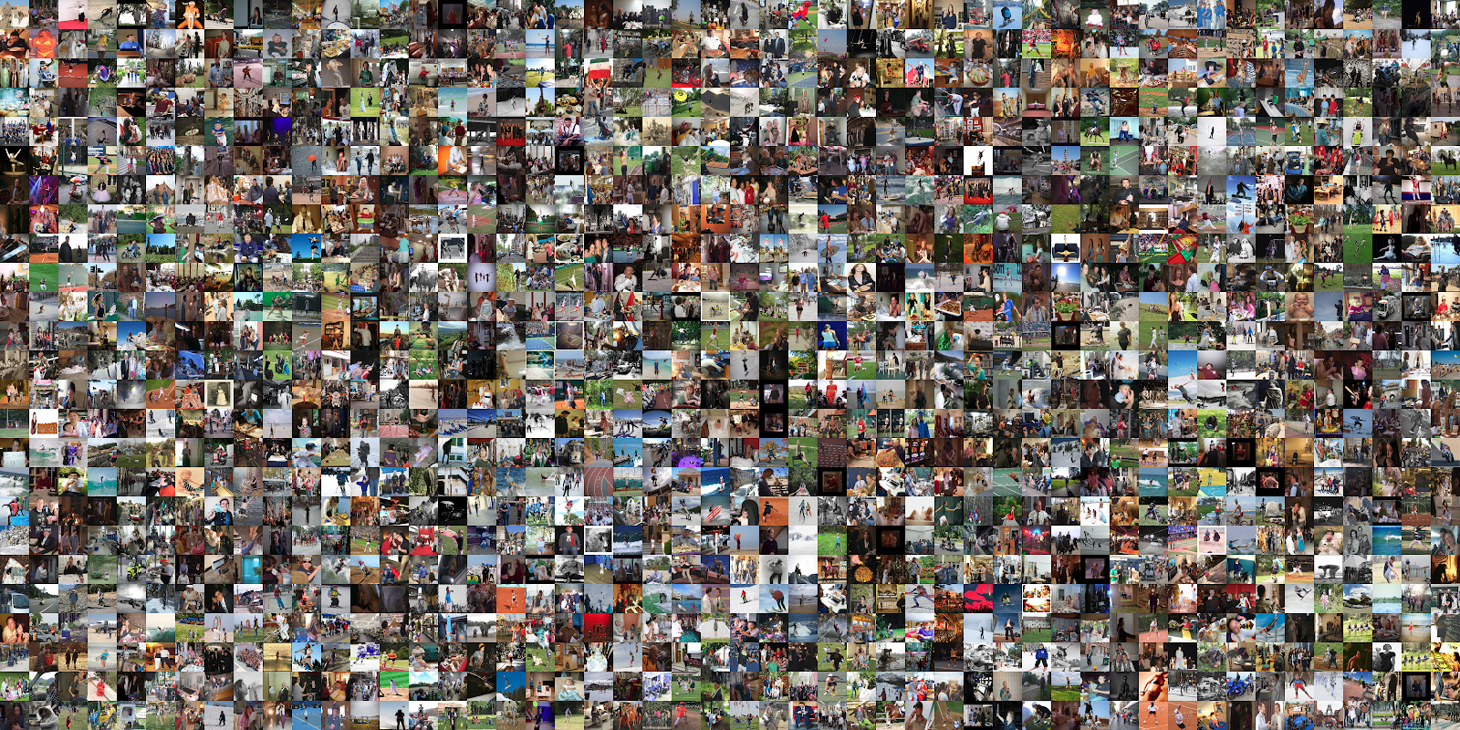
BodyHands

Slide 24
BodyHands Dataset
20K images in-the-wild
Annotations for hand locations and corresponding person locations

Slide 25
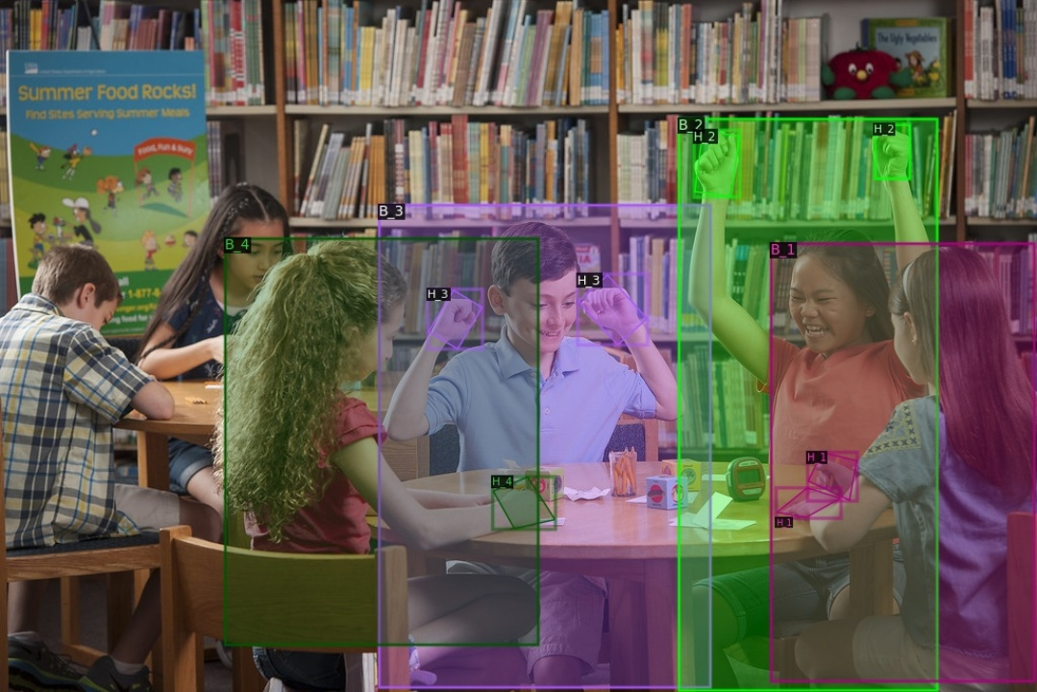
BodyHands Dataset
Hands and bodies belonging to the same person have same color and identification numbers

Slide 26
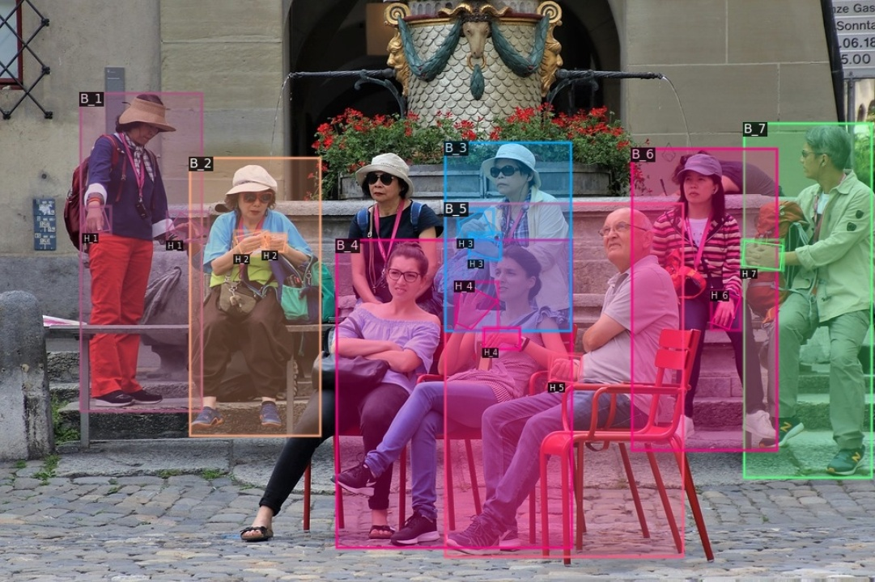
BodyHands Dataset
Hands and bodies belonging to the same person have same color and identification numbers

Slide 27
Quantitative Results
Evaluation Metric
Joint AP for hand detection and hand-body association
True positive: both hand detection and its associated body are correct
Detected hand
Ground truth hand
Associated body
Ground truth associated body
Hand IoU > 0.5
Associated Body IoU > 0.5

Slide 28
Quantitative Results
Method | Joint AP
OpenPose | 27.81
Keypoint Communities | 20.71
Using human pose estimation to associate hands and bodies

Slide 29
Quantitative Results
Method | Joint AP
OpenPose | 27.81
Keypoint Communities | 20.71
Feature Distance | 23.16
Feature Similarity | 23.30
Location Distance | 50.42
IoU | 51.74
Using human pose estimation to associate hands and bodies
Using MaskRCNN to detect hands and bodies & using different association strategies

Slide 30
Quantitative Results
Method | Joint AP
OpenPose | 27.81
Keypoint Communities | 20.71
Feature Distance | 23.16
Feature Similarity | 23.30
Location Distance | 50.42
IoU | 51.74
Proposed | 63.48
Using human pose estimation to associate hands and bodies
Using MaskRCNN to detect hands and bodies & using different association strategies

Slide 31
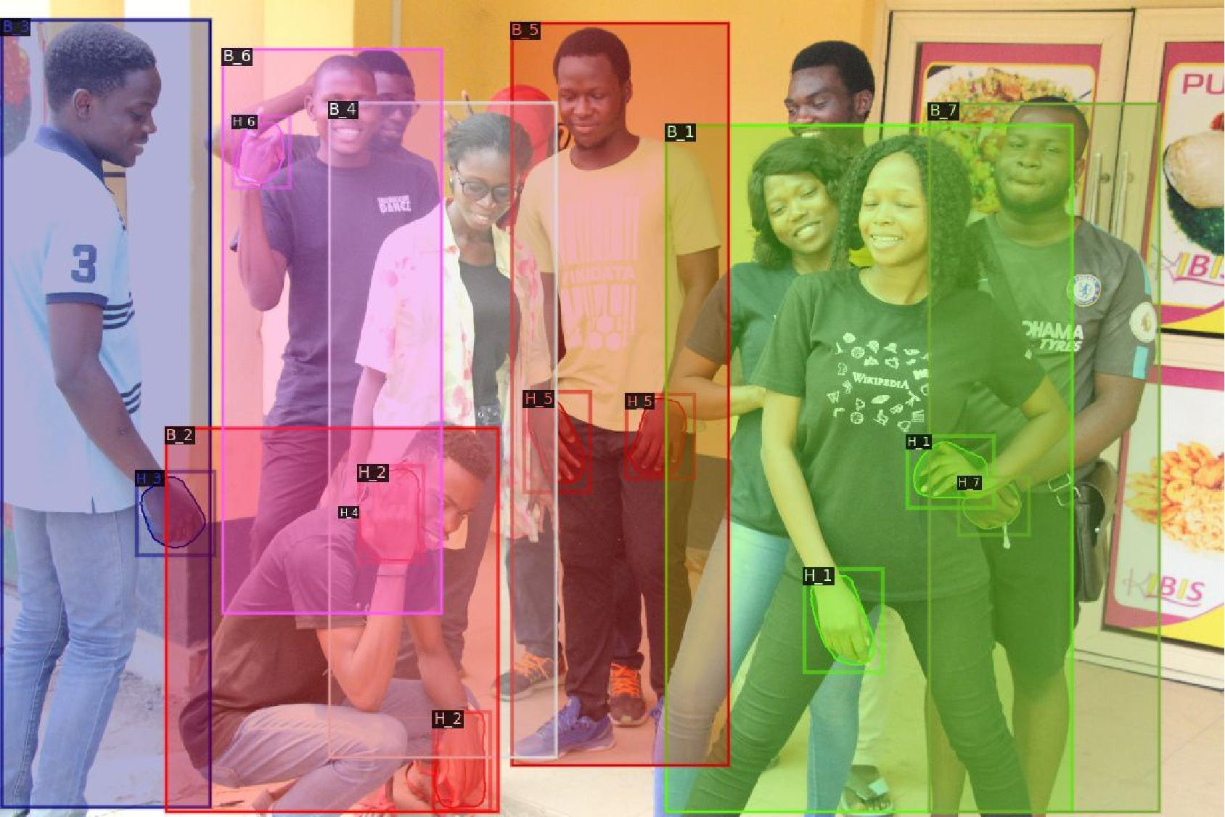
Qualitative Results
Hands and bodies belonging to the same person have same color and identification numbers

Slide 32
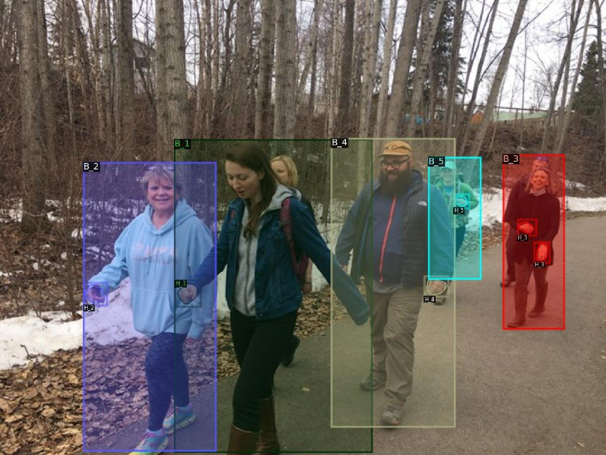
Qualitative Results
Hands and bodies belonging to the same person have same color and identification numbers

Slide 33
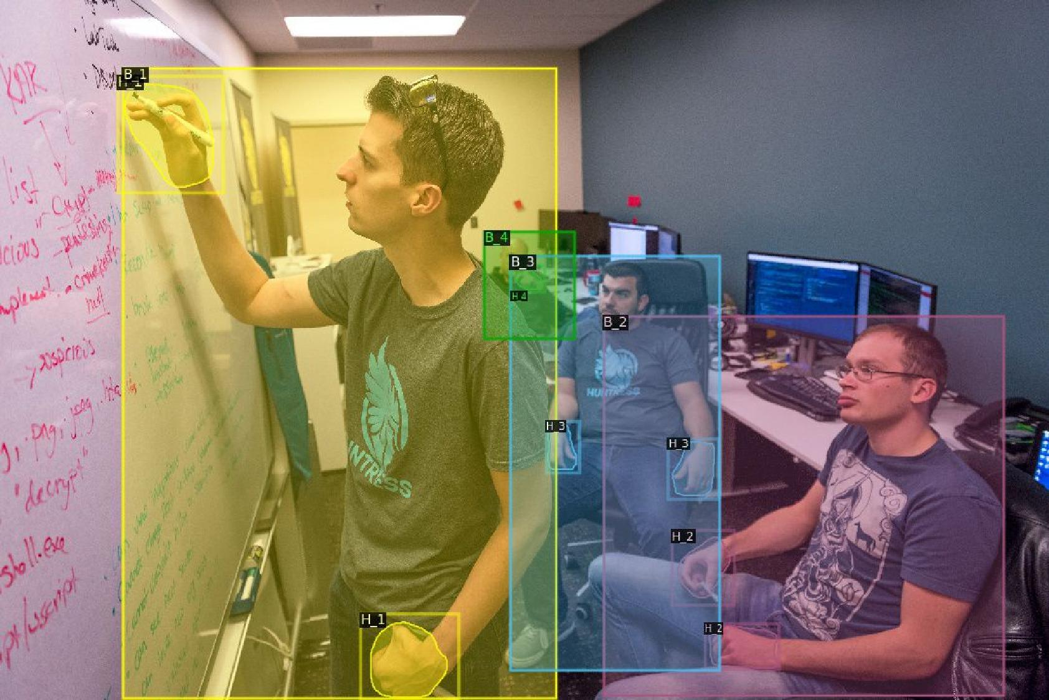
Qualitative Results
Hands and bodies belonging to the same person have same color and identification numbers

Slide 34
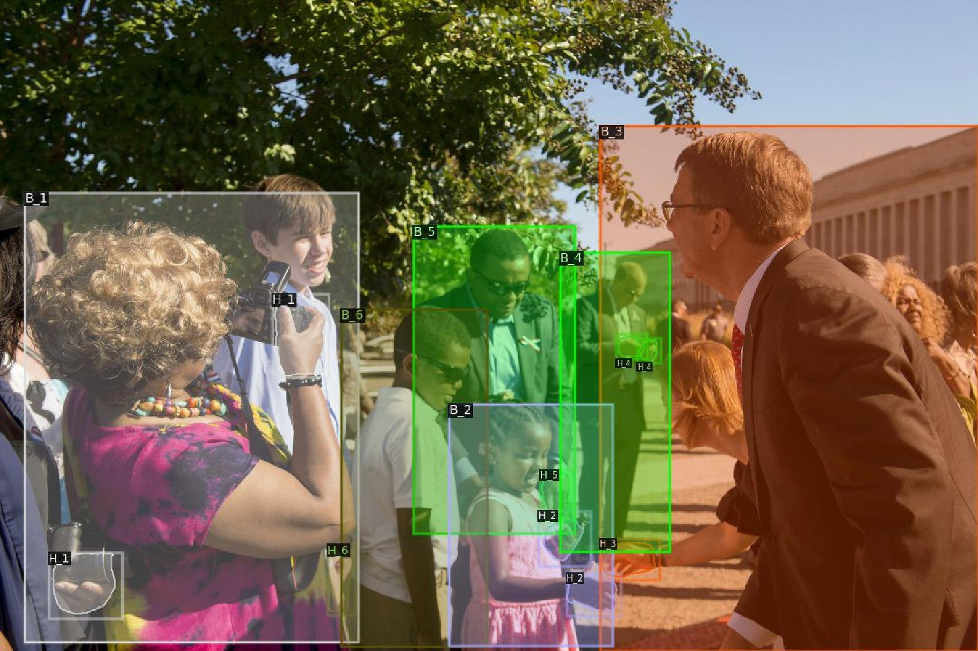
Qualitative Results
Failure case Incorrect hand-body association
Hands and bodies belonging to the same person have same color and identification numbers

Slide 35
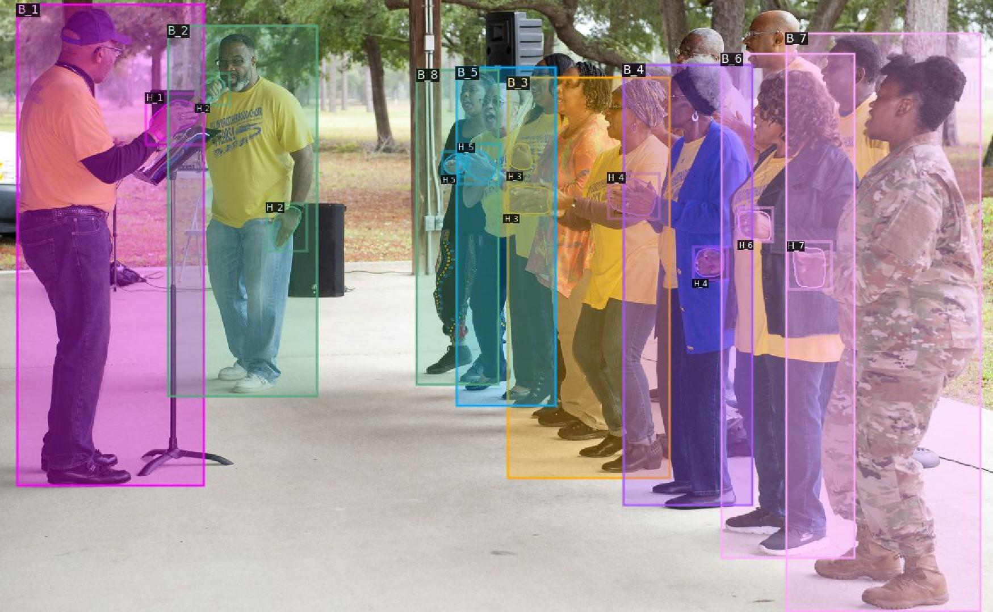
Qualitative Results
Failure case. Incorrect hand-body association
Hands and bodies belonging to the same person have same color and identification numbers

Slide 36
Benefits of Hand-Body Association: Hand Tracking
Tracking-by-detection paradigm: detect hands and link them across frames

Slide 37
Benefits of Hand-Body Association: Hand Tracking
Tracking-by-detection paradigm: detect hands and link them across frames
Hands are fast moving objects and undergo tremendous changes in scale and shape. This leads to large ID switches across frames

Slide 38
Benefits of Hand-Body Association: Hand Tracking
Tracking-by-detection paradigm: detect hands and link them across frames
Hands are fast moving objects and undergo tremendous changes in scale and shape. This leads to large ID switches across frames
Track hands by jointly tracking them with corresponding people

Slide 39
Benefits of Hand-Body Association: Hand Tracking
Tracking-by-detection paradigm: detect hands and link them across frames
Hands are fast moving objects and undergo tremendous changes in scale and shape. This leads to large ID switches across frames
Track hands by jointly tracking them with corresponding people
Method | MOTA
Detect hands and use hand IoU to link them | 46.1
Detect hands and their bodies, and use their weighted IoU | 50.0

Slide 40
Benefits of Hand-Body Association: Hand Contact
Classify hand states
No-Contact
Self-Contact
Other-Person-Contact
Object-Contact

Slide 41
Benefits of Hand-Body Association: Hand Contact
Classify hand states
No-Contact
Self-Contact
Other-Person-Contact
Object-Contact
 | No-Contact | Self-Contact | Other-Person | Object-Contact
AP | 62.48 | 54.31 | 39.51 | 73.34
Most challenging category: Hard to distinguish between Self-contact and Other-person-contact

Slide 42
Benefits of Hand-Body Association: Hand Contact
Classify hand states
No-Contact
Self-Contact
Other-Person-Contact
Object-Contact
 | No-Contact | Self-Contact | Other-Person | Object-Contact
AP | 62.48 | 54.31 | 39.51 | 73.34
Most challenging category: Hard to distinguish between Self-contact and Other-person-contact
Using both the hand features and its corresponding person features reduces ambiguity
Method | Other-Person-Contact
Using only hand features | 39.51
Using both hand & its body features | 47.09

Slide 43
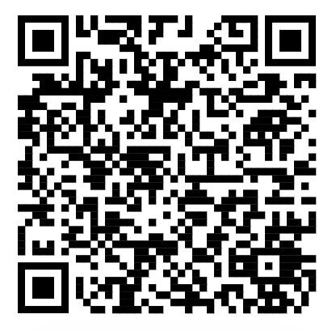
Summary
Hand-Body Association
Dataset
BodyHands
http://vision.cs.stonybrook.edu/~supreeth/BodyHands/

