Slide 1


Exemplar-Based Early
Event Prediction in Video
Zekun Zhang¹, Farrukh M. Koraishy², Minh Hoai¹
¹Department of Computer Science, Stony Brook University
²Division of Nephrology, Department of Medicine, Stony Brook University
Notes:
My name is Zekun Zhang, and I am glad to present this BMVC 2021 poster to you, exemplar based early event prediction in videos.
This research is conducted by researchers in stony brook university.

Slide 2
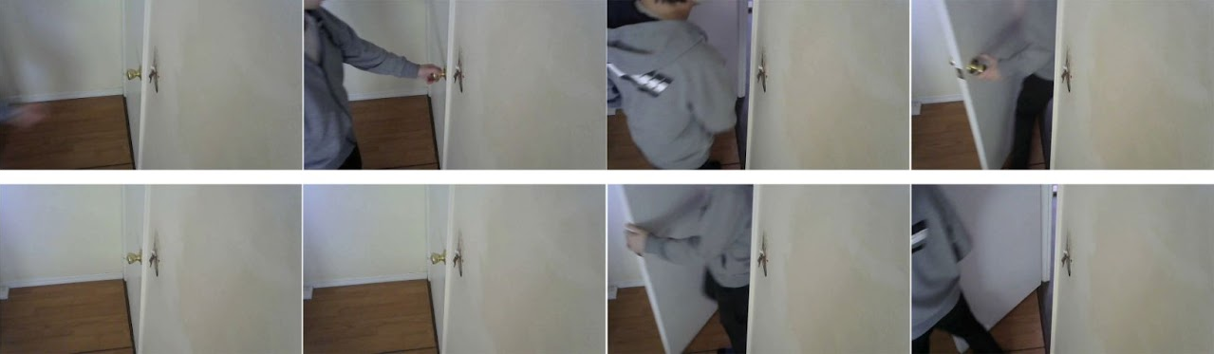
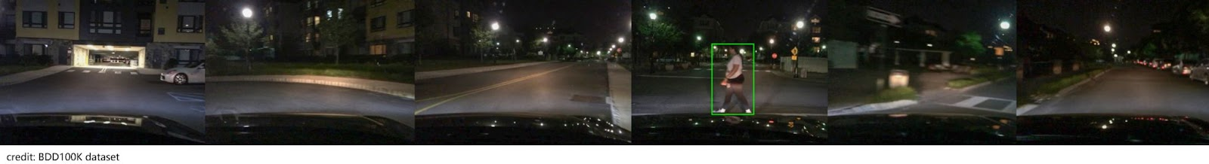
Why is video prediction difficult in general?
Notes:
Generally speaking, video prediction is a difficult task, because future always has some randomness to it. By nature it is more difficult than recognition or detection.
On top of that, the target event we are interested in can be quite sparse in the whole video stream. We usually only have this sparse training signal when learn a predictor. This poses difficulties for model to be optimized.
And not all target events are equally predictable. If we mount a camera inside a room and use it to predict if the door will be opened. It is only possible when the door is opened from the inside.
It is important to consider this during learning, because fitting to unpredictable events can be harmful to overall performance.

Slide 3
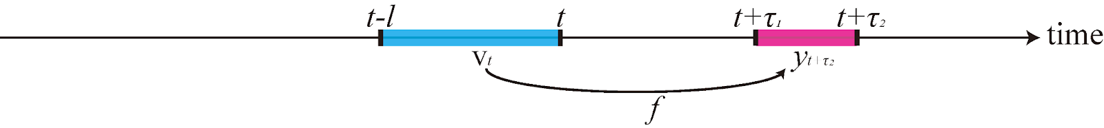
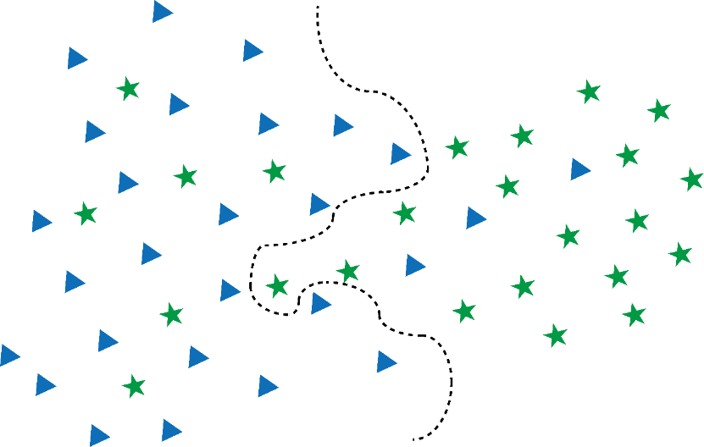
Use deep classifiers as video predictors?
Deep models are data & annotation hungry
Not easy to learn on unbalanced datasets
Treat all samples equally
Training samples & annotations are sparse
Training samples are highly unbalanced
Can fit to noise in unpredictable events
for in mini-batch
Notes:
This means a straight forward prediction model is not guaranteed to work.
First, large models are data and annotation hungry, while in many problems they are sparse.
Second, prediction models can be sensitive to unbalanced datasets, while in many cases the positive samples is much fewer than negatives.
Third, most models treat all training samples equally. If a training sample is not predictable, the model will still try to fit to it, that is not desirable.

Slide 4
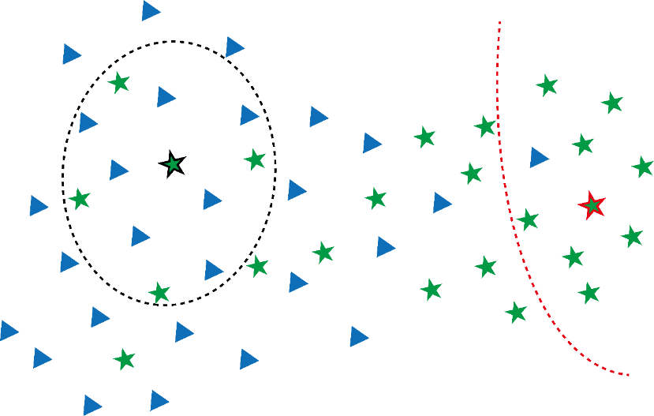
EnEx Predictor Training
for one positive and many negatives
can be solved in one-shot!
Notes:
How to we tackle this problem? Here we have some samples in some sort of feature space.
We have negative samples, the triangles, and positive samples, the stars.
In our EnEx model, we learn an individual exemplar classifier from only one positive sample and many negative samples. The model is a kernel SVM, and we show that all the classifiers can be learned in one shot, so it is very efficient.
Our model produces smooth decision boundaries, and is not sensitive to data imbalance.

Slide 5
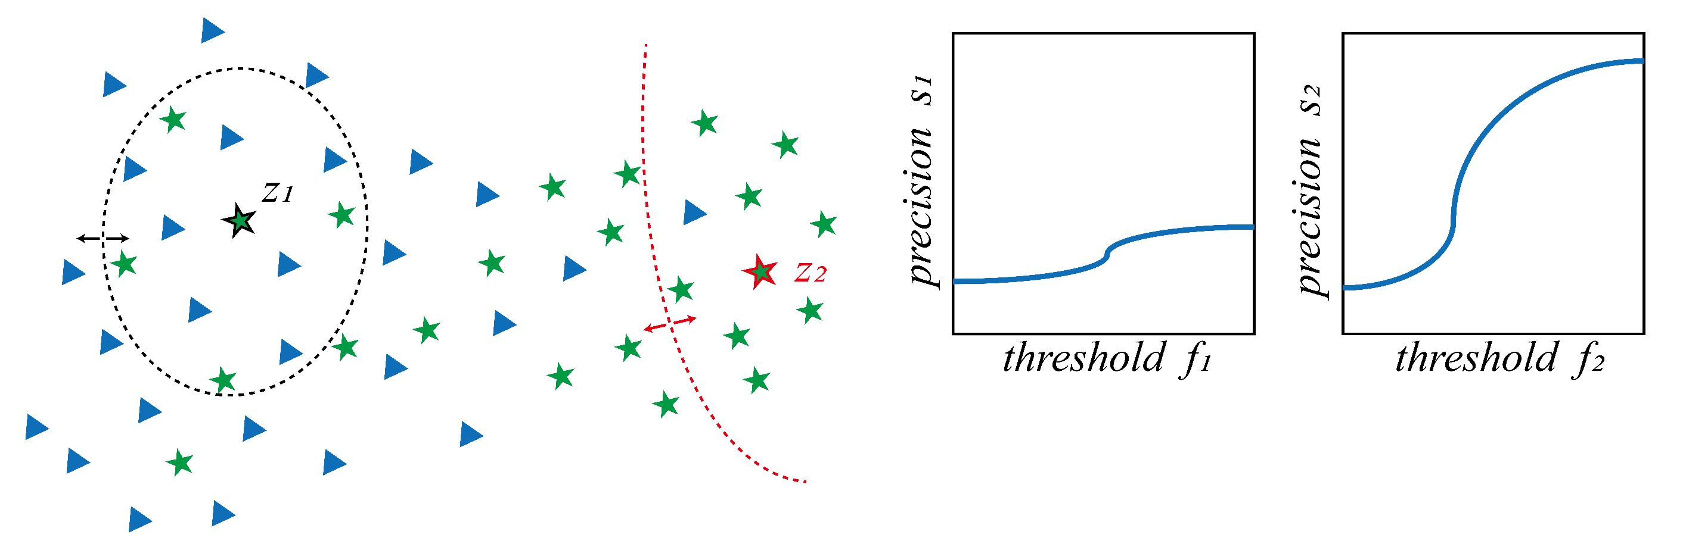
EnEx Predictor Calibration and Combination
Notes:
Now we can calibrate each exemplar classifier to distinguish between predictable positives and unpredictable positives.
We vary the output threshold for each exemplar classifier, and calculate its precision value on a held-out set. By doing this, good exemplars will get more attention.
Then we use a learned weight vector to combine them.
Now our model will rely more on good exemplars so the overall prediction precision is improved.

Slide 6
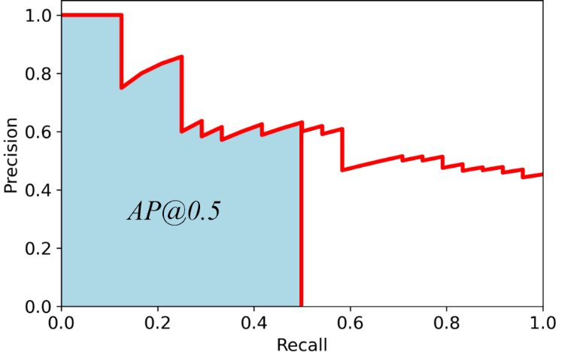
Experiment Results
model | PhonePickup 0.5s |  | OpenDoor 2s |  | EpicKitchen Top-5 |  | Covid19-AKI
 | AP@0.1 | AP@1.0 | AP@0.1 | AP@1.0 | AP@0.1 | AP@1.0 | AP@0.1 | AP@1.0
LogReg | 41.0 | 26.3 | 65.9 | 38.2 | 34.6 | 21.9 | 50.0 | 28.8
LSSVM | 65.8 | 32.4 | 61.3 | 39.1 | 40.5 | 23.6 | 57.8 | 34.0
SVM | 62.6 | 33.1 | 70.8 | 40.8 | 44.1 | 22.4 | 61.4 | 36.3
5-NN | 23.6 | 21.8 | 69.6 | 38.1 | - | - | 41.1 | 20.4
eSVM | 53.7 | 29.6 | 80.3 | 43.1 | 25.7 | 13.3 | 46.7 | 30.5
MLP | 53.2 | 30.0 | 54.5 | 31.1 | - | - | 56.5 | 33.3
ResNet | 68.1 | 38.4 | 57.7 | 31.5 | 41.9 | 22.5 | - | -
ruLSTM | 76.9 | 33.2 | 61.9 | 26.9 | 40.5 | 29.2 | - | -
EnEx | 82.1 | 38.3 | 79.2 | 44.8 | 45.4 | 23.3 | 67.5 | 39.3
Notes:
Besides ordinary average precision, we also evaluate the models using AP at a certain recall threshold, which is shown here.
It is basically AP of the samples that are predicted with higher confidence. We want to use this metric to prioritize precision over recall.
We tested our methods on two custom datasets: opendoor and phonepickup, the widely-used EpicKitchen, and a non-visual dataset that predicts acute kidney injury in Covid19 patients.
Our model outperforms the baselines in most cases.

Slide 7
Summary
EnEx is designed to predict video events when training samples are sparse and unbalanced
EnEx treats each positive samples separately to prioritizes precision over recall
Code, datasets, features: https://github.com/cvlab-stonybrook/EnEx

