Slide 1

Learning to Count Everything
CVPR 2021
Viresh Ranjan¹, Udbhav¹, Thu Nguyen², Minh Hoai^{1,2}
¹Stony Brook University
²VinAI Research

Slide 2
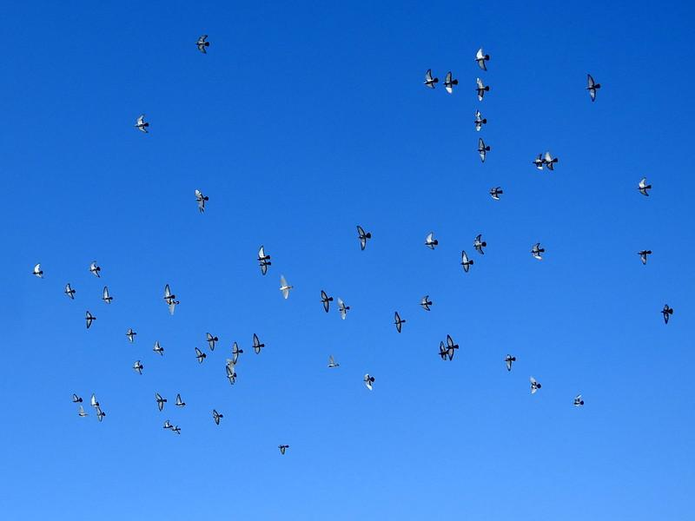

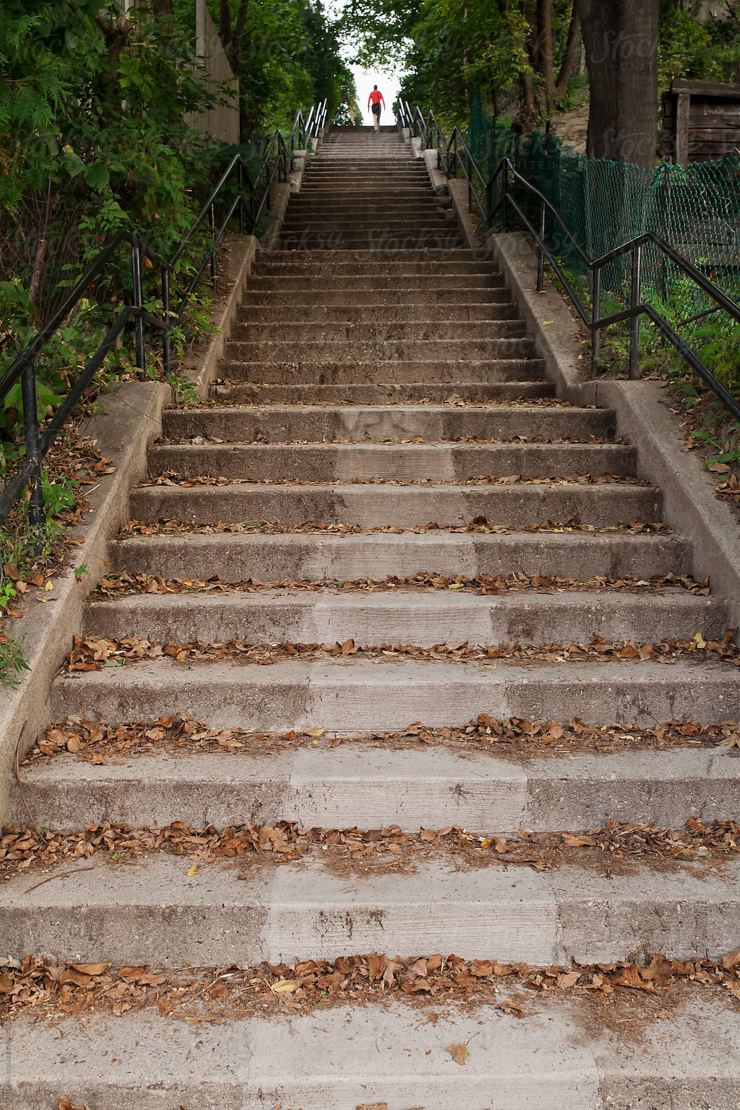
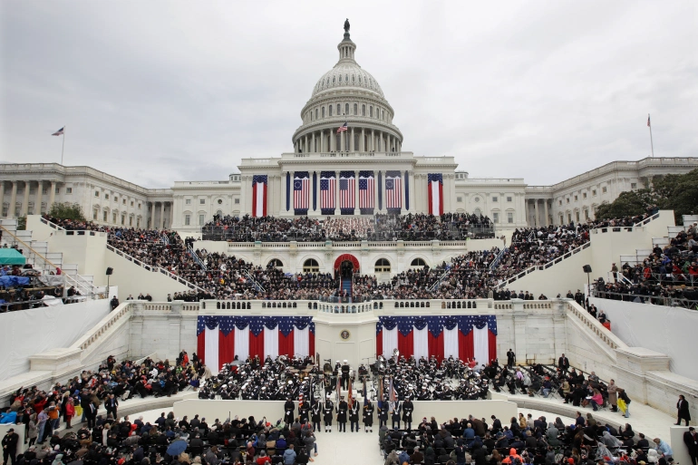

Have you ever wondered?
Notes:
Have you ever seen a flock of birds flying over your head and wondered how many birds are there?
How many people in a crowd?
How many weird windows on the façade of a building?
How many boxes on the shelf?
How many steps you need to climb?

Slide 3
Counting is useful in many situations
Migration tracking
Curiosity Satisfaction
Journalism
Inventory Management
Physical Effort Anticipation
Notes:
Counting is useful in many situations
It can be used for migration tracking, journalism, curiosity satisfaction, inventory management,and physical effort anticipation.

Slide 4
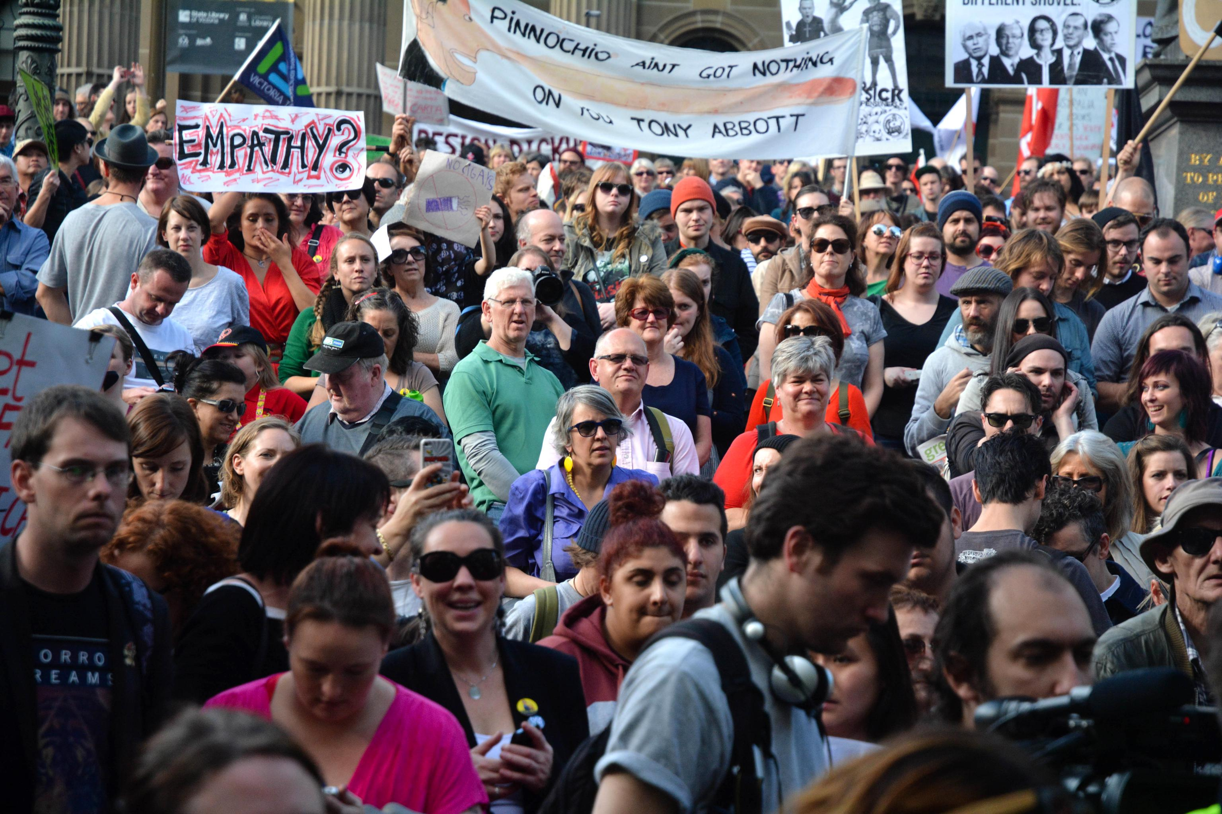
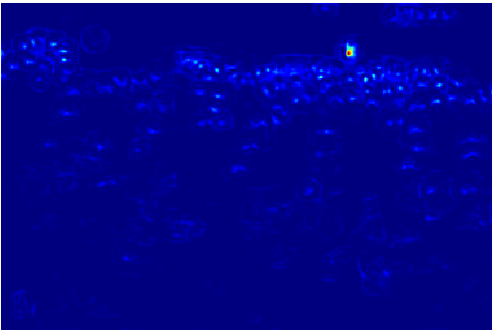
Existing Works for Visual Counting
Crowd Counting
Network
Car Counting
Network
Cell Counting
Network
Notes:
- Visual counting is important problem, and there are many existing works
- But most of them train a specific counting network for a specific object category such as people, cars, cells

Slide 5
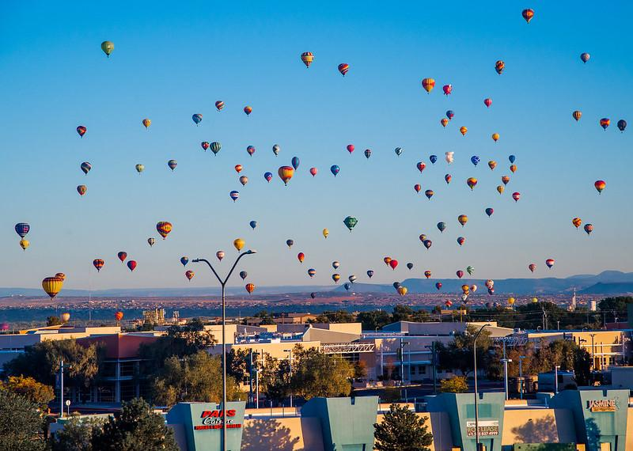
Previous Work for Visual Counting
Existing counting networks won’t work for objects from another category
Crowd Counting
Network
Car Counting
Network
Cell Counting
Network
Notes:
These networks can’t count the objects from a category that they have not been trained on.
The outputs will be garbage.

Slide 6
We can’t afford to train a network every category
Crowd Counting
Network
Name | # images | # People
NWPU-Crowd | 5,109 | 2,133,238
JHU-CROWD | 4,250 | 1,114,785
UCF-QNRF | 1,535 | 1,251,642
ShanghaiTech Part A | 482 | 241,677
UCF_CC_50 | 50 | 63,974
Notes:
And we can afford to train a network for every category, because it takes much data and annotation to train a network
For example, to train a crowd counting network, we need datasets that have thousands of images containing millions of people
Having a single counting network for each category is not a scalable approach

Slide 7
Objective of Our Work
Crowd Counting
Network
Class-agnostic Counting
Network
Car Counting
Network
Cell Counting
Network
Notes:
- In this work, we want to learn a single network for all cateogries.

Slide 8

Objective of Our Work
Learn a network that can count objects of interest from any category
113
Convolutional neural network
Exemplar objects
Notes:
- Our object is to learn a network that can count objects of interest from any category, given a few exemplar objects for that category.

Slide 9


Our Inspiration: Generic Matching Network (GMN)
Requires 10s-100s of examples
Adapting
$$φ$$
$$ψ$$
Erika Lu, Weidi Xie, and Andrew Zisserman. Class-Agnostic Counting, ACCV 2018
Notes:
Our work is inspired by the Generic Matching Network by Lu et al from ACCV’18.
This network contains two blocks: feature embedding and feature matching.
This matching block is meant to be separate from the feature embedding block, and so it is agnostic to the category of the objects so it can count objects in different classes
However, this network still requires an adapting module for the feature extraction, and this adapting module still needs 10s to 100s of training instances
This network is trained on video data, and the pretrained network doesn’t work very well without adaptation or retraining.

Slide 10
Contributions of our paper
A novel method for few-shot counting
  FamNet: Few-Shot Adaptation And Matching Networks
A large-scale dataset for few-shot counting
  FSC147: Few-shot Counting Dataset with 147 classes
Notes:
The contributions of our paper are twofold
First, we present a novel method for few-shot counting, called FamNet, which stands for Few-Shot Adaptation and Matching Network
Second, we introduce a large-scale dataset, called FSC147, which stands for Few-shot Counting Datset with 147 classes

Slide 11
Talk Outline
A novel method for few-shot counting
  FamNet: Few-Shot Adaptation And Matching Networks
A large-scale dataset for few-shot counting
  FSC147: Few-shot Counting Dataset with 147 classes
Experiments
Notes:
This is the outline for the remaining of my talk.
Next, I will describe the method FamNet

Slide 12
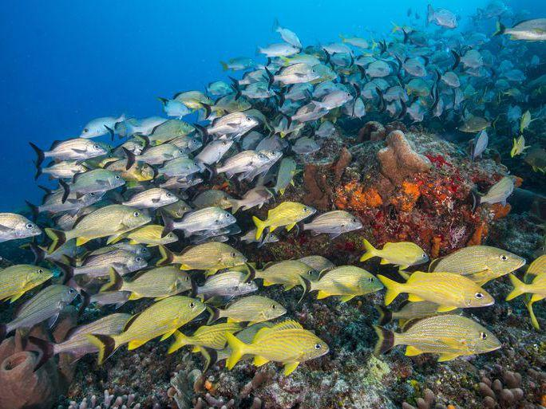

FamNet Processing Pipeline
Exemplar Boxes
Feature Extraction
Module
Feature Correlation
Module
Density Prediction Module
$$∑$$
ResNet50
I will explain next
Notes:
FamNet has three major modules: feature extraction, feature correlation, and density prediction module.
The feature extraction module is ResNet50. I will now explain the other modules

Slide 13
FamNet Processing Pipeline
Feature correlation module
*
1.1
1.0
*
Density Prediction Module
Scale
0.9
*
ROI
pooling
Mean
ResNet50
Feature correlation module
Density Prediction Module
Notes:
Given an image, we use ResNet50 to extract a 3D feature map for the entire image
We use ROI pooling to get the feature tensor for an exemplar object
We scale this feature tensor to different size, and correlate them with the feature map of the entire image.
We have then 3 correlation maps for three scales.
We call this block feature correlation module
If there is another exemplar object, we also pass it through this feature correlation module to get the correlation maps.
Each set of correlation map is passed thru the density prediction module to predict the density map
The density maps are averaged to get the final density map

Slide 14
Density Prediction Module
Conv 196x7x7
RELU
Upsample x2
Conv 128x5x5
RELU
Upsample x2
RELU
Conv 64x3x3
RELU
Upsample x2
Conv 32x1x1
RELU
Conv 1x1x1
RELU
Notes:
- The density prediction module is network with several convolutional, Relu and upsampling layers.

Slide 15
Training FamNet
Exemplar Boxes
Feature Extraction
Module
Feature Correlation
Module
Density Prediction Module
Frozen during training
Sum Squared Differences
Gaussian-smoothed
Ground-truth
dot map
We should’ve used optimal transport loss:
Distribution Matching for Crowd Counting.
B. Wang, H. Liu, D. Samaras, M. Hoai. NeurIPS 2020
Notes:
During training we train the density prediction module by minimizing the sum of squared differences between the predicted density map and the ground truth Gaussian-smoothed dot map
We should have used optimal transport loss, but at the time we started developing this method, the work on optimal transport loss wasn’t ready yet.

Slide 16
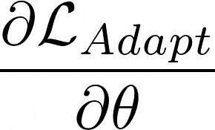
Inference and Test-time Adaptation
Exemplar Boxes
Feature Extraction
Module
Feature Correlation
Module
Density Prediction Module
Notes:
During inference time, we use the network to get the initial prediction presult.
We then look at the density values of the exemplar bounding boxes to adapt the density prediction module
After adaptation, we get the final prediction map and the total count

Slide 17
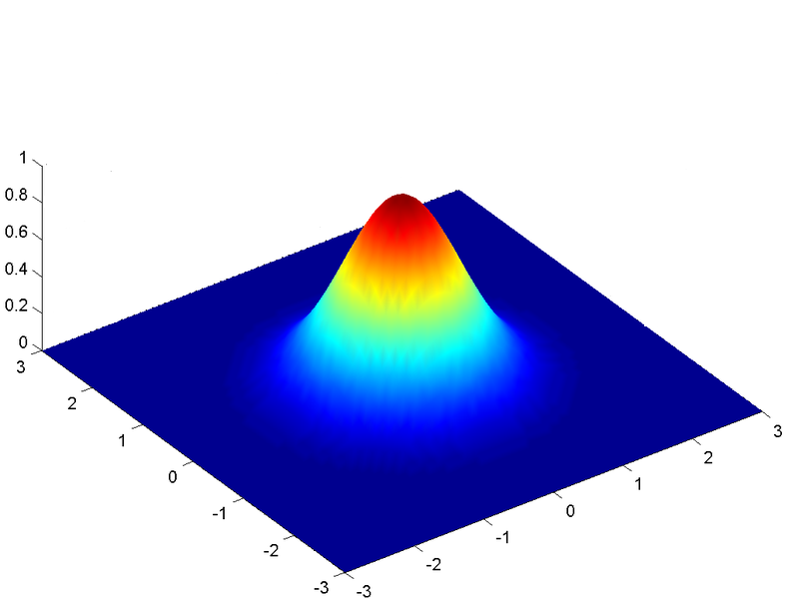
Inference and Test-time Adaptation
Exemplar Boxes
Feature Extraction
Module
Feature Correlation
Module
Density Prediction Module
B₂
B₁
Min-count Loss:
Perturbation Loss:
Adaptation Loss:
Notes:
- The adaptation works as follows.
We know the density values of the exemplar boxes must be at least one, so we enforce a min-count loss
We also introduce the perturbation loss, basically the density value of the pixels within each exemplar box should fall of like a Gaussian as we move away from the center
The adaptation loss is the weighted average of the two.
We run 100 gradient descent step to adapt the density prediction module

Slide 18
Talk Outline
A novel method for few-shot counting
  FamNet: Few-Shot Adaptation And Matching Networks
A large-scale dataset for few-shot counting containing
  FSC147: Few-shot Counting Dataset with 147 classes
Experiments
Notes:
- Let me know explain our second contribution, which is the large scale dataset called FSC147

Slide 19
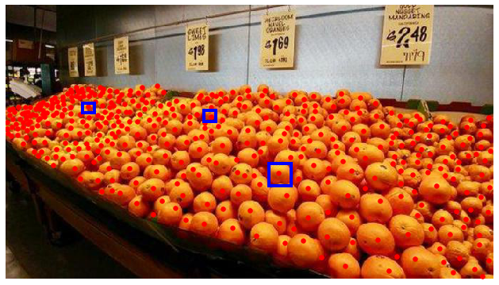
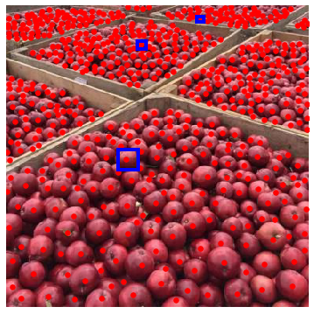
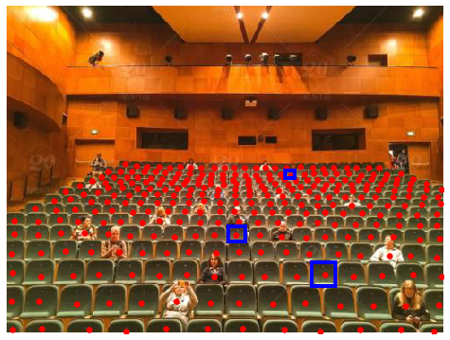
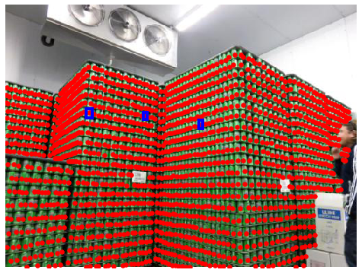
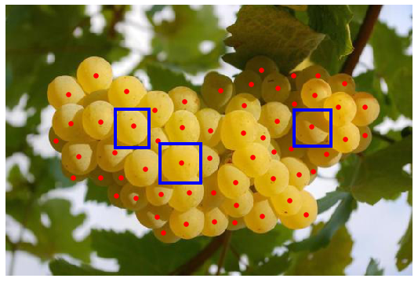
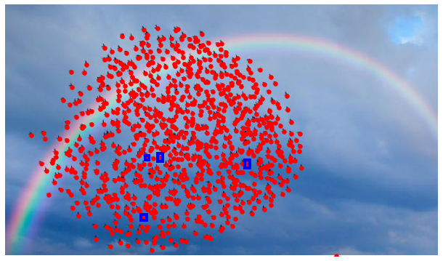
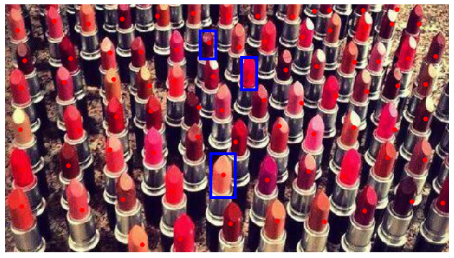
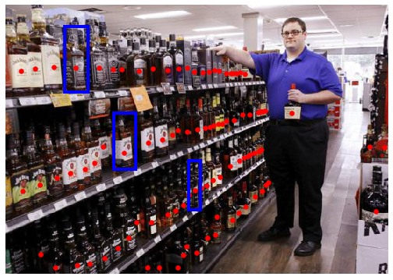
Few-Shot Counting Dataset (FSC-147)
6315 images, 344K objects
Notes:
- This dataset contains > 6000 images with 350K objects

Slide 20

Data Source
Flock of birds
Search keyword:
Quantity Adjective + Object Category
Example keywords:
Flock of birds
Stack of plates
Shelf of books
Row of boats
Pile of oranges
Crowd of people
Many coins
Lot of pencils
Notes:
We collect the data using image search
The search keyword contains quantity adjective + object category

Slide 21
Categories and Super-categories
 | Total | Train | Validation | Test
Images | 6135 | 3659 | 1286 | 1190
Categories | 147 | 89 | 29 | 29
Notes:
These are list of categories and super-categories
Altogether, we have 6135 images and 147 categories

Slide 22
Categories and Super-categories
 | Total | Train | Validation | Test
Images | 6135 | 3659 | 1286 | 1190
Categories | 147 | 89 | 29 | 29
Notes:
The images and categories are divided into disjoint train, validation, test sets
Note that the categories of the subsets are totally different

Slide 23
Number of Objects in Images
Number of objects in all images: 343,818
Number of objects in an image:
  Min: 7
  Max: 3701
  Average: 56
Notes:
- The total number of images is

Slide 24
Comparison to Other Visual Counting Datasets
Notes:
- Compared with other visual counting datasets, our proposed dataset is larger in terms of both images and categories

Slide 25
Talk Outline
A novel method for few-shot counting
  FamNet: Few-Shot Adaptation And Matching Networks
A large-scale dataset for few-shot counting containing
  FSC147: Few-shot Counting Dataset with 147 classes
Experiments

Slide 26
Prediction Results – Coins/Marbles/Bottle caps
GT: 283
Pred: 282.4
GT: 163
Pred: 164.5
Notes:
Our method can counts coins/marbles very well
On the left is the input image with exemplar bounding boxes in yello, and the dot annotations for ground truth
ON the right is the predicted density map, overlaid on the input image, and the predicted count
As you can see, in this example, the error is less than 1.
We can count even when the objects are partially occluded.

Slide 27
Prediction Results – Fruits
GT: 77
Pred: 81
GT: 113
Pred: 116.3
Notes:
We can count fruit in a basket
We can count fruits of different colors/types.

Slide 28
Prediction Results – Animals
GT: 60
Pred: 60.9
GT: 144
Pred: 145.7

Slide 29
Prediction Results – Pills
GT: 65
Pred: 56.3
GT: 76
Pred: 72.2

Slide 30
Prediction Results – Skateboards
GT: 127
Pred: 126.1
GT: 78
Pred: 68.9

Slide 31
Prediction Results – Books
GT: 84
Pred: 78.9
GT: 80
Pred: 85.1

Slide 32
Prediction Results – Chairs
GT: 263
Pred: 259.1
GT: 60
Pred: 72.2

Slide 33
Prediction Results – Shelf Items
GT: 66
Pred: 66.1
GT: 66
Pred: 69.9

Slide 34
Prediction Results – Potted plants
GT: 76
Pred: 87.2
GT: 68
Pred: 65.2

Slide 35
Prediction Results – Clothes and polka dots
GT: 105
Pred: 114.4
GT: 116
Pred: 117.7

Slide 36
Quantitative Evaluation Criteria
Mean Absolute Error (MAE):
Root Mean Square Error (RMSE):

Slide 37
Performance on Test Set
Method Type | Method | MAE | RMSE
Proposed | FamNet | 22.08 | 99.54
Weak baselines | Mean | 47.55 | 147.67
 | Median | 47.73 | 152.46
Few-shot detectors | FR | 41.64 | 141.04
 | FSOD | 32.53 | 140.65
Generic Matching Network | Pre-trained | 62.69 | 159.67
 | Re-trained | 26.52 | 124.57
Meta learning | MAML | 24.90 | 112.68
Notes:
The MAE of our method is 22.08

Slide 38
Performance on Test Set
Method Type | Method | MAE | RMSE
Proposed | FamNet | 22.08 | 99.54
Weak baselines | Mean | 47.55 | 147.67
 | Median | 47.73 | 152.46
Few-shot detectors | FR | 41.64 | 141.04
 | FSOD | 32.53 | 140.65
Generic Matching Network | Pre-trained | 62.69 | 159.67
 | Re-trained | 26.52 | 124.57
Meta learning | MAML | 24.90 | 112.68
Notes:
- It is much better than the weak baselines that usually output mean or median values

Slide 39
Performance on Test Set
Method Type | Method | MAE | RMSE
Proposed | FamNet | 22.08 | 99.54
Weak baselines | Mean | 47.55 | 147.67
 | Median | 47.73 | 152.46
Few-shot detectors | FR | 41.64 | 141.04
 | FSOD | 32.53 | 140.65
Generic Matching Network | Pre-trained | 62.69 | 159.67
 | Re-trained | 26.52 | 124.57
Meta learning | MAML | 24.90 | 112.68
Notes:
- It works better than few-shot detectors

Slide 40
Performance on Test Set
Method Type | Method | MAE | RMSE
Proposed | FamNet | 22.08 | 99.54
Weak baselines | Mean | 47.55 | 147.67
 | Median | 47.73 | 152.46
Few-shot detectors | FR | 41.64 | 141.04
 | FSOD | 32.53 | 140.65
Generic Matching Network | Pre-trained | 62.69 | 159.67
 | Re-trained | 26.52 | 124.57
Meta learning | MAML | 24.90 | 112.68
Notes:
- It outperforms Generic Matching Network

Slide 41
Performance on Test Set
Method Type | Method | MAE | RMSE
Proposed | FamNet | 22.08 | 99.54
Weak baselines | Mean | 47.55 | 147.67
 | Median | 47.73 | 152.46
Few-shot detectors | FR | 41.64 | 141.04
 | FSOD | 32.53 | 140.65
Generic Matching Network | Pre-trained | 62.69 | 159.67
 | Re-trained | 26.52 | 124.57
Meta learning | MAML | 24.90 | 112.68
Notes:
- It also works better than the Meta learning approach MAML

Slide 42
Performance on Test Set
Method Type | Method | MAE | RMSE
Proposed | FamNet | 22.08 | 99.54
Weak baselines | Mean | 47.55 | 147.67
 | Median | 47.73 | 152.46
Few-shot detectors | FR | 41.64 | 141.04
 | FSOD | 32.53 | 140.65
Generic Matching Network | Pre-trained | 62.69 | 159.67
 | Re-trained | 26.52 | 124.57
Meta learning | MAML | 24.90 | 112.68
Notes:
- It also outperforms other methods in terms of RMSE

Slide 43
Comparison to Pretrained Object Detectors
Many object categories have no pretrained detectors
Evaluation on a subset of classes that have pretrained detectors
Method | MAE | RMSE
Faster RCNN | 32.60 | 79.59
Mask RCNN | 35.56 | 80.00
RetinaNet | 52.67 | 85.86
FamNet (proposed) | 22.76 | 45.92
Compared to density regression approach, detection-then-counting is not as robust

Slide 44
Benefits of Having More Exemplars

Slide 45
Ablation Studies

Slide 46
Failure Cases – Under-counting
Super-dense
GT: 1231
Pred: 268.6
Background
inhomogeneity
GT: 718
Pred: 276.2

Slide 47
Failure Cases – Under-counting
Drastic differences in aspect ratios
GT: 207
Pred: 15.3
Drastic scale changes
GT: 252
Pred: 54.2

Slide 48
Failure Cases – Over-counting
Counting background
GT: 77
Pred: 156.6
Bounding box is not a good way specify exemplars
GT: 59
Pred: 84.7

Slide 49
Failure Cases – Over-counting
Ambiguous what the user wants
GT: 35
Pred: 124.3
The system is hungry
GT: 20
Pred: 90

Slide 50
Under and Over Counting statistics
Over-counting
Under-counting

Slide 51
Under and Over Counting statistics – Log scale
Over-counting
Under-counting

Slide 52
Summary
A novel method for few-shot counting
A large-scale dataset few-shot counting
Code, data, pretrained model: https://tinyurl.com/learn2count

